Slide 1

Top 5 supercomputers for November 2012
1.Titan - Cray XK7 , Opteron 6274 16C 2.200GHz, Cray Gemini interconnect, NVIDIA K20x
2.Sequoia - BlueGene/Q, Power BQC 16C 1.60 GHz, Custom
3. K computer, SPARC64 VIIIfx 2.0GHz, Tofu interconnect
4.Mira - BlueGene/Q, Power BQC 16C 1.60GHz, Custom
5.JUQUEEN - BlueGene/Q, Power BQC 16C 1.600GHz, Custom Interconnect
By : Hrisimir Emilov Dakov
Notes:
Top 5 supercomputers for November 2012
by Hrisimir Emilov Dakov.

Slide 2
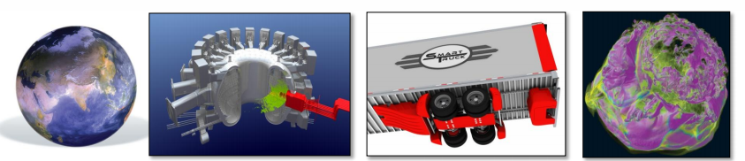
TITAN: Built for Science
Titan System Goals:
-Promote application development for highly scalable architectures through the Center for Accelerated Application Readiness (CAAR).
Deliver breakthrough science for DOE/SC, industry, and the nation
Notes:
Firs is Titan.
The main system goals are to promote application development for highly scalable architectures through the Center for Accelerated Application Readiness (CAAR) and deliver breakthrough science for DOE/SC, industry, and the nation.

Slide 3
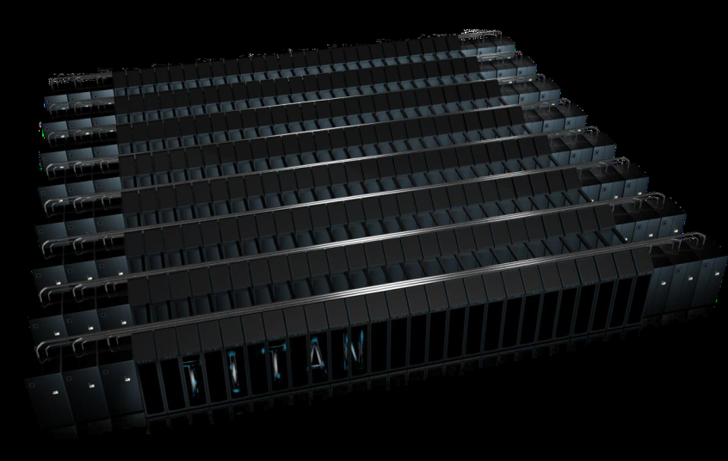
ORNL’s “Titan” System
• Upgrade of Jaguar from
Cray XT5 to XK6
• Cray Linux Environment
operating system
• Gemini interconnect
• 3-D Torus
• Globally addressable memory
• Advanced synchronization features
• AMD Opteron 6274 processors (Interlagos)
• New accelerated node design using NVIDIA
multi-core accelerators
• 2011: 960 NVIDIA x2090 “Fermi” GPUs
• 2012: 14,592 NVIDIA “Kepler” GPUs
• 20+ PFlops peak system performance
• 600 TB DDR3 mem. + 88 TB GDDR5 mem
Titan Specs :
Compute Nodes | 18,688
Login & I/O Nodes | 512
Memory per node | 32 GB + 6 GB
# of Fermi chips | 960
# of NVIDIA “Kepler” | 14,592
Total System Memory | 688 TB
Total System Peak Performance | 20+ Petaflops
Cross Section Bandwidths | X=14.4 TB/s Y=11.3 TB/s Z=24.0 TB/s
Notes:
Titan has 18,688 nodes (4 nodes per blade, 24 blades per cabinet), each containing a 16-core AMD Opteron 6274 CPU with 32 GB of DDR3 ECC memory and an Nvidia Tesla K20X GPU with 6 GB GDDR5 ECC memory . There are a total of 299,008 processor cores and just over 710 TB of RAM Initially Titan used the 10 PB of storage with a transfer speed of 240 GB/s that Jaguar had but in April 2013, the storage was upgraded to 40 PB with a transfer of 1.4 TB/s Titan runs the Cray Linux Environment, a full version of Linux on the login nodes that users directly access, but a scaled down, more efficient version on the compute nodes . GPUs were selected for their vastly higher parallel processing efficiency over CPUs. Although the GPUs have a slower clock speed than the CPUs, each GPU contains 2,688 CUDA cores at 732 MHz,resulting in a faster overall system . Consequently, the CPUs' cores are used to allocate tasks to the GPUs rather than directly processing the data as in conventional supercomputers.

Slide 4
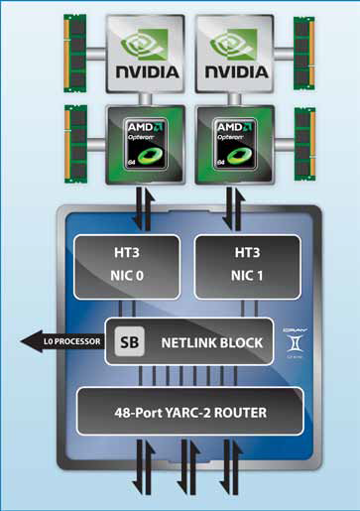
Architecture
Titan’s architecture represents the latest in adaptive hybrid computing. This node combines AMD’s 16-core OpteronTM 6200 Series processor and NVIDIA’s Tesla X2090 many-core accelerator. The result is a hybrid unit with the intranode scalability, power-efficiency of acceleration, and flexibility to run applications with either scalar or accelerator components. This compute unit, combined with the Gemini interconnect’s excellent internode scalability, will enable Titan’s users to answer next-generation computing challenges
Notes:
Titan’s architecture represents the latest in adaptive hybrid computing. This node combines AMD’s 16-core OpteronTM 6200 Series processor and NVIDIA’s Tesla X2090 many-core accelerator. The result is a hybrid unit with the intranode scalability, power-efficiency of acceleration, and flexibility to run applications with either scalar or accelerator components. This compute unit, combined with the Gemini interconnect’s excellent internode scalability, will enable Titan’s users to answer next-generation computing challenges.

Slide 5
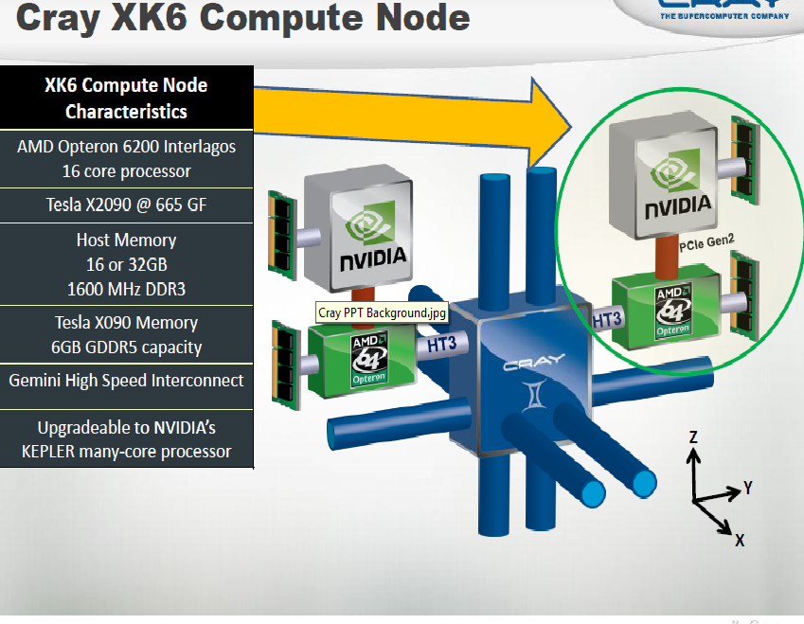
Notes:
Titans uses XK6 Compute Node with AMD Opteron 6200 Interlagos 16 core processor, Tesla X2090 @ 665 GF ,Host Memory 16 or 32GB 1600 MHz DDR3 ,Tesla X090 Memory 6GB GDDR5 capacity ,Gemini High Speed Interconnect ,Upgradeable to NVIDIA’s KEPLER many-core processor.

Slide 6
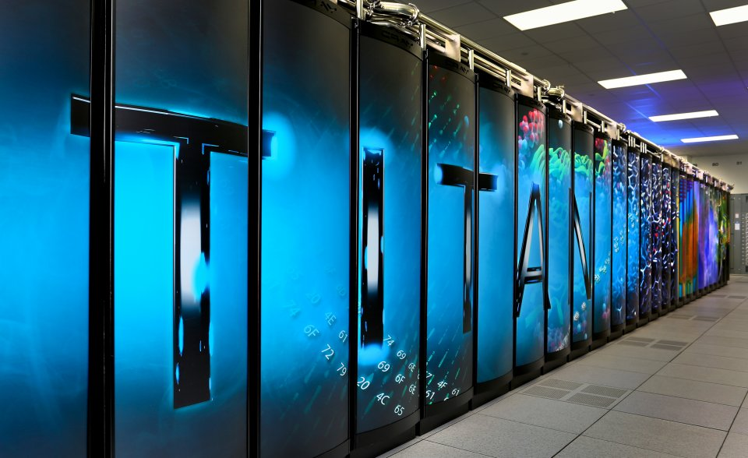
Comparsion:
On November 12, 2012 the TOP500 organisation that ranks the worlds' supercomputers by their LINPACK performance, announced that Titan was ranked first , displacing IBM Sequoia .Titan was also ranked third on the Green500, the same 500 supercomputers re-ordered in terms of energy efficiency.
Notes:
On November 12, 2012 the TOP500 organisation that ranks the worlds' supercomputers by their LINPACK performance, announced that Titan was ranked first , displacing IBM Sequoia .Titan was also ranked third on the Green500, the same 500 supercomputers re-ordered in terms of energy efficiency.

Slide 7
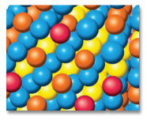
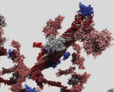
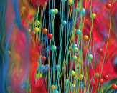
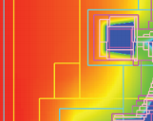
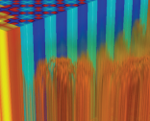
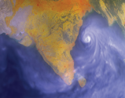
Usages
Initially 50 applications were considered, but this list was eventually pared down to a set of six critical codes from various domain sciences:
-S3D:Combustion simulations to enable the next generation of diesel/bio fuels to burn more efficiently
-WL-LSMS :Role of material disorder, statistics, and fluctuations in nanoscale materials and systems.
-NRDF :Radiation transport – important in astrophysics, laser fusion, combustion , atmospheric dynamics, and medical imaging – computed on AMR grids.
-Discrete ordinates radiation transport calculations that can be used in a variety of nuclear energy and technology applications.
-CAM-SE: Answers questions about specific climate change adaptation and mitigation scenarios.
-LAMMPS:A multiple capability molecular dynamics code.
Notes:
Initially 50 applications were considered, but this list was eventually pared down to a set of six critical codes from various domain sciences:
-S3D:Combustion simulations to enable the next generation of diesel/bio fuels to burn more efficiently
-WL-LSMS :Role of material disorder, statistics, and fluctuations in nanoscale materials and systems.
-NRDF :Radiation transport – important in astrophysics, laser fusion, combustion , atmospheric dynamics, and medical imaging – computed on AMR grids.
-Discrete ordinates radiation transport calculations that can be used in a variety of nuclear energy and technology applications.
-CAM-SE: Answers questions about specific climate change adaptation and mitigation scenarios.
-LAMMPS:A multiple capability molecular dynamics code.

Slide 8
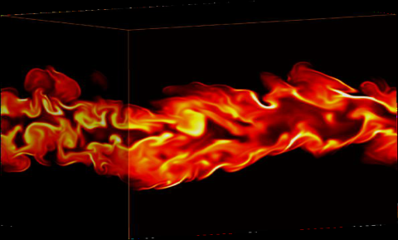
S3D
Used by a team led by Jacqueline Chen of Sandia National Laboratories, is a direct numerical simulation code that models combustion. In 2009, a team led by Chen used Jaguar to create the world’s first fully resolved simulation of small lifted autoigniting hydrocarbon jet flames, allowing for representation of some of the fine-grained physics relevant to stabilization in a direct injection diesel engine.
Notes:
The S3D used by a team led by Jacqueline Chen of Sandia National Laboratories, is a direct numerical simulation code that models combustion. In 2009, a team led by Chen used Jaguar to create the world’s first fully resolved simulation of small lifted autoigniting hydrocarbon jet flames, allowing for representation of some of the fine-grained physics relevant to stabilization in a direct injection diesel engine.

Slide 9
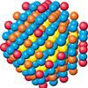
WL-LSMS
WL-LSMS calculates the interactions between electrons and atoms
in magnetic materials—such as those found in computer hard disks
and the permanent magnets found in electric motors. It uses two
methods. The first is locally self-consistent multiple scattering,
which describes the journeys of scattered electrons at the lowest
possible temperature by applying density functional theory to solve
the Dirac equation, a relativistic wave equation for electron behavior.
The second is the Monte Carlo Wang-Landau method, which guides
calculations to explore system behavior at all temperatures, not just
absolute zero. The two methods were combined in 2008 by a team
of researchers from Oak Ridge National Laboratory (ORNL) to
calculate magnetic materials at a finite temperature without
adjustable parameters. The combined code was one of the first codes
to break the petascale barrier on Jaguar.
Notes:
WL-LSMS calculates the interactions between electrons and atoms in magnetic materials—such as those found in computer hard disks and the permanent magnets found in electric motors. It uses two methods. The first is locally self-consistent multiple scattering, which describes the journeys of scattered electrons at the lowest possible temperature by applying density functional theory to solve the Dirac equation, a relativistic wave equation for electron behavior. The second is the Monte Carlo Wang-Landau method, which guides calculations to explore system behavior at all temperatures, not just absolute zero. The two methods were combined in 2008 by a team of researchers from Oak Ridge National Laboratory (ORNL) to calculate magnetic materials at a finite temperature without adjustable parameters. The combined code was one of the first codes to break the petascale barrier on Jaguar.

Slide 10
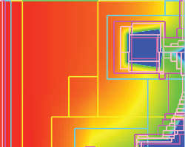
Non-Equilibrium Radiation Diffusion (NRDF)
The Non-Equilibrium Radiation Diffusion (NRDF) application models the journey of noncharged particles. NRDF has applications in astrophysics, nuclear fusion, and atmospheric radiation, while the algorithms being developed should prove valuable in many other areas, such as fluid dynamics, radiation transport, groundwater transport, nuclear reactors, and energy storage.
Notes:
The Non-Equilibrium Radiation Diffusion (NRDF) application models the journey of noncharged particles. NRDF has applications in astrophysics, nuclear fusion, and atmospheric radiation, while the algorithms being developed should prove valuable in many other areas, such as fluid dynamics, radiation transport, groundwater transport, nuclear reactors, and energy storage.

Slide 11
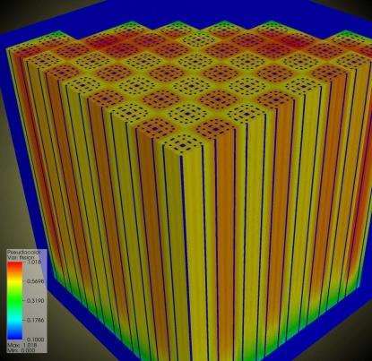
Denovo
Developed by ORNL’s Tom Evans, Denovo allows fully consistent multi-step approaches to high-fidelity nuclear reactor simulations
Notes:
Developed by ORNL’s Tom Evans, Denovo allows fully consistent multi-step approaches to high-fidelity nuclear reactor simulations.

Slide 12
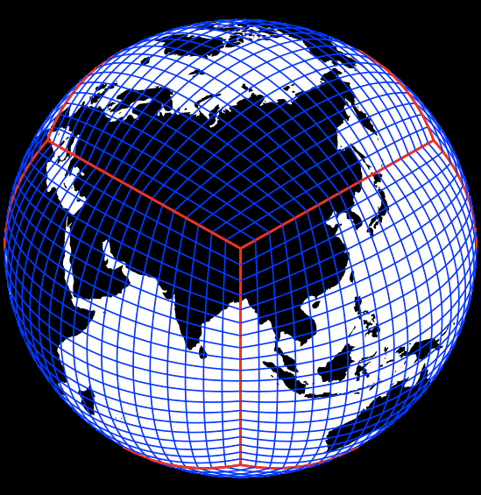
CAM-SE
CAM-SE represents two models that work in conjunction to simulate global atmospheric conditions. CAM (Community Atmosphere Model) is a global atmosphere model for weather and climate research. HOMME, the High Order Method Modeling Environment, is an atmospheric dynamical core, which solves fluid and thermodynamic equations on resolved scales. In order for HOMME to be a useful tool for atmospheric scientists, it is necessary to couple this core to physics packages—such as CAM—regularly employed by the climate modeling community.
Notes:
CAM-SE represents two models that work in conjunction to simulate global atmospheric conditions. CAM (Community Atmosphere Model) is a global atmosphere model for weather and climate research. HOMME, the High Order Method Modeling Environment, is an atmospheric dynamical core, which solves fluid and thermodynamic equations on resolved scales. In order for HOMME to be a useful tool for atmospheric scientists, it is necessary to couple this core to physics packages—such as CAM—regularly employed by the climate modeling community.

Slide 13
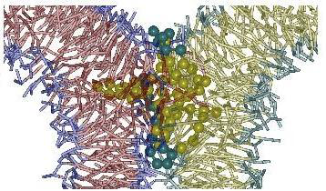
LAMMPS
LAMMPS, the Large-scale Atomic/Molecular Massively Parallel Simulator, was developed by a group of researchers at SNL. It is a classical molecular dynamics code that can be used to model atoms or, more generically, as a parallel particle simulator at the atomic, meso, or continuum scales.
Notes:
LAMMPS, the Large-scale Atomic/Molecular Massively Parallel Simulator, was developed by a group of researchers at SNL. It is a classical molecular dynamics code that can be used to model atoms or, more generically, as a parallel particle simulator at the atomic, meso, or continuum scales.

Slide 14
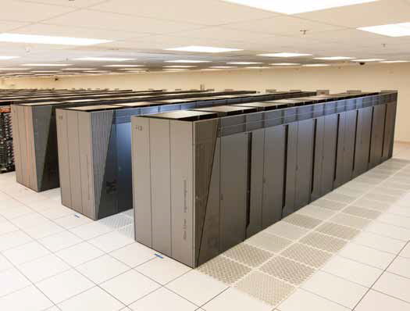
Sequoia
The 20-petaFLOP/s Sequoia system has two main NNSA missions, both of which require “predictive simulation” of complex systems. Predictive simulation is not just computing the behavior of a complex system (the results), but also generating a precise quantification of the uncertainty associated with the results. This is analogous to the “margin of error” cited in scientific and technical papers or commonly used to qualify poll or survey results. Achieving predictive simulation is critical to resolving scientific problems when validation by physical experiment (for example, underground nuclear testing) is impossible, impractical, or prohibited by law or treaty. Predictive simulation is necessary to sustain the nation’s shrinking nuclear deterrent into the future as the deterrent continues to age.
Notes:
Second : The 20-petaFLOP/s Sequoia system has two main NNSA missions, both of which require “predictive simulation” of complex systems. Predictive simulation is not just computing the behavior of a complex system (the results), but also generating a precise quantification of the uncertainty associated with the results. This is analogous to the “margin of error” cited in scientific and technical papers or commonly used to qualify poll or survey results. Achieving predictive simulation is critical to resolving scientific problems when validation by physical experiment (for example, underground nuclear testing) is impossible, impractical, or prohibited by law or treaty. Predictive simulation is necessary to sustain the nation’s shrinking nuclear deterrent into the future as the deterrent continues to age.

Slide 15
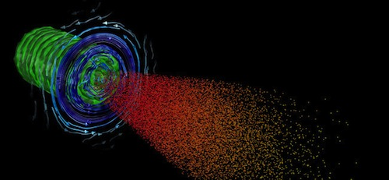
Sequoia’s two missions are:
To quantify the uncertainties in numerical simulations of nuclear weapons performance. This will require the execution of vast suites of simulations not possible on current systems.
To perform the advanced weapons science calculations needed to develop the accurate physics-based models for weapons codes.
Notes:
Sequoia’s two missions are:
To quantify the uncertainties in numerical simulations of nuclear weapons performance. This will require the execution of vast suites of simulations not possible on current systems and to perform the advanced weapons science calculations needed to develop the accurate physics-based models for weapons codes.

Slide 16
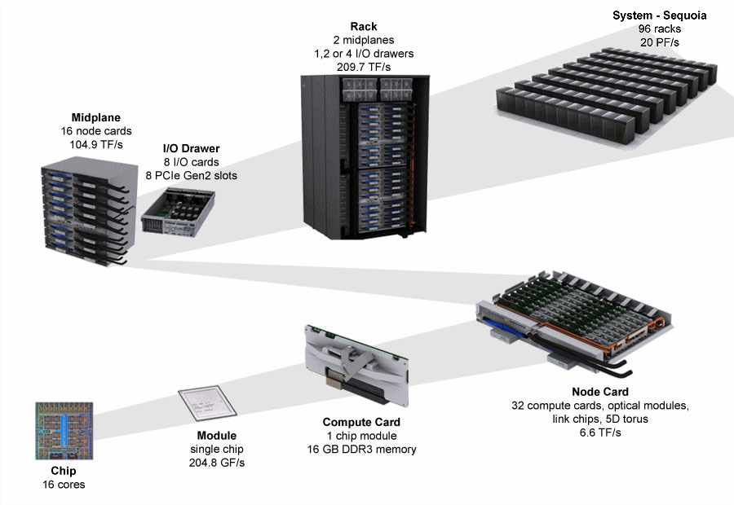
Architecture
Notes:
Sequoia is a Blue Gene/Q design, building off previous Blue Gene designs. It consists of 96 racks containing 98,304 compute nodes [1024/rack]. The compute nodes are 16-core PowerPC A2 processor chips with 16 GB of DDR3 memory each. Thus the system contains in total 1,572,864 processor cores [96*1024*16] with 1.6 PB memory. It covers an area of about 3,000 square feet (280 m2). The computer nodes are interconnected in a 5-imensional torus topology.

Slide 17
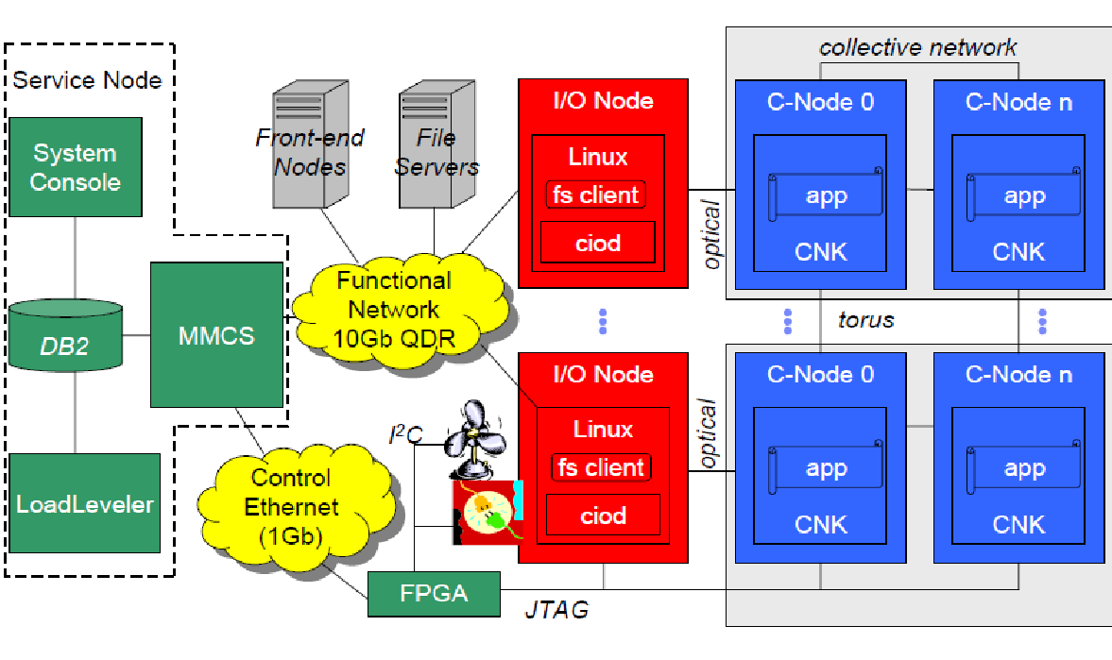
System architecture :
Notes:
Here`s a quick view of the system architecture you can pause the video to check it out.

Slide 18
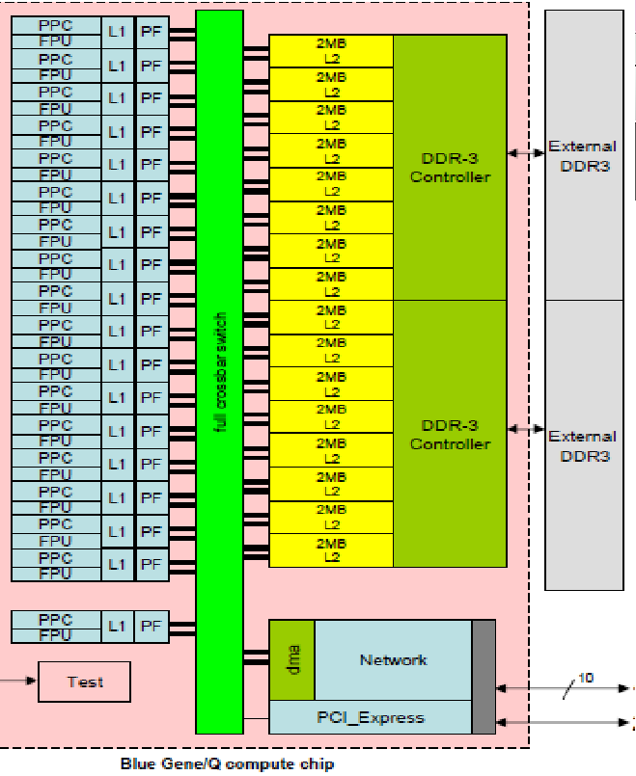
BlueGene/Q compute chip
45nm system on a chip (SOC) technology 
204.8 GFLOP peak 
16+1 core SMP 1.6GHz
4-way hardware threaded
Quad SIMD floating point unit
L1 16B data, 16KB instr
16 stream and list-based prefetch 
32 MB shared L2 cache
Transactional Memory and Speculative Execution support
563 GB/s bisection bandwidth 
42.6 GB/s DDR3 bandwidth (1.333 GHz)
2 channels each with chip kill protection 
10 intra-rack interprocessor links each at 2.0GB/s 
one I/O link at 2.0 GB/s 
16 GB memory/node 
Low power per chip
10*2GB/s intra-rack & inter-rack (5-D torus)
2 GB/s I/O link (to I/O subsystem)
Notes:
Here`s the architecture of the compute chip :
45nm system on a chip (SOC) technology ,204.8 GFLOP peak  ,16+1 core SMP 1.6GHz, 4-way hardware threaded,Quad SIMD floating point unit ,L1 16B data, 16KB instructions,16 stream and list-based prefetch ,32 MB shared L2 cache ,Transactional Memory and Speculative Execution support 563 GB/s bisection bandwidth  ,42.6 GB/s DDR3 bandwidth (1.333 GHz) ,2 channels each with chip kill protection  ,10 intra-rack interprocessor links each at 2.0GB/s  one I/O link at 2.0 GB/s  ,16 GB memory/node  ,Low power per chip

Slide 19
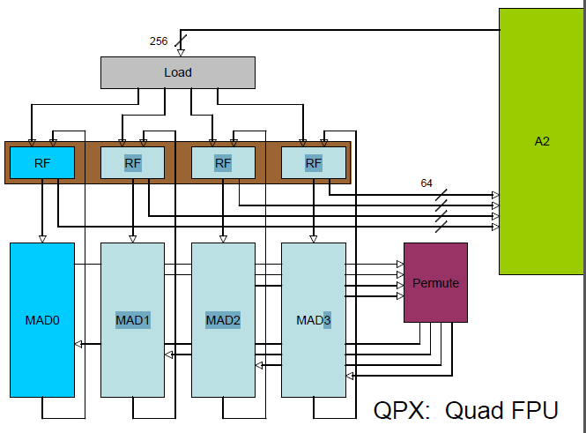
FPU Features
Quad FPU:
4-wide double precision FPU SIMD
2-wide complex SIMD
Supports a multitude of alignments
Allows for higher single thread performance for
some applications
Most will get modest bump (10-25%), some big
bump (approaching 300%)
Notes:
Quad FPU:
4-wide double precision FPU SIMD
2-wide complex SIMD
Supports a multitude of alignments
Allows for higher single thread performance for
some applications
Most will get modest bump (10-25%), some big
bump (approaching 300%)

Slide 20
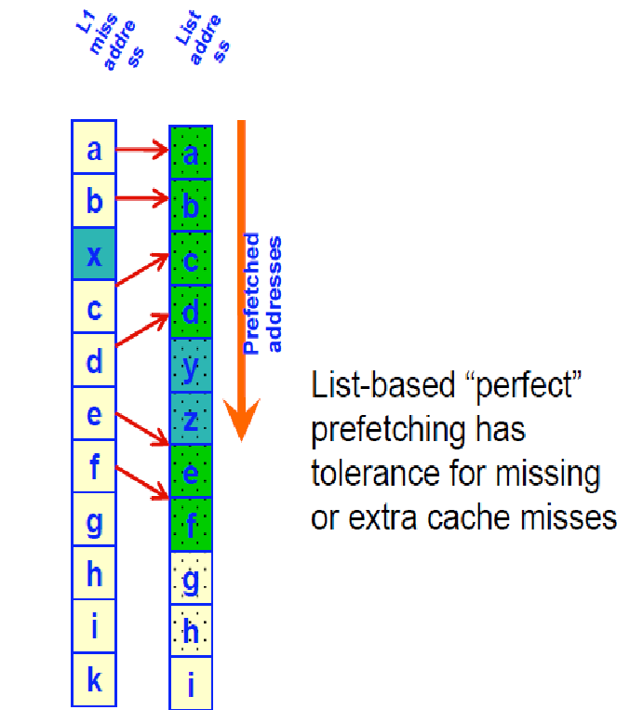
Prefetching
“Perfect” prefetching :
• Augments traditional stream prefetching
• Used for repeated memory reference patterns in arbitrarily long code segments
• Record pattern on first iteration of loop; playback for subsequent iteration
• Tolerance for missing or extra cache misses
• Achieves higher single thread performance for some applications
Notes:
“Perfect” prefetching :
• Augments traditional stream prefetching
• Used for repeated memory reference patterns in arbitrarily long code segments
• Record pattern on first iteration of loop; playback for subsequent iteration
• Tolerance for missing or extra cache misses
• Achieves higher single thread performance for some applications

Slide 21
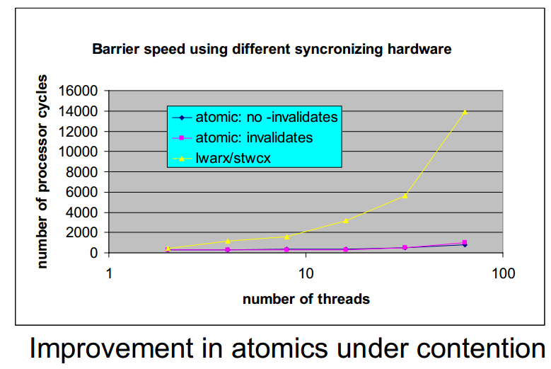
Atomic operations
Atomic operations :
•Pipelined at L2 rather than at processor
•Low latency even under high contention
•Faster OpenMP work hand off; lowers messaging
latency
Notes:
“Atomic operations :
•Pipelined at L2 rather than at processor
•Low latency even under high contention
•Faster OpenMP work hand off; lowers messaging
latency

Slide 22
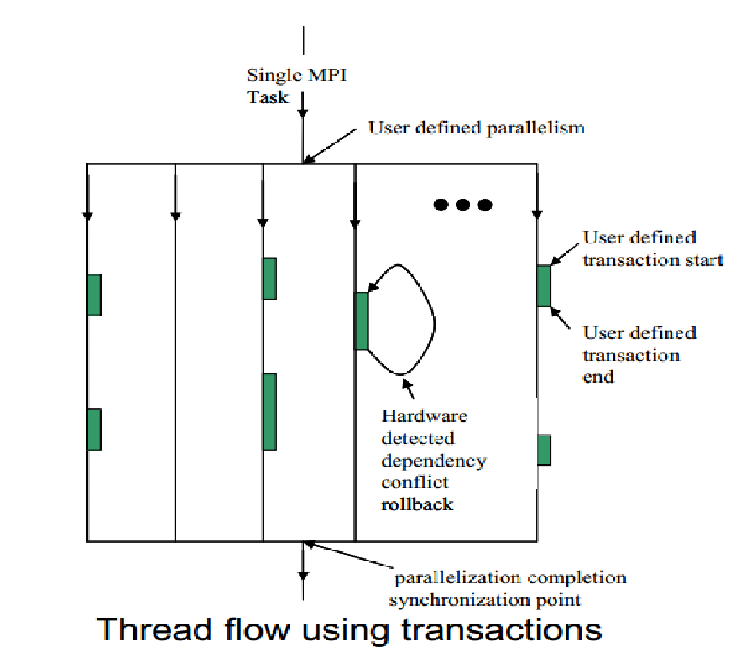
Other Features
• Wake up unit
-Allows SMT threads to “sleep” waiting for an event.
-Registers saving overhead avoided.
• Multiversioning cache
-Transactional Memory eliminates need for locks.
-Speculative Execution allows OpenMP threading for sections with data dependencies
Notes:
• Wake up unit
-Allows SMT threads to “sleep” waiting for an event.
-Registers saving overhead avoided.
• Multiversioning cache
-Transactional Memory eliminates need for locks.
-Speculative Execution allows OpenMP threading for sections with data dependencies

Slide 23
Scalability Enhancements: the 17th Core
• RAS Event handling and interrupt off-load
– Reduce O/S noise and jitter
– Core-to-Core interrupts when necessary
• CIO Client Interface
– Asynchronous I/O completion hand-off
– Responsive CIO application control client
• Application Agents: privileged application processing
– Messaging assist, e.g., MPI pacing thread
– Performance and trace helpers
Notes:
Scalability Enhancements:
• RAS Event handling and interrupt off-load
– Reduce O/S noise and jitter
– Core-to-Core interrupts when necessary
• CIO Client Interface
– Asynchronous I/O completion hand-off
– Responsive CIO application control client
• Application Agents: privileged application processing
– Messaging assist, e.g., MPI pacing thread
– Performance and trace helpers

Slide 24
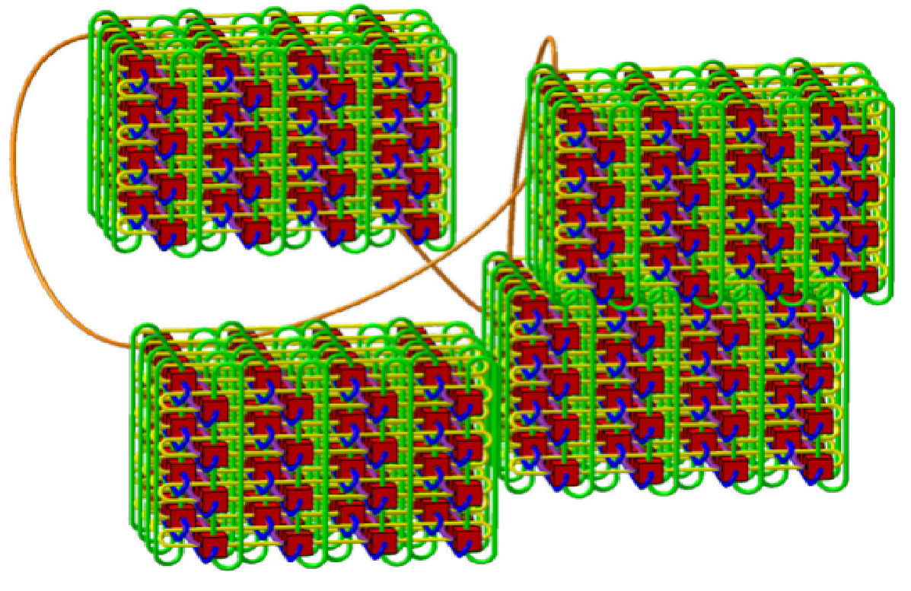
Inter-Processor Communication
• Integrated 5D torus
– Hardware assisted collective and barrier
– FP addition support in network
– Virtual Cut Through
– RDMA direct from application
– Wrapped
• 2 GB/s bandwidth on all 10 links (4 GB/s bidi)
• 5D nearest neighbor exchange measured at ~1.75
GB/s per link
• Hardware latency
– Nearest: 80ns
– Farthest: 3us (96-rack 20PF system)
Network Performance
• All-to-all: 97% of peak
• Bisection: > 93% of peak
• Nearest-neighbor: 98% of peak
• Collective: FP reductions at 94.6% of peak
Notes:
Inter-Processor Communication
• Integrated 5D torus
– Hardware assisted collective and barrier
– FP addition support in network
– Virtual Cut Through
– RDMA direct from application
– Wrapped
• 2 GB/s bandwidth on all 10 links (4 GB/s bidi)
• 5D nearest neighbor exchange measured at ~1.75
GB/s per link
• Hardware latency
– Nearest: 80ns
– Farthest: 3us (96-rack 20PF system)
Network Performance
• All-to-all: 97% of peak
• Bisection: > 93% of peak
• Nearest-neighbor: 98% of peak
• Collective: FP reductions at 94.6% of peak

Slide 25
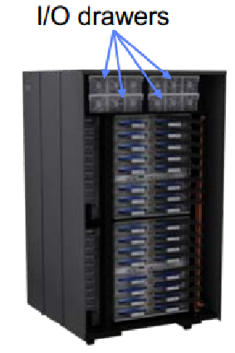
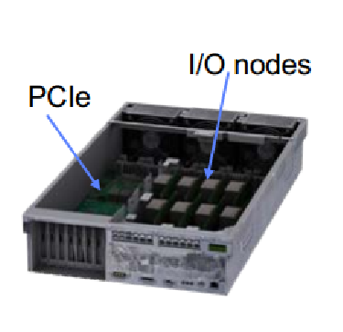
External I/O
• I/O Network to/from Compute rack
– 2 links (4GB/s in 4GB/s out) feed an I/O PCI-e port
– Every node card has up to 4 ports (8 links)
– Typical configurations
• 8 ports (32 GB/s/rack)
• 16 ports (64 GB/s/rack)
• 32 ports (128 GB/s/rack)
– Extreme configuration 128 ports (512 GB/s/rack)
• I/O Drawers
– 8 I/O nodes/drawer with 8 ports (16 links) to
compute rack
– 8 PCI-e gen2 x8 slots (32 GB/s aggregate)
– 4 I/O drawers per compute rack
– Optional installation of I/O drawers in external
racks for extreme bandwidth configurations
Notes:
External input / output
• I/O Network to/from Compute rack
– 2 links (4GB/s in 4GB/s out) feed an I/O PCI-e port
– Every node card has up to 4 ports (8 links)
– Typical configurations
• 8 ports (32 GB/s/rack)
• 16 ports (64 GB/s/rack)
• 32 ports (128 GB/s/rack)
– Extreme configuration 128 ports (512 GB/s/rack)
• I/O Drawers
– 8 I/O nodes/drawer with 8 ports (16 links) to
compute rack
– 8 PCI-e gen2 x8 slots (32 GB/s aggregate)
– 4 I/O drawers per compute rack
– Optional installation of I/O drawers in external
racks for extreme bandwidth configurations

Slide 26
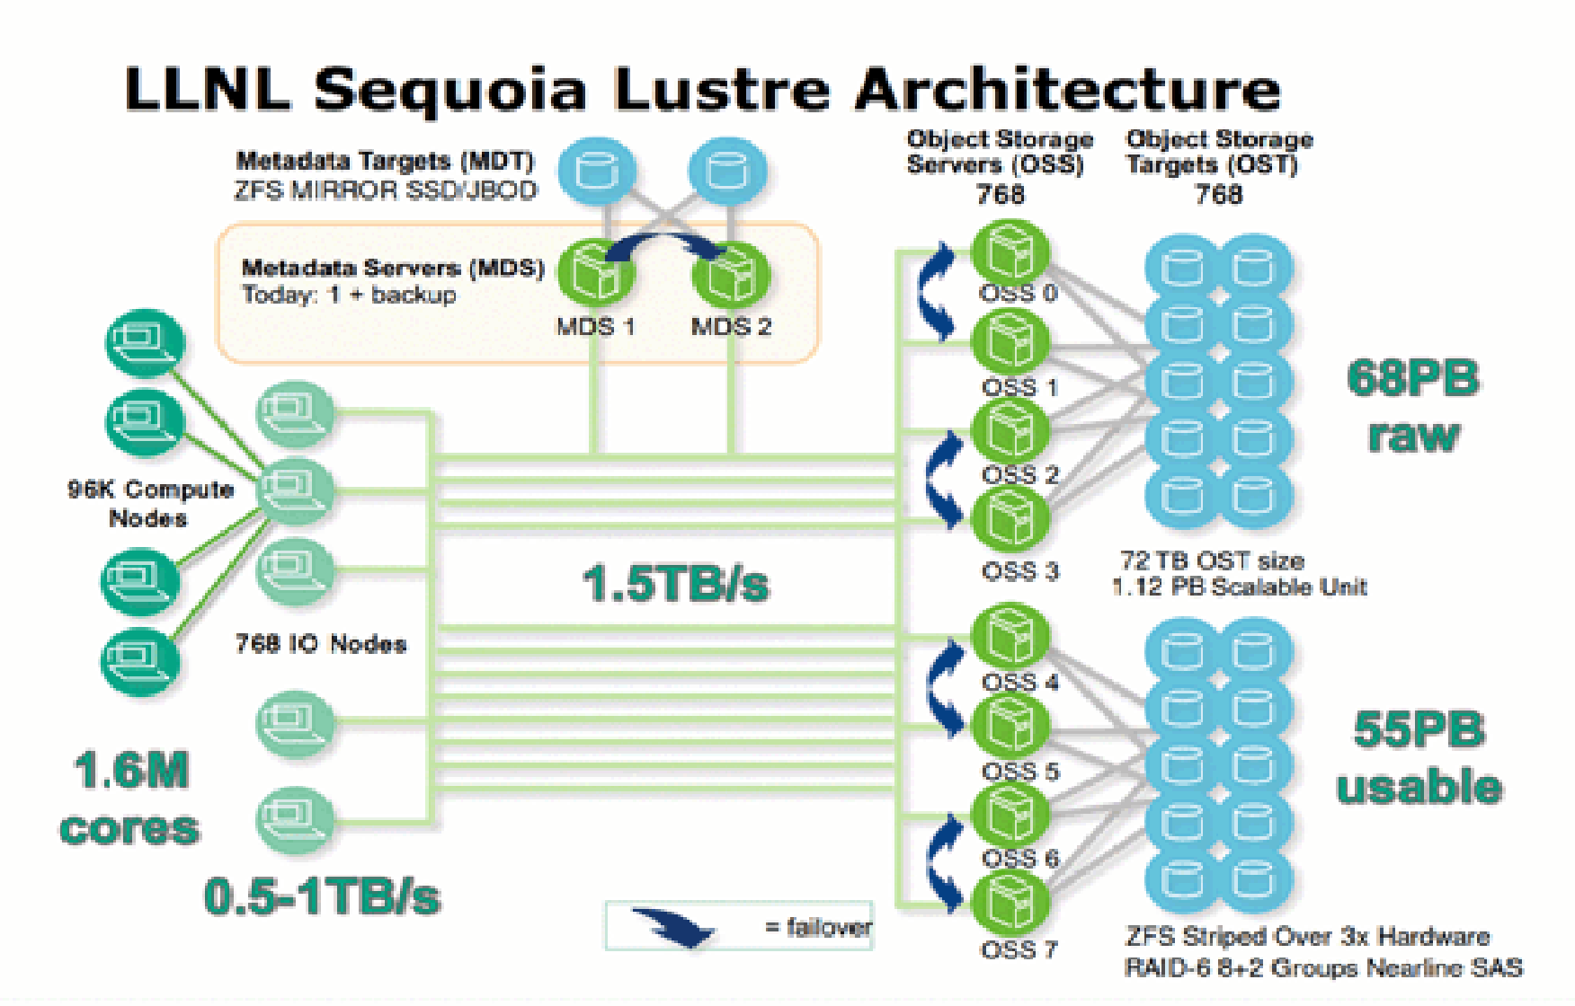
File system
LLNL uses Lustre as the parallel filesystem, and has ported ZFS to Linux as the Lustre OSD (Object Storage Device) to take advantage of the performance and advanced features of the filesystem.
Notes:
File system: LLNL uses Lustre as the parallel filesystem, and has ported ZFS to Linux as the Lustre OSD (Object Storage Device) to take advantage of the performance and advanced features of the filesystem.

Slide 27
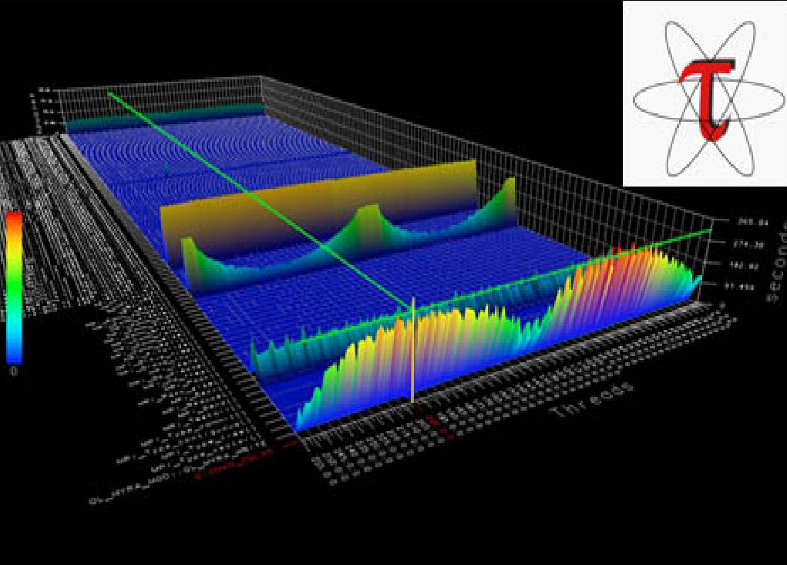
Sequoia statistics:
• Cores : 1572864
• Memory 1.6 PB
• Theoretical Peak (Rpeak)-20132.7 TFlop/s
• Linpack Performance (Rmax) :16324.8 TFlop/s
• 3 PB/s link bandwidth
• 60 TB/s bisection bandwidth
• 0.5–1.0 TB/s Lustre bandwidth
• 9.6 MW power
• area of 4,000 ft2
Notes:
Sequoia statistics:
• Cores : 1572864
• Memory 1.6 PB
• Theoretical Peak (Rpeak)-20132.7 TFlop/s
• Linpack Performance (Rmax) :16324.8 TFlop/s
• 3 PB/s link bandwidth
• 60 TB/s bisection bandwidth
• 0.5–1.0 TB/s Lustre bandwidth
• 9.6 MW power
• area of 4,000 ft2

Slide 28
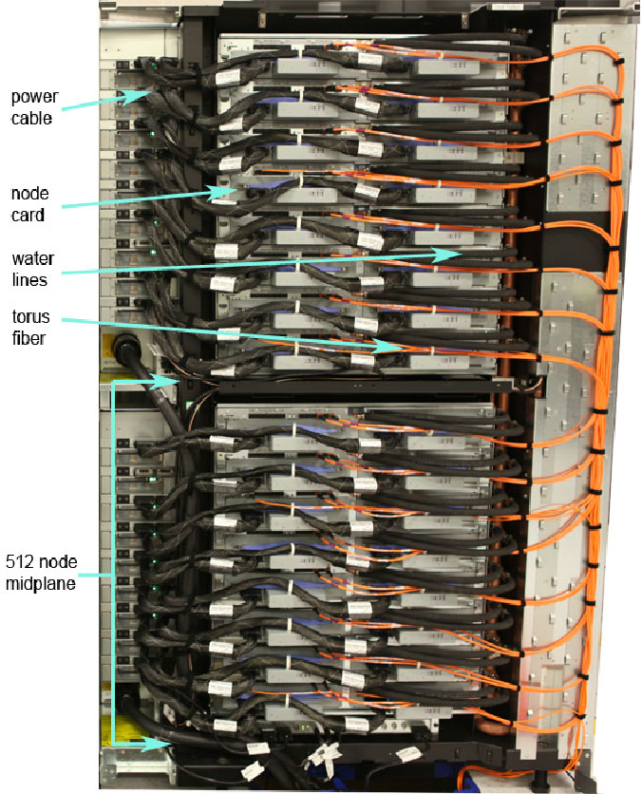
Cooling
Sequoia is primarily water cooled. Though orders of magnitude more powerful than such predecessor systems as ASC Purple and BlueGene/L, Sequoia will be roughly 90 times more power efficient than Purple and about eight times more than BlueGene/L relative to the peak speeds of these systems. For systems of this scale, energy efficiency is of central importance and absolutely essential to drive down operating costs.
Notes:
Cooling : Sequoia is primarily water cooled. Though orders of magnitude more powerful than such predecessor systems as ASC Purple and BlueGene/L, Sequoia will be roughly 90 times more power efficient than Purple and about eight times more than BlueGene/L relative to the peak speeds of these systems. For systems of this scale, energy efficiency is of central importance and absolutely essential to drive down operating costs.

Slide 29
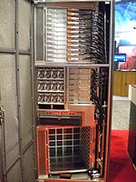
K computer
The K computer – named for the Japanese word “kei”, meaning 10 quadrillion (10^16) – is a supercomputer manufactured by Fujitsu, currently installed at the RIKEN Advanced Institute for Computational Science campus in Kobe, Japan.
The K computer is based on a distributed memory architecture with over 80,000 computer nodes.
It is used for a variety of applications, including climate research, disaster prevention and medical research.
Notes:
The thirt in charts is :
The K computer – named for the Japanese word “kei”, meaning 10 quadrillion (10^16) – is a supercomputer manufactured by Fujitsu, currently installed at the RIKEN Advanced Institute for Computational Science campus in Kobe, Japan.
The K computer is based on a distributed memory architecture with over 80,000 computer nodes.
It is used for a variety of applications, including climate research, disaster prevention and medical research.

Slide 30
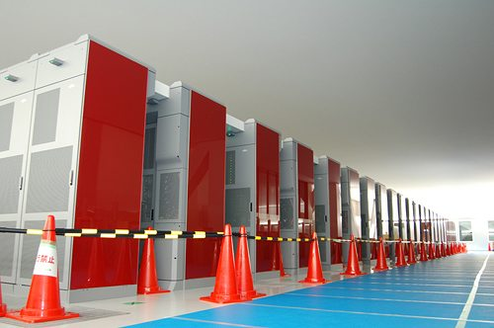
Architecture
As of 2013, the K computer comprises over 80,000 2.0 GHz 8-core SPARC64 VIIIfx processors contained in 864 cabinets, for a total of over 640,000 cores, manufactured by Fujitsu with 45 nm CMOS technology. Each cabinet contains 96 computing nodes, in addition to 6 I/O nodes. Each computing node contains a single processor and 16 GB of memory. The computer's water cooling system is designed to minimize failure rate and power consumption.
Notes:
Architecture : As of 2013, the K computer comprises over 80,000 2.0 GHz 8-core SPARC64 VIIIfx processors contained in 864 cabinets, for a total of over 640,000 cores, manufactured by Fujitsu with 45 nm CMOS technology. Each cabinet contains 96 computing nodes, in addition to 6 I/O nodes. Each computing node contains a single processor and 16 GB of memory. The computer's water cooling system is designed to minimize failure rate and power consumption.

Slide 31
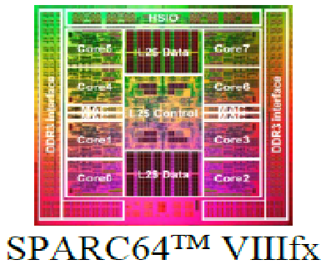
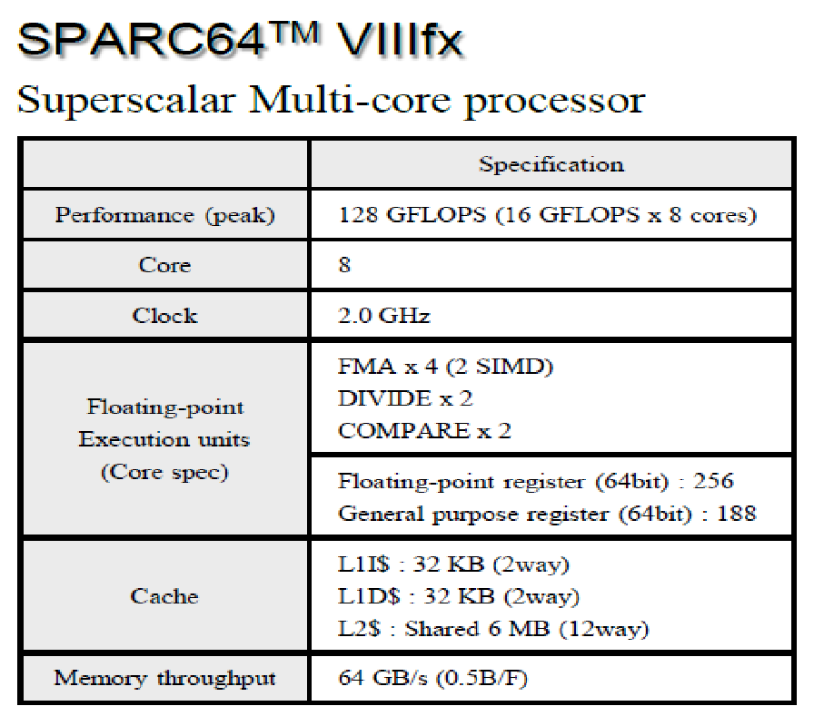
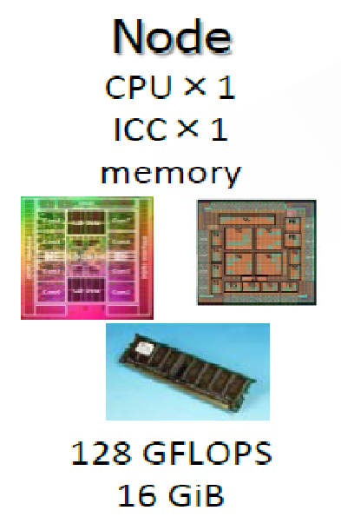
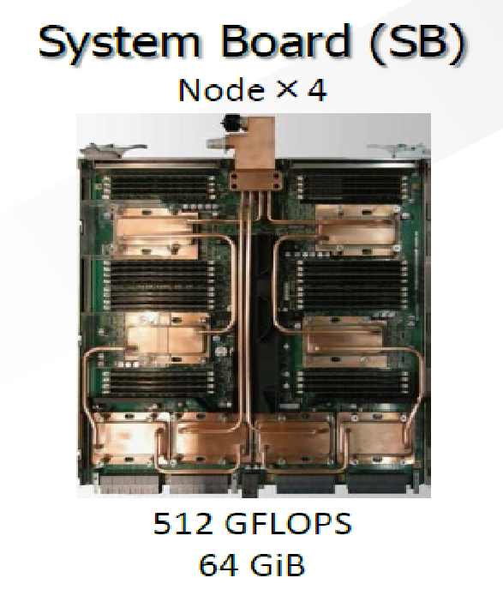
Node architecture
Notes:
The system uses scalar CPUs (SPARC64TMVIIIfx, 8 cores, 128 gigaflops) manufactured with 45nm CMOS process technology. To achieve high performance and high scalability to ultra-large-scale system, the CPU additionally supports SIMD (Single Instruction and Multiple Data) processing, and is furnished with functions for instruction retry as well as exhaustive error detection/correction, contributing to high performance and reliability in application execution in an environment with huge numbers of CPUs.

Slide 32
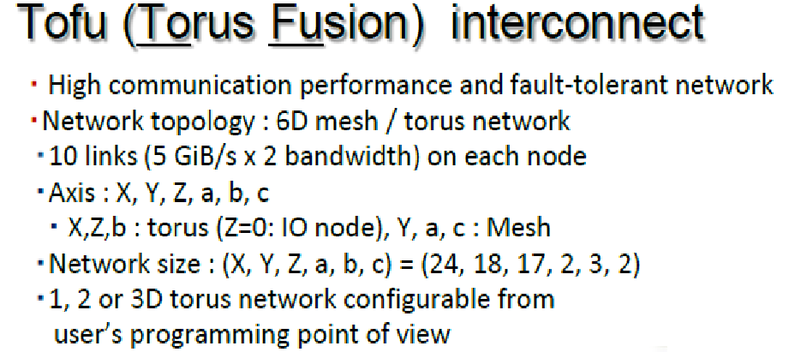
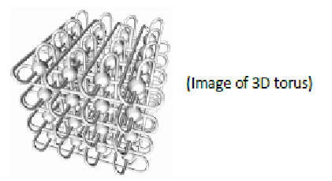
Interconnect
Notes:
In the K computer, a tremendously large system containing more than 80,000 CPUs, the network that exchanges data such as computational results between CPUs plays a very important role. The K computer's network, called Tofu, uses an innovative structure called "6-dimensional mesh/torus" topology. This enables the mutual interconnection of more than 80,000 CPUs.

Slide 33
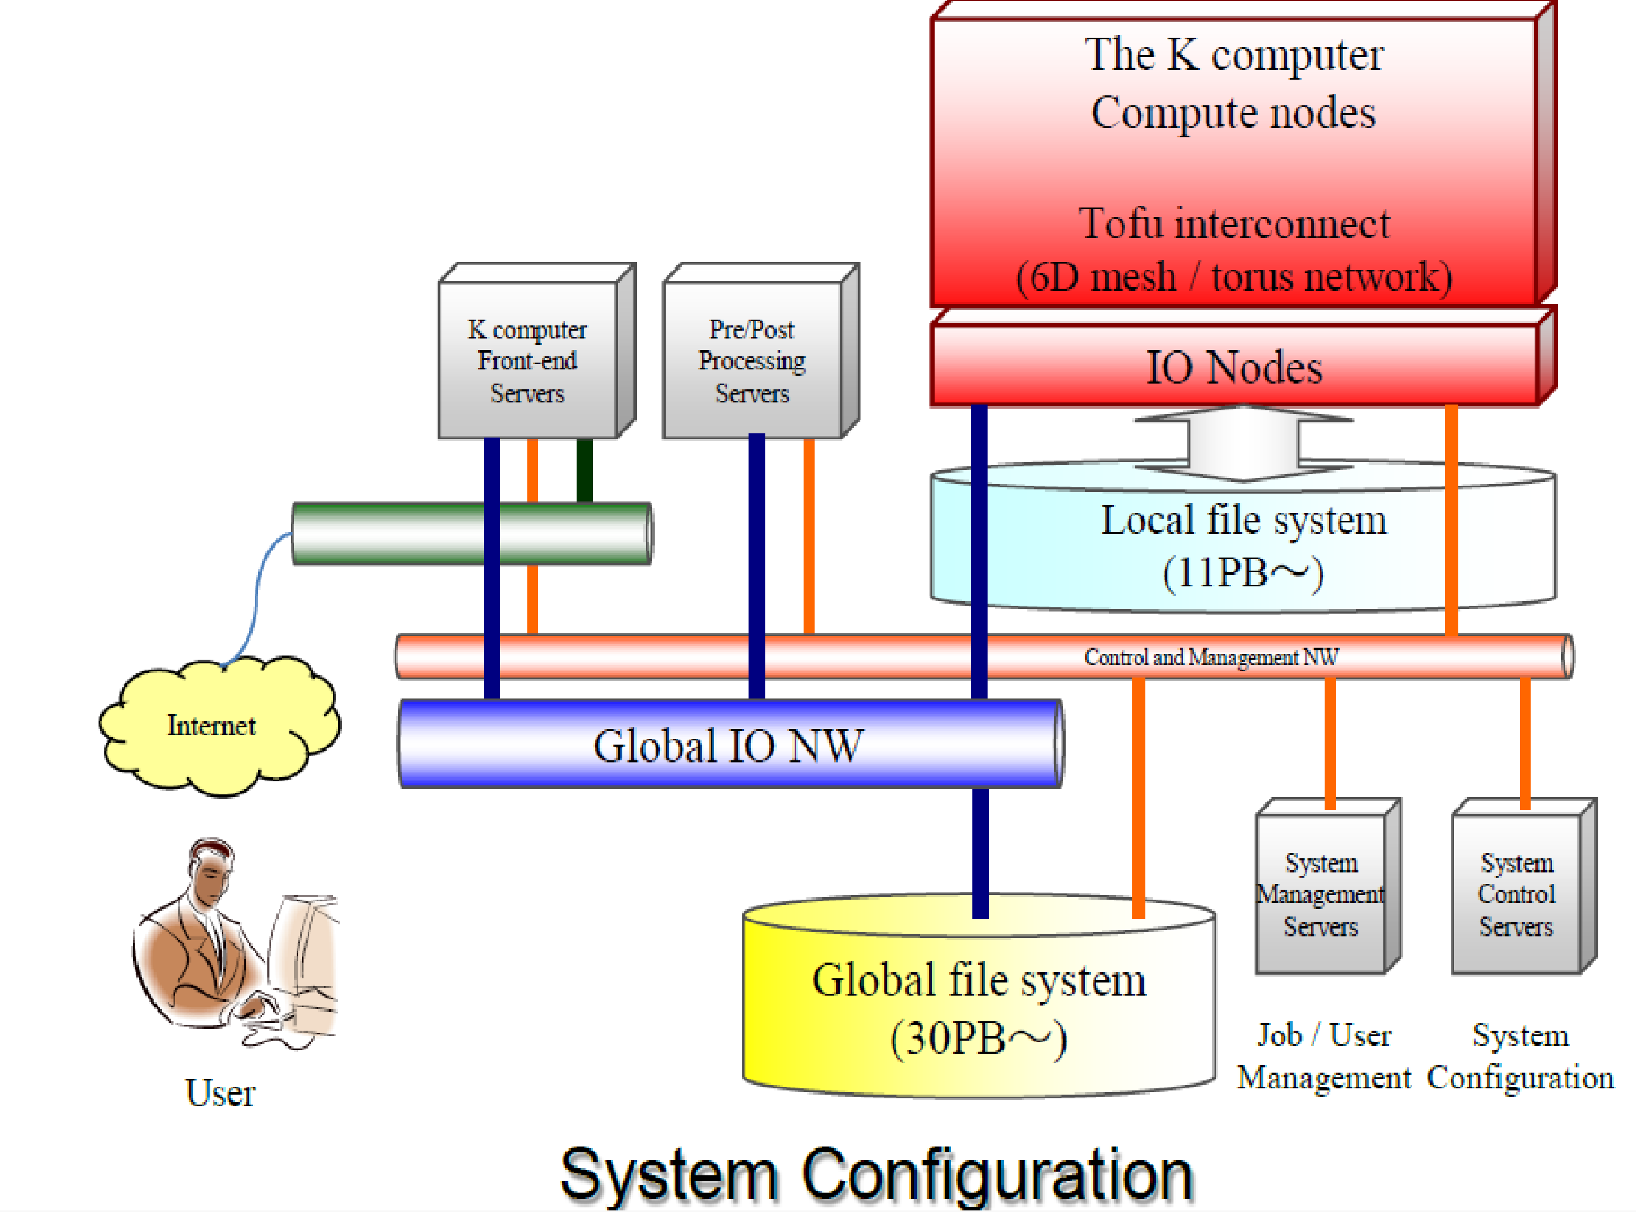
File system
Notes:
The system adopts a two-level local/global file system with parallel/distributed functions, and provides users with an automatic staging function for moving files between global and local file systems. Fujitsu developed an optimized parallel file system based on Lustre, called the Fujitsu Exabyte File System (FEFS), which is scalable to several hundred petabytes.

Slide 34
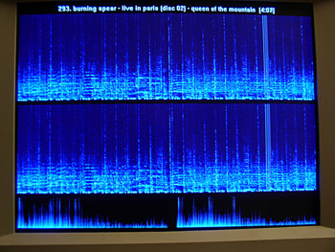
System Environment
Linux-based OS on each compute and IO node
Two-level distributed file system (based on Lustre) with a staging function
- Local file system for temporary files used in a job .
- Global file sysmte for users' permanent files .
The staging function copies/moves files between them before/after the job execution.
Notes:
System enviorment si :
Linux-based OS on each compute and IO node
Two-level distributed file system (based on Lustre) with a staging function
- Local file system for temporary files used in a job .
- Global file sysmte for users' permanent files .
The staging function copies/moves files between them before/after the job execution.

Slide 35
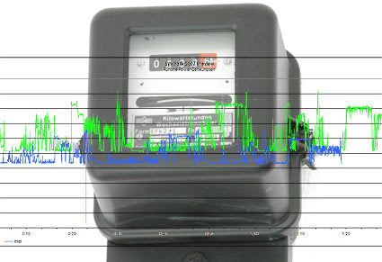
Power consumption
Although the K computer reported the highest total power consumption of any 2011 TOP500 supercomputer (9.89 MW – the equivalent of almost 10,000 suburban homes), it is relatively efficient, achieving 824.6 GFlop/kWatt. This is 29.8% more efficient than China's NUDT TH MPP(ranked #2 in 2011), and 225.8% more efficient than Oak Ridge's Jaguar-Cray XT5-HE (ranked #3 in 2011).
However, K's power efficiency still falls far short of the 2097.2 GFlops/kWatt supercomputer record set by IBM's NNSA/SC Blue Gene/Q Prototype 2.
For comparison, the average power consumption of a TOP 10 system in 2011 was 4.3 MW, and the average efficiency was 463.7 GFlop/kW.
The computer's annual running costs are estimated at US$10 million.
Notes:
Power consumption :
Although the K computer reported the highest total power consumption of any 2011 TOP500 supercomputer (9.89 MW – the equivalent of almost 10,000 suburban homes), it is relatively efficient, achieving 824.6 GFlop/kWatt. This is 29.8% more efficient than China's NUDT TH MPP(ranked #2 in 2011), and 225.8% more efficient than Oak Ridge's Jaguar-Cray XT5-HE (ranked #3 in 2011).
However, K's power efficiency still falls far short of the 2097.2 GFlops/kWatt supercomputer record set by IBM's NNSA/SC Blue Gene/Q Prototype 2.
For comparison, the average power consumption of a TOP 10 system in 2011 was 4.3 MW, and the average efficiency was 463.7 GFlop/kW.
The computer's annual running costs are estimated at US$10 million.

Slide 36
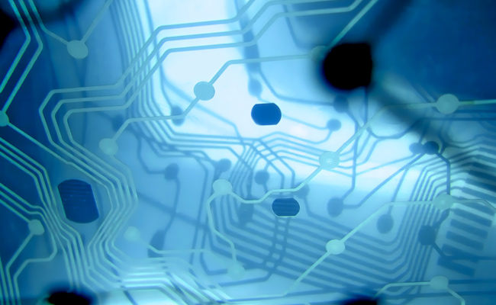
Performance
According to TOP500 compiler Jack Dongarra, professor of electrical engineering and computer science at the University of Tennessee, the K computer's performance equals "one million linked desktop computers“
Linpack Performance (Rmax) 10510.0 TFlop/s
Theoretical Peak (Rpeak) 11280.4 TFlop/s
Notes:
Performance :
According to TOP500 compiler Jack Dongarra, professor of electrical engineering and computer science at the University of Tennessee, the K computer's performance equals "one million linked desktop computers“
Linpack Performance (Rmax) 10510.0 TFlop/s
Theoretical Peak (Rpeak) 11280.4 TFlop/s

Slide 37
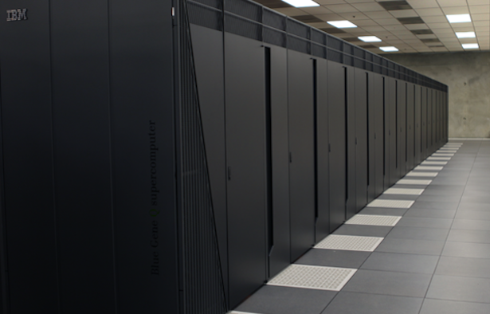
Mira
Constructed by IBM for Argonne National Laboratory's Argonne Leadership Computing Facility with the support of the United States Department of Energy, and partially funded by the National Science Foundation. Mira will be used for scientific research, including studies in the fields of material science, climatology, seismology, and computational chemistry. The supercomputer is being utilized initially for sixteen projects, selected by the Department of Energy.
Notes:
The fourth in the charts is the supercomputer Mira.
Constructed by IBM for Argonne National Laboratory's Argonne Leadership Computing Facility with the support of the United States Department of Energy, and partially funded by the National Science Foundation. Mira will be used for scientific research, including studies in the fields of material science, climatology, seismology, and computational chemistry. The supercomputer is being utilized initially for sixteen projects, selected by the Department of Energy.

Slide 38
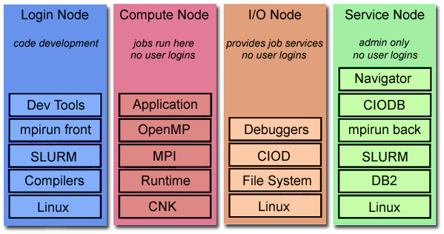
System architecture
Mira is a petascale Blue Gene/Q supercomputer like Sequoia;
Blue Gene /Q systems are composed of login nodes, I/O nodes, service nodes and compute nodes.
Notes:
Mira is a petascale Blue Gene/Q supercomputer like Sequoia;
Blue Gene /Q systems are composed of login nodes, I/O nodes, service nodes and compute nodes.

Slide 39
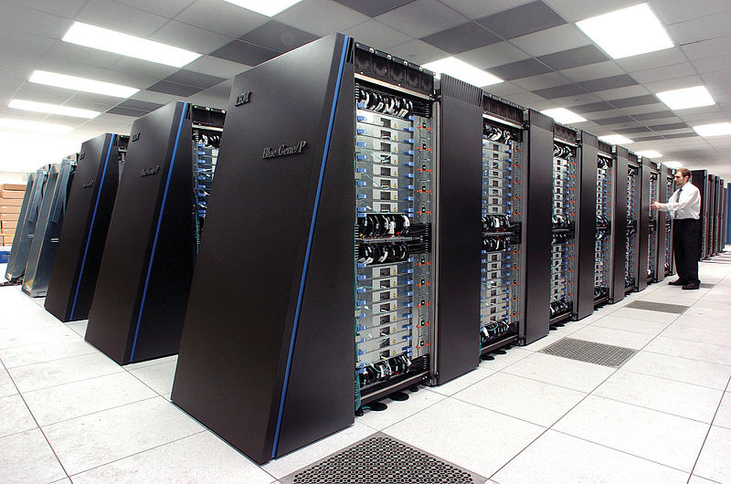
Login nodes
Login and compile nodes are IBM Power 7-based systems running Red Hat Linux and are the user’s interface to a Blue Gene/Q system. This is where users login, edit files, compile, and submit jobs. These are shared resources with multiple users.
Notes:
Login and compile nodes are IBM Power 7-based systems running Red Hat Linux and are the user’s interface to a Blue Gene/Q system. This is where users login, edit files, compile, and submit jobs. These are shared resources with multiple users.

Slide 40
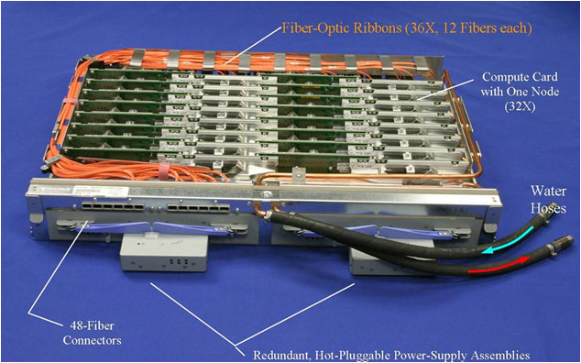
Compute Nodes
A compute rack is composed of two midplanes with electrical power, cooling, and clock signal provisioned at the rack level. Each midplane within the rack is composed of 16 node boards and a service card. The service card is analogous to a desktop system’s BIOS. It helps manage the booting of the compute nodes and manages activity within a midplane. Each node board hosts 32 compute nodes and the link chips and optics that compose the Blue Gene /Q’s 5D torus interconnect. It is also at the node board level that boards connect to I/O drawers.
ALCF’s I/O configuration aims for maximum isolation. Every I/O drawer has 8 nodes that are identical to a compute node, except for the heatsink being air-cooled rather than water-cooled. Each I/O node drives a PCI Express card that interfaces with a given system’s available file systems. On Cetus and Mira, every rack connects to one drawer with four I/O nodes driving a given midplane, allowing for I/O isolation at the midplane level. The I/O ratio is 128 compute nodes to 1 I/O node.
Notes:
A compute rack is composed of two midplanes with electrical power, cooling, and clock signal provisioned at the rack level. Each midplane within the rack is composed of 16 node boards and a service card. The service card is analogous to a desktop system’s BIOS. It helps manage the booting of the compute nodes and manages activity within a midplane. Each node board hosts 32 compute nodes and the link chips and optics that compose the Blue Gene /Q’s 5D torus interconnect. It is also at the node board level that boards connect to I/O drawers.

Slide 41
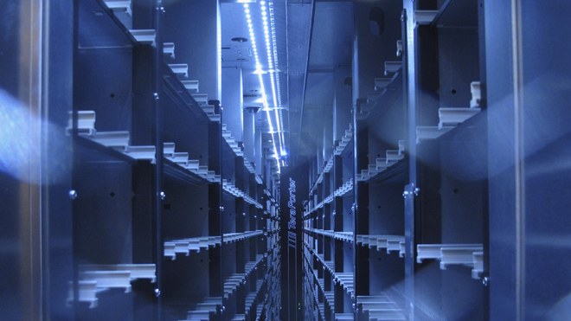
Mira stats
Linpack performance - 8162.4 TFlop/s
Theoretical Peak -10066.3 TFlop/s
Compute Racks – 48
I/O Drawers – 48
Total Cores – 786.432
Minimum block size – 512 nodes
Smallest block with I/O isolation – 521 nodes
I/O Ratio – 1:128
Notes:
Mira`s stats are :
Linpack performance - 8162.4 TFlop/s
Theoretical Peak -10066.3 TFlop/s
Compute Racks – 48
I/O Drawers – 48
Total Cores – 786.432
Minimum block size – 512 nodes
Smallest block with I/O isolation – 521 nodes
I/O Ratio – 1:128

Slide 42
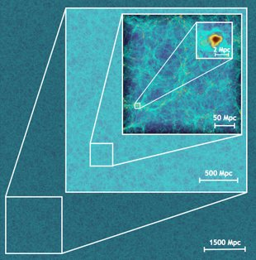
Usages
Any researcher with a question can apply for time on the supercomputer, typically in chunks of millions of processor-hours, to run programs for their experiments.
Scientists will use Mira to study exploding stars, nuclear energy, climate change, and jet engines.
Notes:
Usages :
Any researcher with a question can apply for time on the supercomputer, typically in chunks of millions of processor-hours, to run programs for their experiments.
Scientists will use Mira to study exploding stars, nuclear energy, climate change, and jet engines.

Slide 43

JUQUEEN
Main memory: 448 TB
Overall peak performance: 5.9 Petaflops
Linpack: > 4.141 Petaflops
I/O Nodes: 248 (27x8 + 1x32) connected to 2 CISCO Switches
28 racks (7 rows * 4 racks) 28,672 nodes (458,752 cores)
- Rack: 2 midplanes * 16 nodeboards (16,384 cores)
- Nodeboard: 32 compute nodes Node: 16 cores
Notes:
The fift supercomputer is JUQUEEN with
Main memory: 448 TB
Overall peak performance: 5.9 Petaflops
Linpack: > 4.141 Petaflops
I/O Nodes: 248 (27x8 + 1x32) connected to 2 CISCO Switches
28 racks (7 rows * 4 racks) 28,672 nodes (458,752 cores)
- Rack: 2 midplanes * 16 nodeboards (16,384 cores)
- Nodeboard: 32 compute nodes Node: 16 cores

Slide 44

IBM BlueGene/Q Specifications
Compute Card/Processor IBM PowerPC® A2, 1.6 GHz, 16 cores per node
Memory 16 GB SDRAM-DDR3 per node
Operating system Compute nodes: CNK, lightweight proprietary kernel
Notes:
Blue gene`s specifications :
Compute Card/Processor IBM PowerPC® A2, 1.6 GHz, 16 cores per node
Memory 16 GB SDRAM-DDR3 per node
Operating system Compute nodes: CNK, lightweight proprietary kernel

Slide 45

Networks
Networks 5D Torus
— 40 GBps 2.5 μsec latency (worst case)
— Collective network — part of the 5D Torus collective logic operations supported
— Global Barrier/Interrupt — part of 5D Torus, PCIe x8 Gen2 based I/O 1 GB Control Network — System Boot, Debug, Monitoring
I/O Nodes (10 GbE) 16-way SMP processor; configurable in 8,16 or 32 I/O nodes per rack
Notes:
Networks 5D Torus
— 40 GBps 2.5 μsec latency (worst case)
— Collective network — part of the 5D Torus collective logic operations supported
— Global Barrier/Interrupt — part of 5D Torus, PCIe x8 Gen2 based I/O 1 GB Control Network — System Boot, Debug, Monitoring
I/O Nodes (10 GbE) 16-way SMP processor; configurable in 8,16 or 32 I/O nodes per rack

Slide 46

Power
Power Direct-current voltage (48V to 5V, 3.3V, 1.8V on node boards) 10 - 80 kW per rack (estimated); maximum 100 kW per rack FZJ used 1.9 MW in 2012 (compares to 5000 households) FZJ: app 4380 m power cables (63A/400V), app. 7900 kg
Cooling 90% water cooling (18-25°C,demineralized,closed circle); 10% air cooling Temperature: in: 18°C, out: 27°C
FZJ, Cable Trays 48 m, 1900kg
Notes:
Power Direct-current voltage (48V to 5V, 3.3V, 1.8V on node boards) 10 - 80 kW per rack (estimated); maximum 100 kW per rack FZJ used 1.9 MW in 2012 (compares to 5000 households) FZJ: app 4380 m power cables (63A/400V), app. 7900 kg
Cooling 90% water cooling (18-25°C,demineralized,closed circle); 10% air cooling Temperature: in: 18°C, out: 27°C
FZJ, Cable Trays 48 m, 1900kg

Slide 47

Infrastructure
2 service nodes and 2 login nodes (IBM Power 740)
Total number of processors 16
Processor type: Power7, 8C, 3.55 GHz
Total amount of memory 128 GB
Operating system:RedHat Linux V6.2
Internet address of login node: juqueen.fz-juelich.de
Notes:
Infrastructure :
2 service nodes and 2 login nodes (IBM Power 740)
Total number of processors 16
Processor type: Power7, 8C, 3.55 GHz
Total amount of memory 128 GB
Operating system:RedHat Linux V6.2
Internet address of login node: juqueen.fz-juelich.de

Slide 48

Thanks for the attention!
Notes:
Thanks for the attention !

