Slide 1
Classes
Lecture No 4
CJv1, chapter 4

Slide 2
Defining Classes
Defining new classes is a matter of defining the data each instance maintains, and the set of methods that manipulate that data.
Java (and other OO languages) allows programmers to create user defined classes, extending the type system with new object types.
As a running example, we will develop a class to represent Vect2D numbers z=a+bi

Slide 3

Defining Classes
Classes are defined with keyword 'class'. The source for a class must be in a .java file of the same name (case sensitive).
The data carried by each class instance is defined as instance variables.

Slide 4
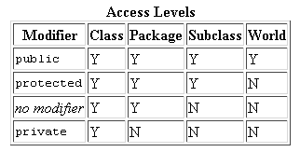
Access Modifiers
Access modifiers allow you to manage access to members of classes.
Access may be controlled at 2 levels:
  At the top level—public, or package-private (no explicit modifier).
  At the member level—public, private, protected, or package-private (no explicit modifier).

Slide 5
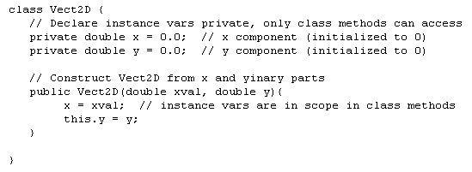
Defining Classes
Instance variables can be initialized in their definition as well as their constructor.
Constructor routines have the same name as the class and return no type (not even void).

Slide 6
Constructors
All classes must have at least one constructor.
If the class doesn’t declare explicitly one, the Java compiler creates constructor without parameters, called default constructor automatically.

Slide 7
This.
Using this with fields
The implicit instance argument is bound to the reserved variable 'this' We could have used this.x instead of x.
Since data members are private (always good practice), we provide accessor routines to access them.
There is a naming convention: for variable 'foo' accessor is getFoo().

Slide 8
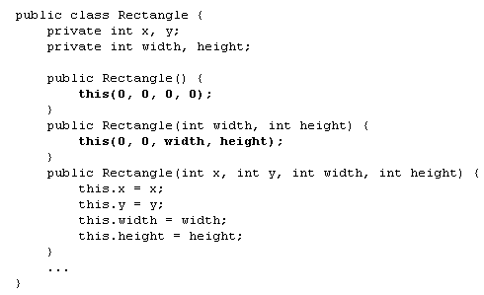
Using this in constructor
Serves to call another constructor of the same class.

Slide 9

Static Initialization Blocks
Serves for initialization of static data.
A class may have any number of static initialization blocks and they can occur anywhere in the class body
The runtime system guarantees that static initialization blocks will be invoked in order of their meeting in the code.

Slide 10
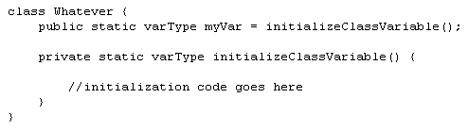
Static Initialization Blocks
Alternative of this block is private static method:
Its advantage is that it can be used many times.

Slide 11

Intialization of the data object
For this purpose except constructor and initialization in definition, can be used Initializer block.

Slide 12
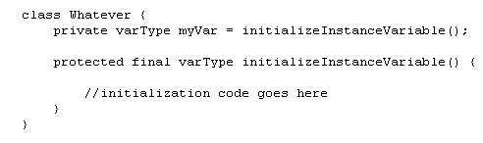
Initialization with final method
final method can be used for initialization of object fields:

Slide 13
Defining Classes
String is a built-in object type (this lets Java use '+' for concat)
Java (and other OO languages) allows programmers to create user defined classes, extending the type system with new object types.
Defining new classes is a matter of defining the data each instance maintains, and the set of methods that manipulate that data.
Classes are defined with keyword 'class'. The source for a class must be in a .java file of the same name (case sensitive)

Slide 14
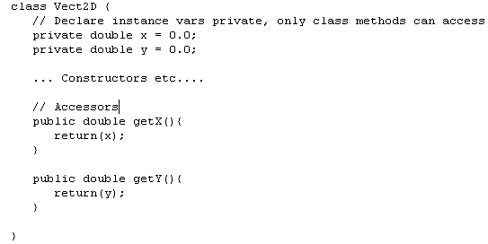
Defining Classes

Slide 15
Defining Classes
In general, class declarations can include these components, in order:
Modifiers such as public, private, can be used.
The class name, with the initial letter capitalized by convention.
The name of the class's parent (superclass), if any, preceded by the keyword extends. A class can only extend (subclass) one parent.
A comma-separated list of interfaces implemented by the class, if any, preceded by the keyword implements. A class can implement more than one interface.
The class body, surrounded by braces, {}.

Slide 16
Defining Classes
An accessor method is used to return the value of a private field. It follows a naming scheme prefixing the word "get" to the start of the method name.
These methods always return the same data type as their corresponding private field (e.g., String) and then simply return the value of that private field.
A mutator method is used to set a value of a private field. It follows a naming scheme prefixing the word "set" to the start of the method name.
These methods do not have a return type and accept a parameter that is the same data type as their corresponding private field. The parameter is then used to set the value of that private field.

Slide 17
Declaring Member Variables
There are several kinds of variables:
  Member variables in a class—these are called fields.
  Variables in a method or block of code—these are called local variables.
  Variables in method declarations—these are called parameters.
Field declarations are composed of three components, in order:
  Zero or more modifiers, such as public or private.
  The field's type.
  The field's name.

Slide 18
Defining Methods
Method declarations have six components, in order:
  Modifiers—such as public, private, and others.
  The return type—the data type of the value returned by the method, or void if the method does not return a value.
  The method name—the rules for field names apply to method names as well, but the convention is a little different.
  The parameter list in parenthesis—a comma-delimited list of input parameters, preceded by their data types, enclosed by parentheses, (). If there are no parameters, you must use empty parentheses.
  An exception list—to be discussed later.
  The method body, enclosed between braces—the method's code, including the declaration of local variables.

Slide 19
Passing Parameters
You can use any data type for a parameter of a method or a constructor. This includes primitive data types, such as doubles, floats, and integers, and reference data types, such as objects and arrays.
The Java programming language doesn't let you pass methods into methods. But you can pass an object into a method and then invoke the object's methods.

Slide 20
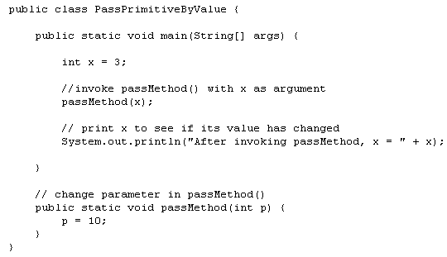
Passing Primitive Data Type Arguments
Primitive arguments, such as an int or a double, are passed into methods by value. This means that any changes to the values of the parameters exist only within the scope of the method. When the method returns, the parameters are gone and any changes to them are lost.

Slide 21
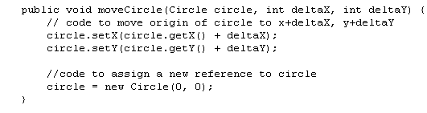
Passing Reference Data Type Arguments
Reference data type parameters, such as objects, are also passed into methods by value. This means that when the method returns, the passed-in reference still references the same object as before. However, the values of the object's fields can be changed in the method, if they have the proper access level.

Slide 22
Passing Arguments Demo
PassByReference1
PassByReference2
PassByReference3

Slide 23
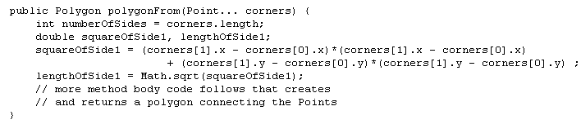
Arbitrary Number of Arguments
You can use a construct called varargs to pass an arbitrary number of values to a method.
You use varargs when you don't know how many of a particular type of argument will be passed to the method. It's a shortcut to creating an array manually (the previous method could have used varargs rather than an array).
To use varargs, you follow the type of the last parameter by an ellipsis (three dots, ...), then a space, and the parameter name.
The method can then be called with any number of that parameter, including none.

Slide 24
Returning a Value from a Method
A method returns to the code that invoked it when it
  completes all the statements in the method,
  reaches a return statement, or
  throws an exception (covered later),
whichever occurs first.
You declare a method's return type in its method declaration. Within the body of the method, you use the return statement to return the value.
Any method declared void doesn't return a value. It does not need to contain a return statement, but it may do so. In such a case, a return statement can be used to branch out of a control flow block and exit the method.

Slide 25
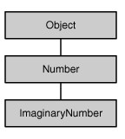
Returning a Value from a Method
When a method uses a class name as its return type, the class of the type of the returned object must be either a subclass of, or the exact class of, the return type.
This technique, called covariant return type, means that the return type is allowed to vary in the same direction as the subclass.

Slide 26
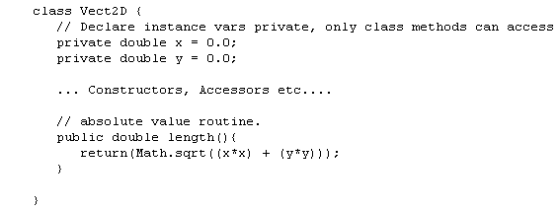
Defining Class
We are making Vect2D an immutable type, otherwise we would supply mutator methods as well (convention setFoo())
Vect2D should support an absolute value methods (sqrt r2 + i2)

Slide 27
Defining Class
Vect2D should support an binary operations add and mult. We have a choice:
  make them static binary methods as in
  or unary instance methods
  Binary (static form emphesizes symmetry while unary (instance) form more flexible due to inheritance. We'll do both here.

Slide 28
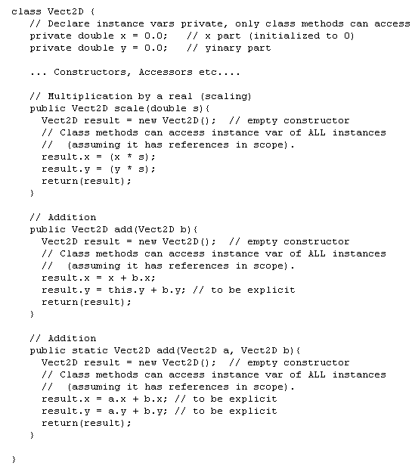

Slide 29
Typical class types
Some common categories of classes in typical programs
  Database -- classes that essentially represent database objects, common in business ( or psuedo-business apps). Algebraic -- classes represent algebraic types (eg Complex)
  Container -- classes to hold collections of objects: lists, hashtables, etc.
  I/O and Network -- mediate access to external data streams.
  GUI objects -- Buttons, frames, text areas, etc.
  Graphics -- Fonts, images, brushes, etc.
  Callbacks -- a technical use of objects to pass methods around as arguments and store as data (methods are not first-class objects in Java, they need a supporting instance).

Slide 30
Objects
Each of these statements has three parts:
Declaration: The code set in bold are all variable declarations that associate a variable name with an object type.
Instantiation: The new keyword is a Java operator that creates the object.
Initialization: The new operator is followed by a call to a constructor, which initializes the new object.

Slide 31
Objects
Declaring a Variable to Refer to an Object
  Previously, you learned that to declare a variable, you write:
  type name;
  Simply declaring a reference variable does not create an object. For that, you need to use the new operator.
Instantiating a Class
  The new operator instantiates a class by allocating memory for a new object and returning a reference to that memory. The new operator also invokes the object constructor.
Initializing an Object
  All classes have at least one constructor. If a class does not explicitly declare any, the Java compiler automatically provides a no-argument constructor, called the default constructor. This default constructor calls the class parent's no-argument constructor, or the Object constructor if the class has no other parent. If the parent has no constructor (Object does have one), the compiler will reject the program.

Slide 32
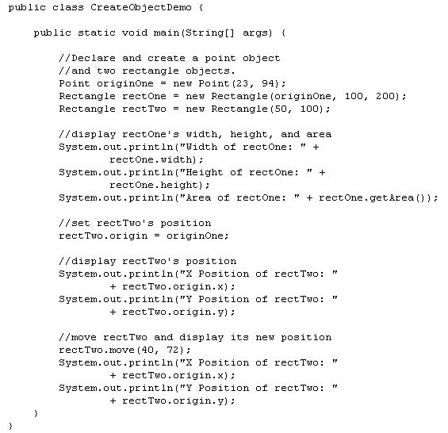
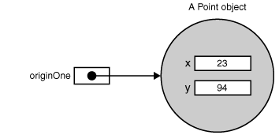
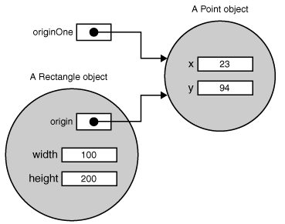
Objects

Slide 33
Using Objects
Referencing an Object's Fields
  objectReference.fieldName
Calling an Object's Methods
  objectReference.methodName(argList);
  objectReference.methodName();

Slide 34
The Garbage Collector
Some object-oriented languages require that you keep track of all the objects you create and that you explicitly destroy them when they are no longer needed. Managing memory explicitly is tedious and error-prone.
The Java platform allows you to create as many objects as you want (limited, of course, by what your system can handle), and you don't have to worry about destroying them.
The Java runtime environment deletes objects when it determines that they are no longer being used. This process is called garbage collection.

Slide 35
Class Methods and Variables
Fields that have the static modifier in their declaration are called static fields or class variables.
They are associated with the class, rather than with any object.
Every instance of the class shares a class variable, which is in one fixed location in memory.
Any object can change the value of a class variable, but class variables can also be manipulated without creating an instance of the class.

Slide 36
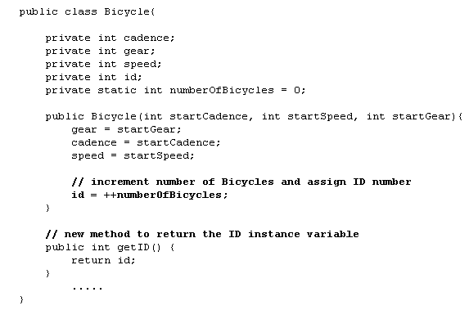
Class Methods and Variables

Slide 37

Class Methods and Variables
The Java programming language supports static methods as well as static variables. Static methods, which have the static modifier in their declarations, should be invoked with the class name, without the need for creating an instance of the class:
  ClassName.methodName(args)
You can also refer to static methods with an object reference like:
  instanceName.methodName(args)

Slide 38
Class Methods and Variables
Not all combinations of instance and class variables and methods are allowed:
Instance methods can access instance variables and instance methods directly.
Instance methods can access class variables and class methods directly.
Class methods can access class variables and class methods directly.
Class methods cannot access instance variables or instance methods directly—they must use an object reference. Also, class methods cannot use the this keyword as there is no instance for this to refer to.

Slide 39
Class Methods and Variables Demo
static

Slide 40
Constants
The static modifier, in combination with the final modifier, is also used to define constants. The final modifier indicates that the value of this field cannot change.
Constants defined in this way cannot be reassigned, and it is a compile-time error if your program tries to do so. By convention, the names of constant values are spelled in uppercase letters. If the name is composed of more than one word, the words are separated by an underscore (_)

Slide 41
Constant Demo
final

Slide 42
Sorting Demo
sorting

Slide 43
Inheritance
Lecture No 5
CJv1, chapter 5

Slide 44
Introduction
It is a general principle of OOP and good programming in general to try to have each piece of code or logical function appear only once. If you find a (as is often the case), that similar code appears in multiple places, for example, similar methods in different classes, try to factor the code so it appears once.
One reason why this is a good policy is that when that algorithm or functionality must be modified or extended (as it almost surely will), it only has to be changed in one place. There is no need to hunt through the code to find (almost) all of the places to be modified.
There are several mechanisms to support this sort of code re-use:
  Abstraction: If you have a lot of sections of code doing similar things, try to focus on what they have in common, and how to implement it so that a simgle, more general implementation can replace several sections.
  Re-use through method calls: An example: the static and instance methods on Vect2D do the same thing. One could be implemented by calling the other.

Slide 45
Introduction
  Inheritance
  Inheritance is the (according to some) the essence of OOP.
  Inheritance allows common behavior and implementation to be factored out in parent classes and shared. Child classes only need to implement child specific functions.
  Child classes (or subclasses) inherit data and methods from their parent classes (superclasses).
  Child classes are more specific, parent classes more general.

Slide 46

Inheritance in Java
Use 'extends' keyword to indicate inheritance.
Example: Complex Numbers Complex numbers are mathematical entities of the for a+bi, where (i*i = -1). and a and b are real numbers. Complex numbers support addition, subtraction, abs, reciprocal. Since complex numbers can be considered points in a plane, we can inherit from Vect2D rather than starting from scratch.

Slide 47

Inheritance in Java
Child class inherits parent's public methods and instance vars.

Slide 48
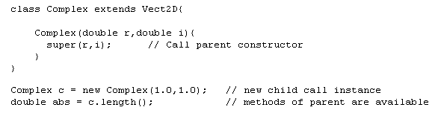
Inheritance in Java
Parent instance referenced through keyword 'super'. In particular, the parent's constructor is called as super().
Parent's constructor must be explicitly called by child class constructor (otherwise empty constructor is used).

Slide 49
Inheritance Demo
Inherit1
inherit2

Slide 50
Hiding Fields
Within a class, a field that has the same name as a field in the superclass hides the superclass's field, even if their types are different.
Within the subclass, the field in the superclass cannot be referenced by its simple name. Instead, the field must be accessed through super, which is covered in the next section.
Generally speaking, we don't recommend hiding fields as it makes code difficult to read.

Slide 51
Inheritance Demo
inherit3

Slide 52
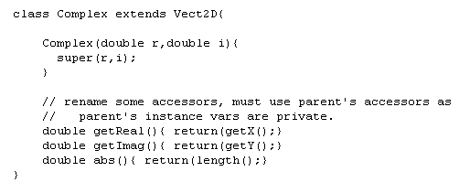
Inheritance in Java
Method of child class CANNOT access private variables of parent, must use accessors, mutator.

Slide 53
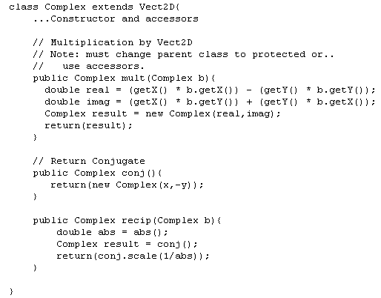
Inheritance in Java
Child class can add additional methods.
For example Complex numbers support multiplication, division, and conjugation.

Slide 54
Inheritance in Java
It is good practice to factor out common code in parent methods even when overriding, and call from child class implementations.
Inheritance is based on the 'is-a' relationship. For example: birds, mammals, and reptiles are all vertebrates. The share common properties and behavior as vertebrates as well as properties specific to their subclass.
Another common relationship is the 'has-a' relationship. The relationship between a whole and it's components. For example. bird have wings, legs, color, habitat etc. Our Vect2D class HAS x and y components. On the other hand, a Complex IS a Vect2D with some additional functionality. Understanding these relationships is an important part of OOP and program design.

Slide 55
Inheritance in Java
Issue: Of course there is always more than one way to carve up the world. More than one possible hierarchy and the hierarchies are not necessarily consistant.(eg flying_animals -> birds,bats,insects). More about this problem in next lecture. Using class inheritance we have to pick the most important decomposition.
One a single parent is allowed in Java (full multiple inheritance is supported in C++...use with extreme caution).

Slide 56
Inheritance in Java
Child classes can also override the parent's methods. This is useful if,
  the child's behavior is slightly different form the parents or,
  certain behavior is not defined for the parent, but is for all child classes. In this case the method is usually defined in the parent class, and overridden on all child classes.

Slide 57
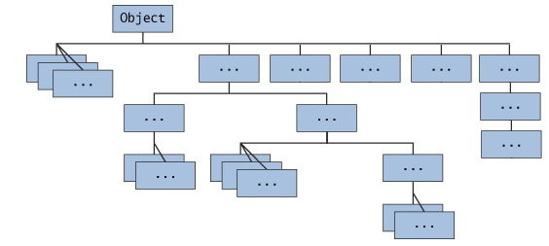
Java Platform Class Hierarchy

Slide 58
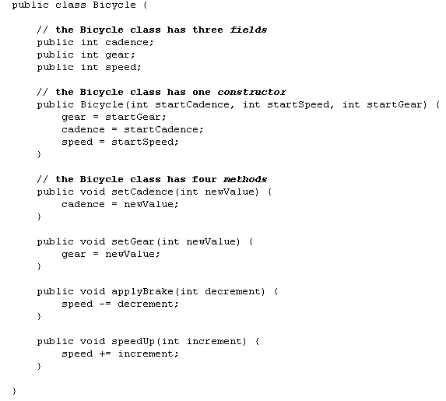
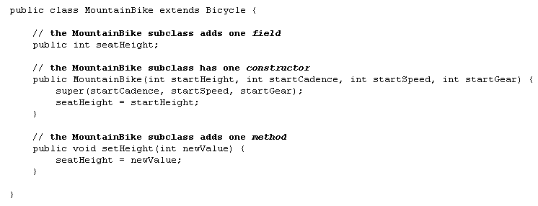
Example

Slide 59
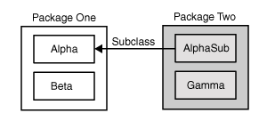
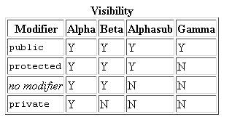
Access Modifiers

Slide 60
Tips on Choosing an Access Level
Use the most restrictive access level that makes sense for a particular member. Use private unless you have a good reason not to.
Avoid public fields except for constants. (Many of the examples in the tutorial use public fields. This may help to illustrate some points concisely, but is not recommended for production code.) Public fields tend to link you to a particular implementation and limit your flexibility in changing your code.

Slide 61
What You Can Do in a Subclass?
A subclass inherits all of the public and protected members of its parent, no matter what package the subclass is in. If the subclass is in the same package as its parent, it also inherits the package-private members of the parent. You can use the inherited members as is, replace them, hide them, or supplement them with new members:
  The inherited fields can be used directly, just like any other fields.
  You can declare a field in the subclass with the same name as the one in the superclass, thus hiding it (not recommended).
  You can declare new fields in the subclass that are not in the superclass.

Slide 62
What You Can Do in a Subclass?
  The inherited methods can be used directly as they are.
  You can write a new instance method in the subclass that has the same signature as the one in the superclass, thus overriding it.
  You can write a new static method in the subclass that has the same signature as the one in the superclass, thus hiding it.
  You can declare new methods in the subclass that are not in the superclass.
  You can write a subclass constructor that invokes the constructor of the superclass, either implicitly or by using the keyword super.

Slide 63
Casting Objects
MountainBike is descended from Bicycle and Object. Therefore, a MountainBike is a Bicycle and is also an Object, and it can be used wherever Bicycle or Objectobjects are called for.
The reverse is not necessarily true: a Bicycle may be a MountainBike, but it isn't necessarily. Similarly, an Object may be a Bicycle or a MountainBike, but it isn't necessarily.

Slide 64
Casting Objects
Casting shows the use of an object of one type in place of another type, among the objects permitted by inheritance and implementations.
For example, if we write
then obj is both an Object and a Mountainbike (until such time as obj is assigned another object that is not a Mountainbike). This is called implicit casting.
If, on the other hand, we write
we would get a compile-time error because obj is not known to the compiler to be a MountainBike. However, we can tell the compiler that we promise to assign aMountainBike to obj by explicit casting:

Slide 65

Casting Objects
You can make a logical test as to the type of a particular object using the instanceof operator. This can save you from a runtime error owing to an improper cast.
Here the instanceof operator verifies that obj refers to a MountainBike so that we can make the cast with knowledge that there will be no runtime exception thrown.

Slide 66
Overriding and Hiding Methods
An instance method in a subclass with the same signature (name, plus the number and the type of its parameters) and return type as an instance method in the superclass overrides the superclass's method.
The ability of a subclass to override a method allows a class to inherit from a superclass whose behavior is "close enough" and then to modify behavior as needed. The overriding method has the same name, number and type of parameters, and return type as the method it overrides. An overriding method can also return a subtype of the type returned by the overridden method. This is called a covariant return type.

Slide 67

Overriding and Hiding Methods
When overriding a method, you might want to use the @Override annotation that instructs the compiler that you intend to override a method in the superclass. If, for some reason, the compiler detects that the method does not exist in one of the superclasses, it will generate an error.

Slide 68
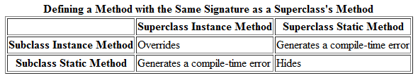
Overriding and Hiding Methods
If a subclass defines a class method with the same signature as a class method in the superclass, the method in the subclass hides the one in the superclass.
In a subclass, you can overload the methods inherited from the superclass. Such overloaded methods neither hide nor override the superclass methods—they are new methods, unique to the subclass.

Slide 69
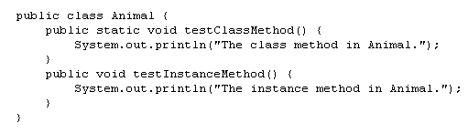
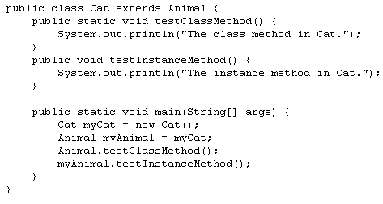

Overriding and Hiding Methods

Slide 70
Overriding and Hiding Methods
The access specifier for an overriding method can allow more, but not less, access than the overridden method. For example, a protected instance method in the superclass can be made public, but not private, in the subclass.
You will get a compile-time error if you attempt to change an instance method in the superclass to a class method in the subclass, and vice versa.

Slide 71
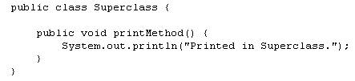
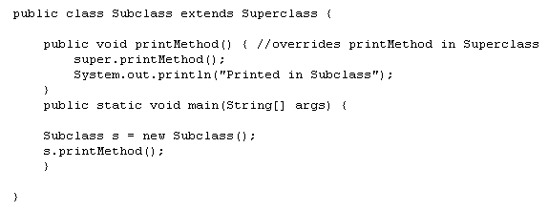

Accessing Superclass Members
If your method overrides one of its superclass's methods, you can invoke the overridden method through the use of the keyword super. You can also use super to refer to a hidden field (although hiding fields is discouraged).

Slide 72
Inheritance Demo
Inherit4
Inherit5
inherit6

Slide 73
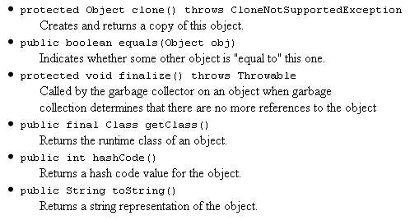
Object as a Superclass
The Object class, in the java.lang package, sits at the top of the class hierarchy tree. Every class is a descendant, direct or indirect, of the Object class. Every class you use or write inherits the instance methods of Object:

Slide 74
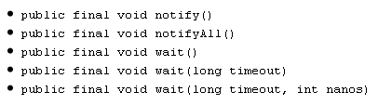
Object as a Superclass

Slide 75
clone() Method
If a class, or one of its superclasses, implements the Cloneable interface, you can use the clone() method to create a copy from an existing object.
If, however, an object contains a reference to an external object, say ObjExternal, you may need to override clone() to get correct behavior. Otherwise, a change in ObjExternal made by one object will be visible in its clone also. This means that the original object and its clone are not independent—to decouple them, you must override clone() so that it clones the object and ObjExternal. Then the original object referencesObjExternal and the clone references a clone of ObjExternal, so that the object and its clone are truly independent.

Slide 76
Clone Demo
clone

Slide 77
equals() Method
The equals() method compares two objects for equality and returns true if they are equal.
The equals() method provided in the Object class uses the identity operator (==) to determine whether two objects are equal. For primitive data types, this gives the correct result. For objects, however, it does not. The equals() method provided byObject tests whether the object references are equal—that is, if the objects compared are the exact same object.
To test whether two objects are equal in the sense of equivalency (containing the same information), you must override the equals() method.

Slide 78
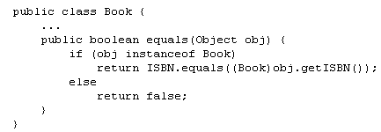
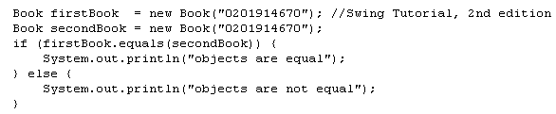
equals() Method
If you override equals(), you must override hashCode() as well.

Slide 79
Equals Demo
Object_equal

Slide 80
finalize() Method
The Object class provides a callback method, finalize(), that may be invoked on an object when it becomes garbage. Object's implementation of finalize() does nothing—you can override finalize() to do cleanup, such as freeing resources.
The finalize() method may be called automatically by the system, but when it is called, or even if it is called, is uncertain. Therefore, you should not rely on this method to do your cleanup for you. For example, if you don't close file descriptors in your code after performing I/O and you expect finalize() to close them for you, you may run out of file descriptors.

Slide 81
getClass() Method
The getClass() method returns a Class object, which has methods you can use to get information about the class, such as its name (getSimpleName()), its superclass (getSuperclass()), and the interfaces it implements (getInterfaces()).

Slide 82
hashCode() Method
The value returned by hashCode() is the object's hash code, which is the object's memory address in hexadecimal.
By definition, if two objects are equal, their hash code must also be equal. If you override the equals() method, you change the way two objects are equated and Object's implementation of hashCode() is no longer valid. Therefore, if you override the equals() method, you must also override the hashCode() method as well.

Slide 83
toString() Method
You should always consider overriding the toString() method in your classes.
The Object's toString() method returns a String representation of the object, which is very useful for debugging.
The String representation for an object depends entirely on the object, which is why you need to override toString() in your classes.

Slide 84
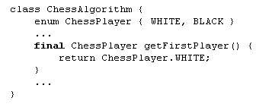
Final Classes and Methods
You can declare some or all of a class's methods final. You use the final keyword in a method declaration to indicate that the method cannot be overridden by subclasses. The Object class does this—a number of its methods are final.
You might wish to make a method final if it has an implementation that should not be changed and it is critical to the consistent state of the object.

Slide 85
Final Classes and Methods
Methods called from constructors should generally be declared final. If a constructor calls a non-final method, a subclass may redefine that method with surprising or undesirable results.
Note that you can also declare an entire class final — this prevents the class from being subclassed. This is particularly useful, for example, when creating an immutable class like the String class.

Slide 86
Abstract Methods and Classes
An abstract class is a class that is declared abstract—it may or may not include abstract methods. Abstract classes cannot be instantiated, but they can be subclassed.
An abstract method is a method that is declared without an implementation (without braces, and followed by a semicolon), like this:

Slide 87

Abstract Methods and Classes
If a class includes abstract methods, the class itself must be declared abstract
When an abstract class is subclassed, the subclass usually provides implementations for all of the abstract methods in its parent class. However, if it does not, the subclass must also be declared abstract.

Slide 88

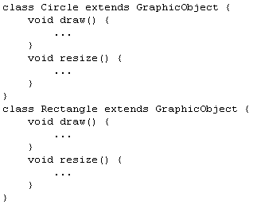
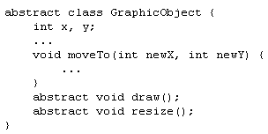
Abstract Methods and Classes
An abstract class may have static fields and static methods. You can use these static members with a class reference

Slide 89
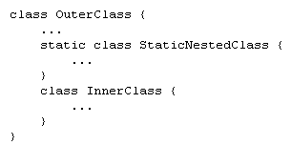
Nested Classes
The Java programming language allows you to define a class within another class. Such a class is called a nested class
Nested classes are divided into two categories: static and non-static. Nested classes that are declared static are simply called static nested classes. Non-static nested classes are called inner classes.

Slide 90
Nested Classes
A nested class is a member of its enclosing class.
Non-static nested classes (inner classes) have access to other members of the enclosing class, even if they are declared private.
Static nested classes do not have access to other members of the enclosing class.
As a member of the OuterClass, a nested class can be declared private, public,protected, or package private.

Slide 91
Why Use Nested Classes?
There are several compelling reasons for using nested classes, among them:
  It is a way of logically grouping classes that are only used in one place.
  It increases encapsulation.
  Nested classes can lead to more readable and maintainable code.

Slide 92
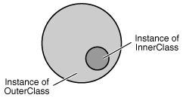
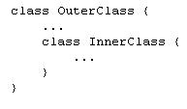
Inner Classes
As with instance methods and variables, an inner class is associated with an instance of its enclosing class and has direct access to that object's methods and fields. Also, because an inner class is associated with an instance, it cannot define any static members itself.
Objects that are instances of an inner class exist within an instance of the outer class.

Slide 93
Inner Classes
Additionally, there are two special kinds of inner classes - local classes and anonymous classes (also called anonymous inner classes).
You can declare an inner class within the body of a method. Such a class is known as a local inner class.
You can also declare an inner class within the body of a method without naming it. These classes are known as anonymous inner classes.
You can use the same modifiers for inner classes that you use for other members of the outer class. For example, you can use the access specifiers — private, public, andprotected — to restrict access to inner classes, just as you do to other class members.

Slide 94
Inner Classes
DataStructure

Slide 95
Interfaces
Lecture No 6
CJv1, chapter 6

Slide 96
Introduction: What are interfaces?
There are a number of situations in software engineering when it is important for disparate groups of programmers to agree to a "contract" that spells out how their software interacts. Each group should be able to write their code without any knowledge of how the other group's code is written. Generally speaking, interfaces are such contracts.
In the Java programming language, an interface is a reference type, similar to a class, that can contain only constants, method signatures, and nested types. There are no method bodies. Interfaces cannot be instantiated—they can only be implemented by classes or extended by other interfaces.
To use an interface, you write a class that implements the interface.

Slide 97
Introduction: What are interfaces?
Essentially abstract classes with no instance variables or concrete methods.
Cannot be instantiated. Only classes that implement interfaces can be instantiated. However, variables can be defined to interface types.
Why not just use abstract classes? Java doesn't permit multiple inheritance from classes, but permits implementation of multiple interfaces.

Slide 98
Interfaces: General
A collection of method (of function) with specific signatures and behavior.
Specifies what a data type "looks like" to callers: the 'contract' the between the implementer and caller.
Completely separates specification/behavior from implementation.
Implementation can be in different language or on different machine.

Slide 99
Interfaces: General
Easy to substitute implementations.
Easy to use multiple implementations.
Useful for implementing callbacks.
Technology of choice for specifying modules (highest level of program structure) since it abstracts all implementation.

Slide 100
Java Interfaces
Interfaces have another very important role in the Java programming language. Interfaces are not part of the class hierarchy, although they work in combination with classes. The Java programming language does not permit multiple inheritance (inheritance is discussed later in this lesson), but interfaces provide an alternative.
In Java, a class can inherit from only one class but it can implement more than one interface. Therefore, objects can have multiple types: the type of their own class and the types of all the interfaces that they implement. This means that if a variable is declared to be the type of an interface, its value can reference any object that is instantiated from any class that implements the interface.

Slide 101
Java Interfaces
To define: 'interface' keyword instead of 'class', define methods without implementations.
Interfaces and inherited from parent classes (parent's implementation is used by default).
Interfaces can be 'extend‘ed just like classes: same syntax.
Classes must specify which interface (if any) they implement.

Slide 102
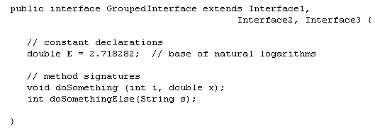
Java Interfaces
An interface declaration consists of modifiers, the keyword interface, the interface name, a comma-separated list of parent interfaces (if any), and the interface body. For example:

Slide 103
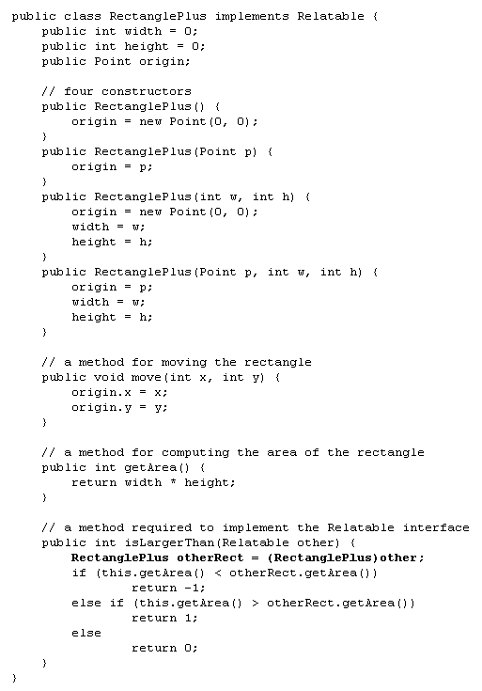
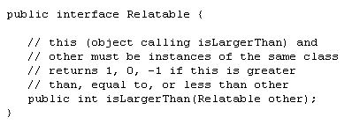
Implementing an Interface

Slide 104
Using an Interface as a Type
When you define a new interface, you are defining a new reference data type.
You can use interface names anywhere you can use any other data type name.
If you define a reference variable whose type is an interface, any object you assign to it must be an instance of a class that implements the interface.

Slide 105
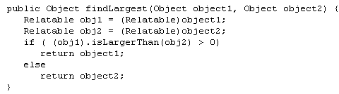
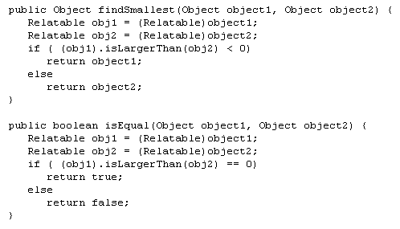
Using an Interface as a Type

Slide 106
Rewriting Interfaces
If you make this change, all classes that implement the old interface will break because they don't implement the interface anymore. Programmers relying on this interface will protest loudly.
Try to anticipate all uses for your interface and to specify it completely from the beginning. Given that this is often impossible, you may need to create more interfaces later.

Slide 107
Using an Interface
InterfaceSample

Slide 108
Abstract Classes versus Interfaces
Unlike interfaces, abstract classes can contain fields that are not static and final, and they can contain implemented methods. Such abstract classes are similar to interfaces, except that they provide a partial implementation, leaving it to subclasses to complete the implementation. If an abstract class contains only abstract method declarations, it should be declared as an interface instead.

Slide 109
Abstract Classes versus Interfaces
Multiple interfaces can be implemented by classes anywhere in the class hierarchy, whether or not they are related to one another in any way. Think of Comparable orCloneable, for example.
By comparison, abstract classes are most commonly subclassed to share pieces of implementation. A single abstract class is subclassed by similar classes that have a lot in common (the implemented parts of the abstract class), but also have some differences (the abstract methods).

Slide 110
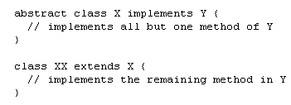
Interfaces vs Classes
A class that implements an interface must implement all of the interface's methods. It is possible, however, to define a class that does not implement all of the interface methods, provided that the class is declared to be abstract.

Slide 111
Interfaces vs Classes
Often there is a choice between specifying some functionality as a class, an abstract class, or an interface. There are no hard and fast rules for this. Here is some advice:
  Java supports only single inheritance, so class hierarchies are strict. Interfaces are useful for general functionality across a variety of class types when it would be impossible to represent them in a single hierarchy.

Slide 112
Interfaces vs Classes
  Interfaces are useful for specifying the behavior of high-level modules in a design as it provides maximum separation of specification and implementation.
  Interface can be a nuisance, since one must eventually define classes to instantiate. You will see this in the Java GUI system.
  Class hierarchies should follow 'is-a' relationships. Interfaces follow 'behaves-like-a' relationships.

Slide 113
Documentation with JavaDoc
Javadoc is a system for helping generate API documentation (of the sort you can find at http://java.sun.com/javase/6/docs/api/).
Javadoc help unify the coding and documentation processes.
Javadoc can document, Classes, Interfaces, instance variables and methods.
By default it only generates doc of public classes and interfaces, so be careful in your specification.

Slide 114
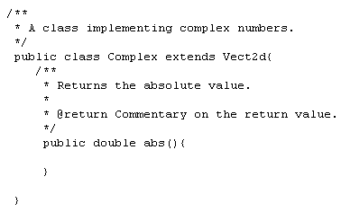
Documentation with JavaDoc
To use Javadoc, you write code as usual, but comment your code in a particular format. The basic Javadoc comment looks like

Slide 115
Documentation with JavaDoc
Javadoc allows plain text or HTML in comments. Javadoc also allows a set of special fields indicated in the comment by @. Some examples :
  @author – име на автора
  @param – параметри на метод
  @return – тип на връщаната стойност от метод
  @see – референция към друг клас или метод

Slide 116
Annotations
Annotations provide data about a program that is not part of the program itself. They have no direct effect on the operation of the code they annotate.
Annotations have a number of uses, among them:
  Information for the compiler — Annotations can be used by the compiler to detect errors or suppress warnings.
  Compiler-time and deployment-time processing — Software tools can process annotation information to generate code, XML files, and so forth.
  Runtime processing — Some annotations are available to be examined at runtime.

Slide 117

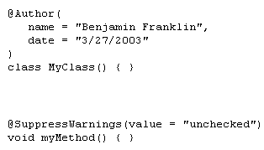

Annotations
Annotations can be applied to a program's declarations of classes, fields, methods, and other program elements.
The annotation appears first, often (by convention) on its own line, and may include elements with named or unnamed values:

Slide 118
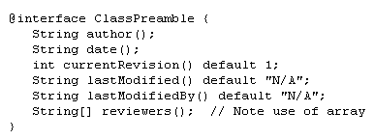
Documentation
Suppose that a software group has traditionally begun the body of every class with comments providing important information.
To add this same metadata with an annotation, you must first define the annotation type. The syntax for doing this is:

Slide 119
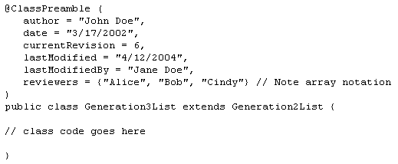
Documentation
Once the annotation type has been defined, you can use annotations of that type, with the values filled in, like this:

Slide 120
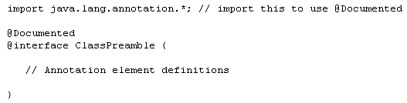
Documentation
To make the information in @ClassPreamble appear in Javadoc-generated documentation, you must annotate the @ClassPreamble definition itself with the@Documented annotation:

Slide 121

Annotations Used by the Compiler
@Deprecated—the @Deprecated annotation indicates that the marked element is deprecated and should no longer be used. The compiler generates a warning whenever a program uses a method, class, or field with the @Deprecated annotation. When an element is deprecated, it should also be documented using the Javadoc @deprecated tag, as shown in the following example. The use of the "@" symbol in both Javadoc comments and in annotations is not coincidental—they are related conceptually. Also, note that the Javadoc tag starts with a lowercase "d" and the annotation starts with an uppercase "D".

Slide 122

Annotations Used by the Compiler
@Override—the @Override annotation informs the compiler that the element is meant to override an element declared in a superclass.

Slide 123

Annotations Used by the Compiler
@SuppressWarnings—the @SuppressWarnings annotation tells the compiler to suppress specific warnings that it would otherwise generate. In the example below, a deprecated method is used and the compiler would normally generate a warning. In this case, however, the annotation causes the warning to be suppressed.

Slide 124
Annotations Used by the Compiler
Every compiler warning belongs to a category. The Java Language Specification lists two categories: "deprecation" and "unchecked."
The "unchecked" warning can occur when interfacing with legacy code written before the advent of generics. To suppress more than one category of warnings, use the following syntax:

Slide 125
Run-time Errors and Exceptions
CJv1, chapter 11

Slide 126
Run-time Errors
Error handling is a major aspect of serious software development. It is represents a significant part of the total development effort, (and not the fun part either). Today we are going to discuss error handling techniques in general, and their specific incarnations in Java.What could go wrong?
  unexpected or inconsistant input
    syntacticly incorrect - wrong types or values
    semanticly incorrect

Slide 127
Run-time Errors
  I/O errors
    Ex: Attempt to open non-existant file
  Processing errors
    Ex: divide by zero; array access out of bounds; null Object access
  External conditions
    Network host unreachable; network connection disconnected
    External device conditions; audio, cameras, etc.
  System errors (usually fatal)
    Out of memory; disk errors; hardware errors

Slide 128
Manipulating run-time errors
Three issues:
  Detecting: testing for error conditions
  Signaling: communicating error to handling code
  Handling: attempt to recover, or at least die gracefully

Slide 129
Testing
Choices:
  High level: Test arguments before calling library methods.For example, in the case of bracketRoot, check signs before call.
  Low level: Detect error in called method and pass them up.If you are implementing both the caller and callee, one can check for consistancy in the caller and assume all is well in the callee.
  If you are implementing a library or class to be used by others, you probably have to check all inputs for error in your library methods.
Choice should be based on program structure, probabilities of error, and cost of testing. At any rate, policy should be clear, explicit and consistant. It should be clear at each level what conditions on input and data values have been check and enforced.

Slide 130
Signaling
Two methods: Error return codes, and Throwing Exceptions
Error codes
  Have all library methods return an error code: usually 0 for success, and a non-zero code specifying type of error.
  Advantages: low overhead, conceptually simple
  Disadvantages:
    uses up return value,
    caller must test codes after each call, multi-level system must pass errors up the call chain.
  For example, in our bracketRoot method, we are returning a double so it's hard to return an error code. You can select an unlikely value or return NaN, or null (for Object types)

Slide 131
Signaling
  If we really, wanted to (cleanly) use the return value to signal error conditions, we could use it solely for this purpose, and use a shared data structure to return a value. For example we would specify bracketRoot aspublic ErrorCode bracketRoot(double a, double b, double e, double[] val); and return our answer in val[0]; (In some language (like C on UNIX), this is really the only choice, and many C libraries are specified this way). and many
Exceptions
  Higher overhead, but can lead to cleaner code

Slide 132
Exceptions: General
The basic problems Exception mechanisms are trying to solve are:
Indicating an error without using up the return value
Getting the exception to the code that deals with it, with have to constantly check return values.

Slide 133
Exceptions: General
The basic process of the exception mechanism is as follows:
    When error condition is detected an exception is thrown
    "throw" is a system/language specific mechanism that unwinds the call stack until a handler for the specific exception is found
    Exception handlers defined in "catch" blocks
    After processing catch handler code, execution resumes after catch block
    Many languages/systems have catch/throw exception systems: Java, C++, Windows C (no raw C catch/throw available in UNIX). All of these systems are more or less the same as the Java version

Slide 134


Exceptions: General

Slide 135
The Three Kinds of Exceptions
The first kind of exception is the checked exception. These are exceptional conditions that a well-written application should anticipate and recover from. For example, suppose an application prompts a user for an input file name, then opens the file by passing the name to the constructor for java.io.FileReader. Normally, the user provides the name of an existing, readable file, so the construction of the FileReader object succeeds, and the execution of the application proceeds normally. But sometimes the user supplies the name of a nonexistent file, and the constructor throws java.io.FileNotFoundException. A well-written program will catch this exception and notify the user of the mistake, possibly prompting for a corrected file name.
Checked exceptions are subject to the Catch or Specify Requirement. All exceptions are checked exceptions, except for those indicated by Error, RuntimeException, and their subclasses.

Slide 136
The Three Kinds of Exceptions
The second kind of exception is the error. These are exceptional conditions that are external to the application, and that the application usually cannot anticipate or recover from. For example, suppose that an application successfully opens a file for input, but is unable to read the file because of a hardware or system malfunction. The unsuccessful read will throw java.io.IOError. An application might choose to catch this exception, in order to notify the user of the problem — but it also might make sense for the program to print a stack trace and exit.
Errors are not subject to the Catch or Specify Requirement. Errors are those exceptions indicated by Error and its subclasses.

Slide 137
The Three Kinds of Exceptions
The third kind of exception is the runtime exception. These are exceptional conditions that are internal to the application, and that the application usually cannot anticipate or recover from. These usually indicate programming bugs, such as logic errors or improper use of an API. For example, consider the application described previously that passes a file name to the constructor for FileReader. If a logic error causes a null to be passed to the constructor, the constructor will throw NullPointerException. The application can catch this exception, but it probably makes more sense to eliminate the bug that caused the exception to occur.
Runtime exceptions are not subject to the Catch or Specify Requirement. Runtime exceptions are those indicated by RuntimeException and its subclasses.
Errors and runtime exceptions are collectively known as unchecked exceptions.

Slide 138

Exceptions: Java
Errors and Exceptions are Objects (of course). Inherit from Throwable class. Can be subclasses for application specific errors (and are by various libraries). Java actually has a class hierarchy of exceptions.

Slide 139
Exceptions: Java
Error represents system error: bugs in the run-time, out-of-memory, etc. These things you can generally do little about.
The Exception class represents all other condition and has two subclasses
RuntimeException class represent, essentally, programming errors: arrayAccessOutOfBounds, bad dowencast, NullObject access, etc.

Slide 140

Exceptions: Java
IOException class represent exceptions from the IO system, such as attempting to open a non-existing file. But can also be subclassed to represent any semantic type of error (for example the inconsistant input condition on bracketRoot())
In the case of bracketRoot, we might want our own exception class to indicate the type or error. We do this by subclassing:

Slide 141

Catching and Handling Exceptions
This class won't compile by design!

Slide 142


The try Block
The segment in the example labeled code contains one or more legal lines of code that could throw an exception.

Slide 143

The catch Blocks
Each catch block is an exception handler and handles the type of exception indicated by its argument. The argument type, ExceptionType, declares the type of exception that the handler can handle and must be the name of a class that inherits from the Throwable class. The handler can refer to the exception with name.

Slide 144

The catch Blocks
The catch block contains code that is executed if and when the exception handler is invoked. The runtime system invokes the exception handler when the handler is the first one in the call stack whose ExceptionType matches the type of the exception thrown. The system considers it a match if the thrown object can legally be assigned to the exception handler's argument.

Slide 145

Catching More Than One Type of Exception with One Exception Handler
In Java SE 7 and later, a single catch block can handle more than one type of exception. This feature can reduce code duplication and lessen the temptation to catch an overly broad exception.
In the catch clause, specify the types of exceptions that block can handle, and separate each exception type with a vertical bar (|):
If a catch block handles more than one exception type, then the catch parameter is implicitly final. In this example, the catch parameter ex is final and therefore you cannot assign any values to it within the catch block.

Slide 146

The finally Block
The finally block always executes when the try block exits. This ensures that the finally block is executed even if an unexpected exception occurs. But finally is useful for more than just exception handling — it allows the programmer to avoid having cleanup code accidentally bypassed by a return, continue, or break. Putting cleanup code in a finally block is always a good practice, even when no exceptions are anticipated.

Slide 147
The finally Block
The finally block is a key tool for preventing resource leaks. When closing a file or otherwise recovering resources, place the code in a finally block to ensure that resource is always recovered.
If you are using Java SE 7 or later, consider using the try-with-resources statement in these situations, which automatically releases system resources when no longer needed.

Slide 148

The try-with-resources Statement
The try-with-resources statement is a try statement that declares one or more resources. A resource is as an object that must be closed after the program is finished with it. The try-with-resources statement ensures that each resource is closed at the end of the statement. Any object that implements java.lang.AutoCloseable, which includes all objects which implement java.io.Closeable, can be used as a resource.

Slide 149

The try-with-resources Statement
Prior to Java SE 7, you can use a finally block to ensure that a resource is closed regardless of whether the try statement completes normally or abruptly. The following example uses a finally block instead of a try-with-resources statement:

Slide 150

The try-with-resources Statement

Slide 151
The try-with-resources Statement
You may declare one or more resources in a try-with-resources statement.
A try-with-resources statement can have catch and finally blocks just like an ordinary try statement. In a try-with-resources statement, any catch or finallyblock is run after the resources declared have been closed.

Slide 152
Suppressed Exceptions
An exception can be thrown from the block of code associated with the try-with-resources statement. In the example writeToFileZipFileContents, an exception can be thrown from the try block, and up to two exceptions can be thrown from the try-with-resources statement when it tries to close the ZipFile and BufferedWriter objects. If an exception is thrown from the try block and one or more exceptions are thrown from the try-with-resources statement, then those exceptions thrown from the try-with-resources statement are suppressed, and the exception thrown by the block is the one that is thrown by the writeToFileZipFileContents method. You can retrieve these suppressed exceptions by calling the Throwable.getSuppressed method from the exception thrown by the try block.

Slide 153
Classes That Implement the AutoCloseable or Closeable Interface
The Closeable interface extends theAutoCloseable interface. The close method of the Closeable interface throws exceptions of type IOException while the close method of the AutoCloseable interface throws exceptions of type Exception. Consequently, subclasses of the AutoCloseable interface can override this behavior of the close method to throw specialized exceptions, such as IOException, or no exception at all.

Slide 154

Scenario 1: An Exception Occurs

Slide 155

Scenario 2: The try Block Exits Normally

Slide 156
Specifying the Exceptions Thrown by a Method
Sometimes, it's appropriate for code to catch exceptions that can occur within it. In other cases, however, it's better to let a method further up the call stack handle the exception.
To specify that writeList can throw two exceptions, add a throws clause to the method declaration for the writeList method. The throws clause comprises the throws keyword followed by a comma-separated list of all the exceptions thrown by that method.
Remember that ArrayIndexOutOfBoundsException is an unchecked exception; including it in the throws clause is not mandatory.

Slide 157
How to Throw Exceptions
Any code can throw an exception: your code, code from a package written by someone else such as the packages that come with the Java platform, or the Java runtime environment. Regardless of what throws the exception, it's always thrown with the throw statement.
You can also create your own exception classes to represent problems that can occur within the classes you write.
You can also create chained exceptions.

Slide 158

How to Throw Exceptions

Slide 159


Chained Exceptions
An application often responds to an exception by throwing another exception. In effect, the first exception causes the second exception. It can be very helpful to know when one exception causes another. Chained Exceptions help the programmer do this.

Slide 160

Stack Trace Information
A stack trace provides information on the execution history of the current thread and lists the names of the classes and methods that were called at the point when the exception occurred.
A stack trace is a useful debugging tool that you'll normally take advantage of when an exception has been thrown.

Slide 161

Stack Trace Information
The next code snippet logs where an exception occurred from within the catch block. However, rather than manually parsing the stack trace and sending the output toSystem.err(), it sends the output to a file using the logging facility in the java.util.logging package.

Slide 162
Creating Exception Classes
When faced with choosing the type of exception to throw, you can either use one written by someone else — the Java platform provides a lot of exception classes you can use — or you can write one of your own. You should write your own exception classes if you answer yes to any of the following questions; otherwise, you can probably use someone else's.
  Do you need an exception type that isn't represented by those in the Java platform?
  Would it help users if they could differentiate your exceptions from those thrown by classes written by other vendors?
  Does your code throw more than one related exception?
  If you use someone else's exceptions, will users have access to those exceptions? A similar question is, should your package be independent and self-contained?

Slide 163

Creating Exception Classes
The linked list class can throw multiple exceptions, and it would be convenient to be able to catch all exceptions thrown by the linked list with one exception handler. Also, if you plan to distribute your linked list in a package, all related code should be packaged together. Thus, the linked list should provide its own set of exception classes.
The next figure illustrates one possible class hierarchy for the exceptions thrown by the linked list.

Slide 164
Advantages of Exceptions
Advantage 1: Separating Error-Handling Code from "Regular" Code
  Exceptions provide the means to separate the details of what to do when something out of the ordinary happens from the main logic of a program. In traditional programming, error detection, reporting, and handling often lead to confusing spaghetti code.
Advantage 2: Propagating Errors Up the Call Stack
  A second advantage of exceptions is the ability to propagate error reporting up the call stack of methods.
Advantage 3: Grouping and Differentiating Error Types
  Because all exceptions thrown within a program are objects, the grouping or categorizing of exceptions is a natural outcome of the class hierarchy.

