Slide 1
Science Visualization
Vector Visualization Techniques

Slide 2
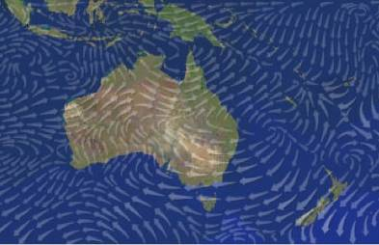
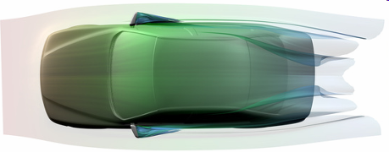
Introduction
What’s Vector Field Visualization?
A sub-branch of scientific visualization
Depiction of magnitude + direction (as opposed to scalar field visualization)
Various applications in our daily life: automotive simulation, aerodynamics, turbo machinery, meteorology, oceanography, medical visualization
Visualization of flow around a car [source: Garth, 2008]
Arrows showing the wind
direction and magnitude [source: Turk, 1996]

Slide 3
Vector Visualization
Data set is given by a vector component and its magnitude often results from study of fluid flow or by looking at derivatives (rate of change) of some quantity trying to find out what to see and how!
Many visualization techniques proposed
Hedgehogs/glyphs
Particle tracing
stream-, streak-, time- & path-lines
stream-ribbon, stream-surfaces, stream-polygons, stream-tube
hyper-streamlines
Line Integral Convolution

Slide 4
Vector Visualization - Origin
Where are those methods coming from??
Rich field of Fluid Flow Visualization
Modern domain - Computational Field Simulations
Vector visualization
Gaseous flow:
development of cars, aircraft, spacecraft
design of machines - turbines, combustion engines
Liquid Flow:
naval applications - ship design
civil engineering - harbor design, coastal protection
Chemistry - fluid flow in reactor tanks
Medicine - blood vessels, SPECT, fMRI

Slide 5
Flow Visualization
What is the problem definition?
Given (typically):
physical position (vector)
pressure (scalar),
density (scalar),
velocity (vector),
entropy (scalar)
steady flow - vector field stays constant
unsteady - vector field changes with time
The goal
What are we looking for?
Answer: ANY UNDERSTANDING!

Slide 6
Flow Visualization - traditionally
Traditionally
Experimental Flow Visualizations
How?
Three basic techniques:
adding foreign material
optical techniques
adding heat and energy
Problems:
the flow is affected by experimental technique
not all phenomena can be visualized
expensive (wind tunnels, small scale models)
time consuming

Slide 7
Dimensions
Spatial dimension:
2D (planar flow)
2.5D (boundary flow, flow on surface)
3D (real-world flow, volumetric flow)
Temporal dimension:
Steady flow: one time step (or instantaneous or static flow)
Time-dependent flow: multiple time steps (or unsteady or transient, real-world)

Slide 8
Overview
Vector fields (VFs) typically used to encode many different data sets:
e.g. Velocity/Flow, E&M, Temp., Stress/Strain
Area of interest: Visualization of VFs
Problem: Data overload!
One solution: Visualize a “skeleton” of the VF by viewing its topology

Slide 9
Vector Fields
A steady vector field (VF) is defined as a mapping:
v: N → TN, N a manfold, TN the tang. bundle of N
In general, N = TN ≈ R^{n}
An integral curve is defined by a diff. eqn:
dφ/dt = v(φ(t)), with φ_{o}, t_{o} as initial conditions
Also called streamlines

Slide 10
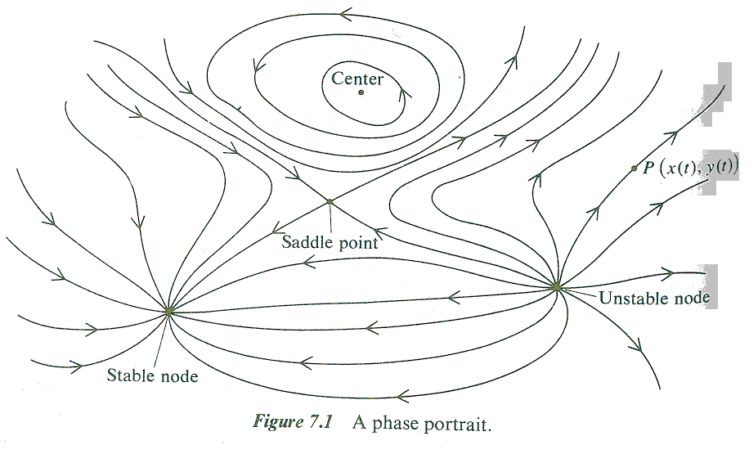
Vector Fields
A phase portrait is a depiction of these integral curves:
Image: A Combinatorial Introduction to Topology, Michael Henle

Slide 11
Critical Points
A critical point is a singularity in the field such that v(x) = 0.
Critical points are classified by eigenvalues of the Jacobian matrix, J, of the VF at their position:
e.g. in 2d,
If J has full rank, the critical point is called linear or first-order
Hyperbolic critical points have nonzero real parts

Slide 12
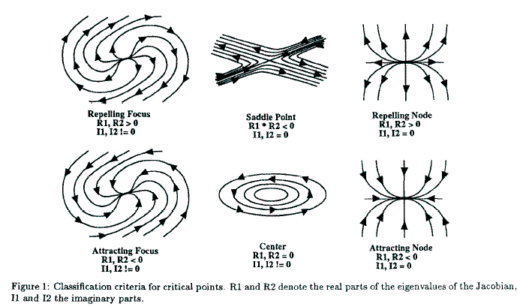
Critical Points
Image: Surface representations of 2- and 3-dimensional fluid flow topology, Helman & Hesselink

Slide 13
Critical Points
Generally:
R > 0 refers to repulsion
R < 0 refers to attraction
e.g. a saddle both repels and attracts
I ≠ 0 refers to rotation
e.g. a focus and a center
Note in 2d case I₁ = -I₂

Slide 14
Sectors & Separatrices
In the vicinity of a critical point, there are various sectors or regions of different flow type:
hyperbolic: paths do not ever reach c.p.
parabolic: one end of all paths is at c.p.
elliptic: all paths begin & end at c.p.
A separatrix is the bounding curve (or surface) which separates these regions

Slide 15
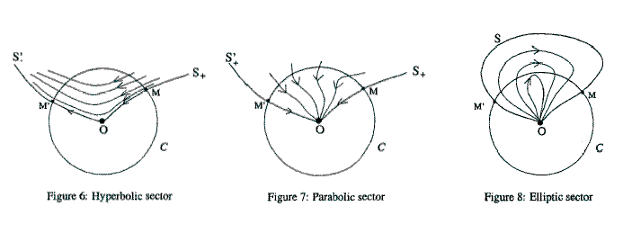
Sectors & Separatrices
Images: A topology simplification method for 2D vector fields. Xavier Tricoche, Gerik Scheuermann, & Hans Hagen

Slide 16
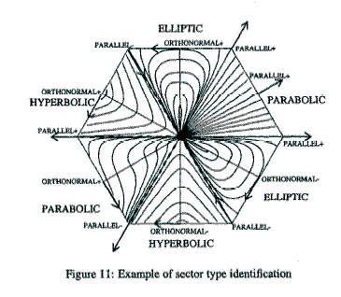
Sectors & Separatrices
Images: A topology simplification method for 2D vector fields. Xavier Tricoche, Gerik Scheuermann, & Hans Hagen

Slide 17
Vector Field Visualization
A vector field:
F(U) = V
U: field domain
(x,y) in 2D
(x,y,z) in 3D
V: vector (u,v) or (u,v,w)
Like scalar fields, vectors are defined at discrete points

Slide 18
Classification
Direct
Overview of vector field, minimal computation, e.g. glyphs, colour mapping
Feature-based
Provides suggestive visualization by extracting subsets of data before visualization, e.g. vector field clustering
Texture-based
Covers domain with a convolved texture, e.g., Spot Noise, LIC, ISA, IBFV(S)
Geometric
Coherent representation, integration-based geometric techniques, e.g. streamlines

Slide 19
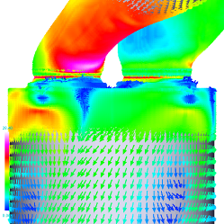
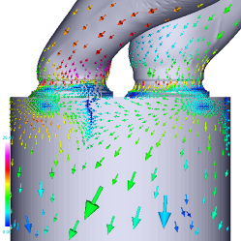
Vector Field Visualization Applications
Hedgehog
Vector field clustering

Slide 20
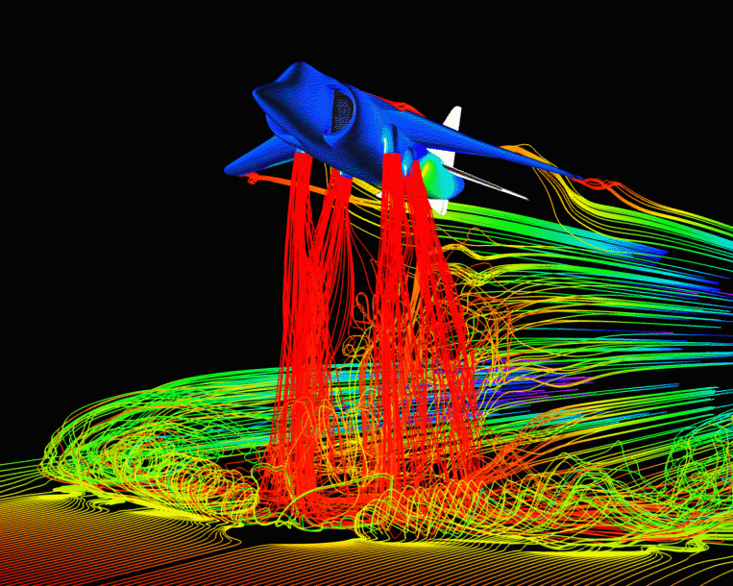
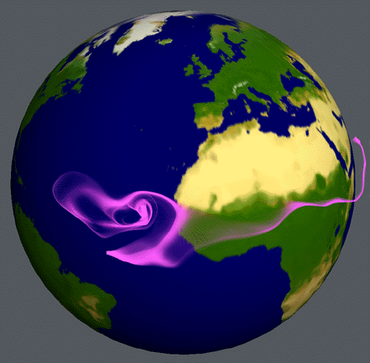
Vector Field Visualization Applications
Computational Fluid Dynamics
Weather modeling

Slide 21
Applications of Vector Field Visualization
The major application area is Computational Fluid Dynamics where we wish to visualize the velocity field within a volume, or on a surface
... but has applications to any other discipline where flow is involved
for example, the flow of population in social sciences
Important distinction between steady and unsteady (time-dependent) flow

Slide 22
Applications of Vector Field Visualization
Experimental fluid dynamics:
aim to get impression of flow around a scale model of object (eg smoke in wind tunnel)
disadvantages in cost, time and integrity
Computational fluid dynamics
simulation of the flow (Navier-Stokes equations)
visualization of the resulting velocity field so as to mimic the experimental techniques

Slide 23
Applications of Vector Field Visualization
Techniques
Time lines
row of small particles (hydrogen bubbles) released at right angles to flow - motion of ‘line’ shows the fluid flow
Streak line
dye injected from fixed position for period of time - tracer of dye shows the fluid flow
Path line
small particles (magnesium powder in liquid; oil drops in gas) - velocity measured by photographing motion with known exposure time
Visualization of flow field on surface of object achieved by fixing tufts at several points on surface - orientation of threads indicates direction of flow
Notes:
Notice distinction:
tufts show flow past a fixed point (Eulerian)
bubbles etc show the flow from point of view of a floating object (Lagrangian)

Slide 24
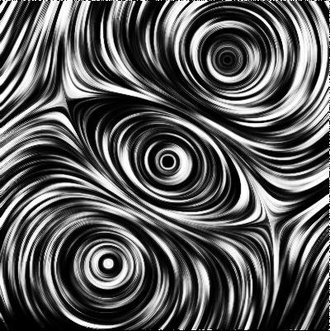
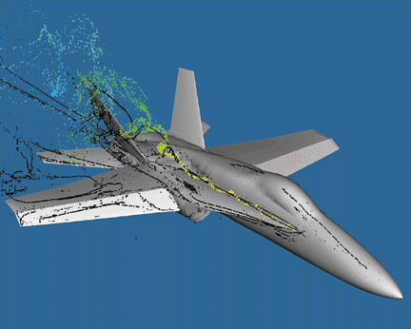
Vector Field Visualization Challenges
General Goal
Display the field’s directional information
Domain Specific:
Detect certain features, Vortex cores, Swirl

Slide 25
Vector Field Visualization Challenges
A good vector field visualization is difficult to get:
Displaying a vector requires more visual attributes
(u,v,w): direction and magnitude
Displaying a vector requires more screen space
more than one pixel is required to display an arrow
==> It becomes more challenging to display a dense vector field

Slide 26
Vector Field Visualization Challenges
Local technique:
Particle Advection: Display the trajectory of a particle starting from a particular location
Global technique:
Display the flow direction everywhere in the field
Hedgehogs, Line Integral Convolution, Texture Splats etc.

Slide 27
Computer Flow Visualization
Now look at methods for computer aided flow visualization
Assume initially velocity field given on 3D Cartesian grid
velocity
v_{x}, v_{y}, v_{z}
given at each
grid point
hexahedral
cells

Slide 28
Using Scalar Techniques
Sometimes it is useful to derive scalar quantities from the velocity field
For example, velocity magnitude
speed = sqrt (v_{x}² + v_{y}² + v_{z}²)
How would these be visualized?

Slide 29
Arrows
Very simple technique
Arrow drawn at each grid point showing direction and size of velocity
This works effectively
enough in 2D

Slide 30
Arrows
But in 3D it suffers from perception problems:
Of course the picture quickly gets cluttered too

Slide 31
Arrows
Arrows can be used successfully in 3D as follows:
by slicing the volume, and attaching arrows (with shadow effects) to the slice plane - this gives a hedgehog effect
by giving more spatial cues - drawing arrows as true 3D objects
but clutter again a
problem!
{BTW - Eulerian or Lagrangian?}

Slide 32
Local technique - Particle Tracing
Visualizing the flow directions by releasing particles and calculating a series of particle positions based on the vector field
The motion of particle: dx/dt = v(x)
x: particle position (x,y,z)
v(x): the vector (velocity) field
Use numerical integration to compute a new particle position
x(t+dt) = x(t) + Integration( v(x(t)) dt )

Slide 33
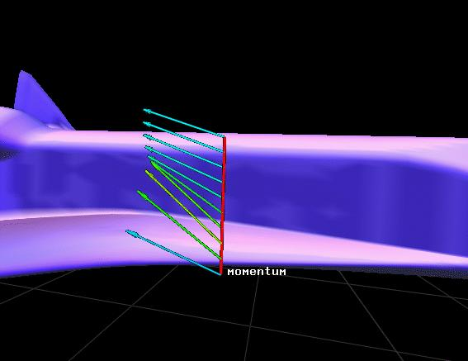
Tufts

Slide 34
Particle Traces
This is analogous to experimental path lines - we imagine following the path of a weightless particle
Suppose initial position (seed point) is
(x₀, y₀, z₀)
The aim is to find how the path develops over time
( x(t), y(t), z(t) )
Also called particle advection

Slide 35
Particle Traces
Motion of a particle is given by:
dx/dt = v_{x}; dy/dt = v_{y}; dz/dt = v_{z}
Three ordinary differential equations with initial conditions at time zero:
x(0) = x₀; y(0) = y₀; z(0) = z₀
In 2D, we have:
(v_{x},v_{y}) is
rate of change
of position
(x₀,y₀)

Slide 36
Particle Tracing
Numerical Techniques for Integrating the ODEs
Simplest technique is Euler’s method:
dx/dt = ( x(t+Δt) - x(t)) / Δt = v_{x}(p(t)), p=(x,y,z)
hence
x(t+Δt) = x(t) + Δt.v_{x}(p(t))
Similarly, for y(t) and z(t)
In 2D, we have:
(x₁,y₁)
(Δt.v_{x},Δt.v_{y})
(x₀,y₀)

Slide 37
Path Tracing
Interpolation
As the solution proceeds, we need velocity values at interior points
(v_{x}, v_{y}, v_{z}) is calculated at current point (x,y,z) - by trilinear interpolation for example.
In 2D, we have:
(x₁,y₁)
(v_{x},v_{y}) found
by interpolation
(bilinear)
(x₀,y₀)

Slide 38
Particle Tracing
Point Location
When we leave one cell, we need to determine which cell the new point belongs to
(x₁,y₁)
- this is quite straightforward for Cartesian grids
(x₀,y₀)

Slide 39
Particle Tracing - Algorithm
Algorithm
find cell containing initial position
{point location}
While particle in grid
determine velocity at current position
{interpolation}
calculate new position
{integration}
find cell containing new position
{point location}
Endwhile

Slide 40
Numerical Integration
First Order Euler method:
x(t+dt) = x(t) + v(x(t)) * dt
Not very accurate, but fast
Other higher order methods are available:
Runge-Kutta second and fourth order integration methods (more popular due to their accuracy)
Result of first order Euler method

Slide 41
Numerical Integration
Second Runge-Kutta Method
x(t+dt) = x(t) + 0.5 * (K₁ + K₂)
k₁ = dt * v(x(t))
k₂ = dt * v(x(t)+k₁)
Standard Method: Runge-Kutta fourth order
x(t+dt) = x(t) + 1/6 *(k1 + 2*k2 + 2*k3 + k4)
k1 = dt * v(t); k2 = dt * v(x(t) + k₁/2)
k3 = dt * v(x(t) + k₂/2); k4 = dt * v(x(t) + k₃)
x(t+dt)
x(t)
0.5 * [v(x(t))+v(x(t)+dt*v(x(t))]

Slide 42
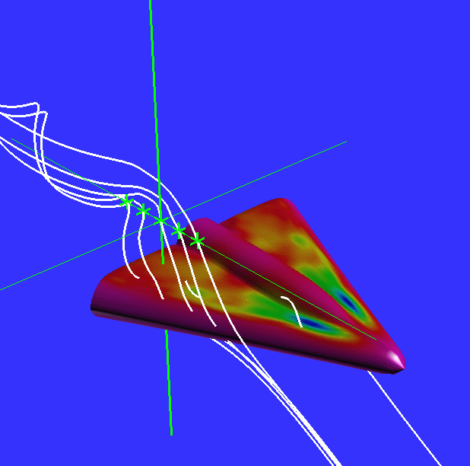
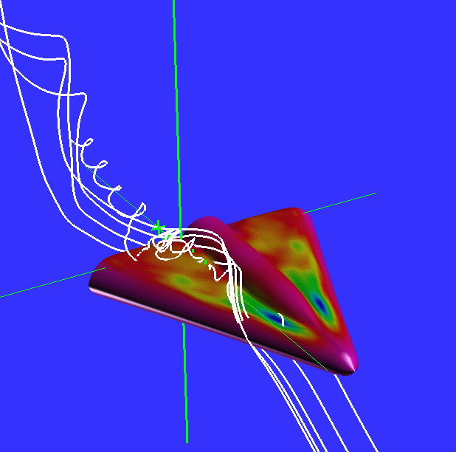
Stream Lines
Mathematically, stream lines are lines everywhere tangential to the flow
For a steady flow
What is the relation between stream lines and particle traces?
A curves that connect all the particle positions
stream lines

Slide 43
Streamlines
Displaying streamlines is a local technique because you can only visualize the flow directions initiated from one or a few particles
When the number of streamlines is increased, the scene becomes cluttered
You need to know where to drop the particle seeds
Streamline computation is expensive

Slide 44
Rendering Streamlines
In 3D, curves are hard to understand without depth cues
Ideas used include:
stream ribbons - each streamline drawn as a thin flat ribbon, showing twist; or two adjacent streamlines connected into ribbon, showing twist and divergence
tubes

Slide 45
Unsteady Flow Visualization
Recent research interest has been in the more complex case of unsteady flows, where velocity depends on time
Particle traces, streak lines and time lines can all be used
Streak lines seem to give the best results

Slide 46
Flow Visualization - Texture Effects
A new class of image-based methods attempts to visualize flow as a texturing effect
Most successful for 2D flow - and also for flow over surfaces in 3D
Methods include:
spot noise
line integral convolution - lic

Slide 47
Pathlines, Timelines, and Streaklines
Extension of streamlines for time-varying data
Pathlines:
Timelines:
Release a line of particles at same instant and draw a curve through the positions at successive time intervals
T=1
T=3
T=4
T=2
T=5
timeline
T = 1
T = 2
T = 3

Slide 48
Streaklines
Continuously injecting a new particle at each time step, moving all the existing particles and connect them together into a streakline.
release continuous flow of particles for a short period
b.t. =2
b.t. =1
b.t. =3
b.t. =4
b.t. =5

Slide 49
Global techniques
Display the entire flow field in a single picture
Minimum user intervention
Example: Hedgehogs (global arrow plots)

Slide 50
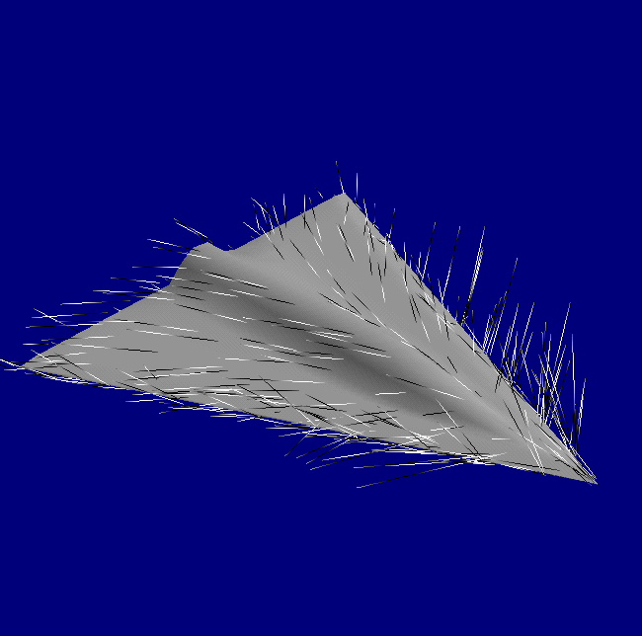
Hedgehogs
Dense 2D fields or 3D fields are difficult

Slide 51
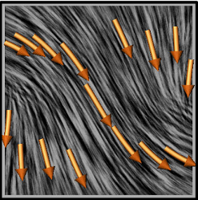
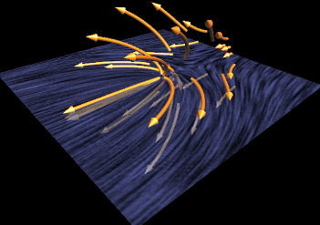
Vector Field Clustering
Simplified Representation of Vector Fields
Dimensions: 3D, Steady
Concept:
a hierarchical clustering based method which presents a suggestive overview of vector fields
Implementation:
Bottom-up fashion
Merger driven by similarity error metric
Interaction

Slide 52
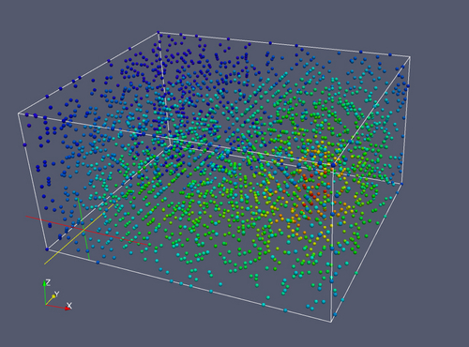
Comparison: Scalar vs. Vector visualization
Scalar data in 3D: As points

Slide 53
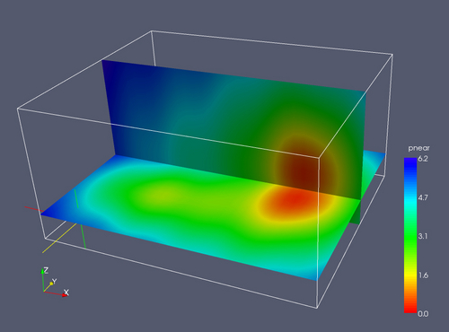
Comparison: Scalar vs. Vector visualization
Scalar data in 3D: Cutplanes

Slide 54
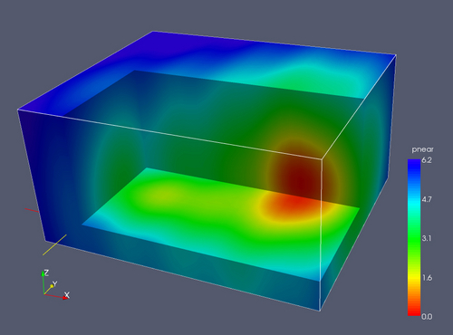
Comparison: Scalar vs. Vector visualization
Scalar data in 3D: Regions of interest

Slide 55
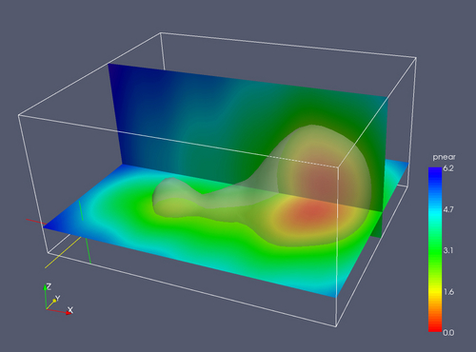
Comparison: Scalar vs. Vector visualization
Scalar data in 3D: Iso-surfaces

Slide 56
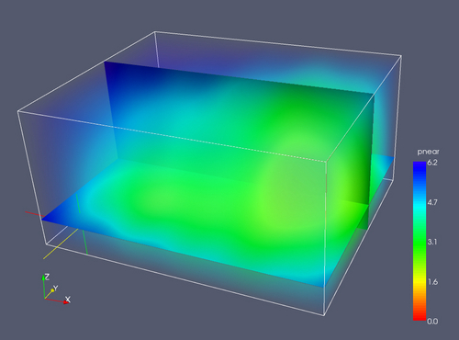
Comparison: Scalar vs. Vector visualization
Scalar data in 3D: Volume visualization

Slide 57
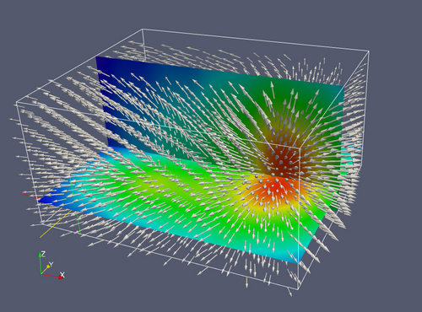
Comparison: Scalar vs. Vector visualization
Vector data in 3D: Vector glyphs

Slide 58
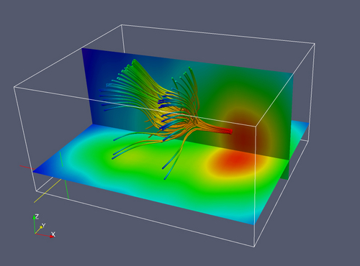
Comparison: Scalar vs. Vector visualization
Vector field: Streaklines

Slide 59
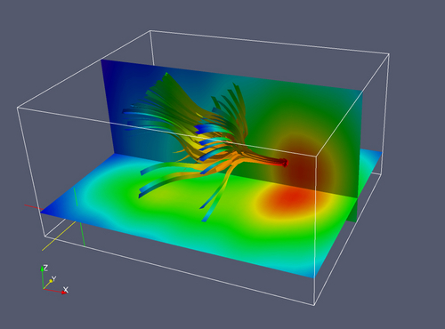
Comparison: Scalar vs. Vector visualization
Vector field: Ribbons

Slide 60
Technique: Vector field ribbons
Notes:
60

Slide 61

Texture-based Visualization
A new class of image-based methods attempts to visualize flow as a texturing effect
Dimensions: 2.5D, Unsteady
Concept
Dense and coherent representations for unsteady flow on surfaces
Implementation:
Most successful for 2D flow - and also for flow over surfaces in 3D
Project vector field to image space
Advection mesh is distorted according to pathlines
Texture is distorted and attached based on the distorted mesh
Blend noise in image space
Methods include:
Spot noise
Line integral convolution (LIC)

Slide 62
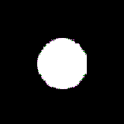
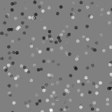
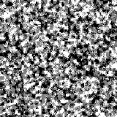
Spot Noise for Flow Visualization
Spots of random size and intensity drawn in a plane give a texture effect
one spot
many spots
spot texture
Texture defined as an intensity function f:
f( x ) = ∑ a_{i} h( x - x_{i} )
where x_{i} is random position, a_{i} is random scale (zero mean), and h is the spot function - zero everywhere except for small area (here circular)

Slide 63
Spot Noise for Flow Visualization
Different textures result from different spot shapes
Aligning the shape of the spot with the direction of flow gives a good visualization effect
In direction of flow, scale proportional to ( 1 + |v | ) , |v| = velocity magnitude
At 90°to flow, scale proportional to 1 / (1 + |v|)

Slide 64
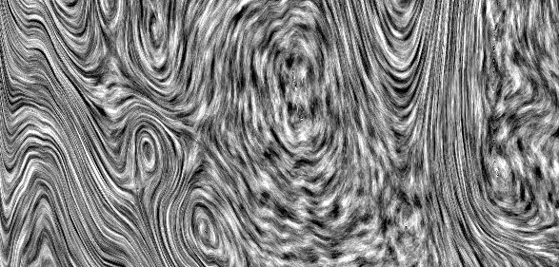
Spot Noise Example

Slide 65
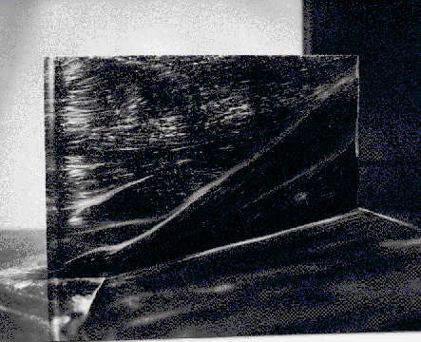
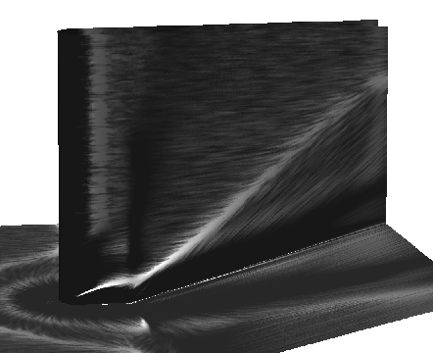
Flow Over a Surface
Numerical simulation
of flow, visualized
using spot noise
Wall friction displayed
using oil and paint - wind
evaporates oil and paint
leaves white traces

Slide 66
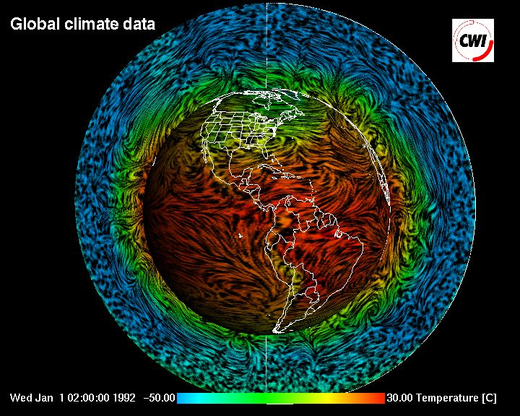
Spot Noise Example

Slide 67
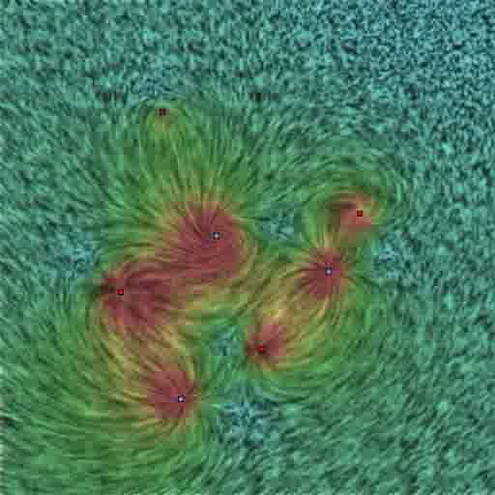
Spot Noise Movie

Slide 68
Line Integral Convolution (LIC)
It is a technique proposed by Brian Cabral and Leith Leedom to visualize fluid motion.
Compared with simpler integration-like techniques, where one follows the flow vector at each point to produce a line, it has the advantage of producing a whole image at every step.
How ?
Intuitively, the flow of a vector field is visualized by adding a random static pattern of dark and light paint sources.
As the flow passes by the sources each parcel of fluid picks up some of the source color, averaging it with the color it has already acquired.
The result is a random striped texture where points along the same streamline tend to have similar color.

Slide 69
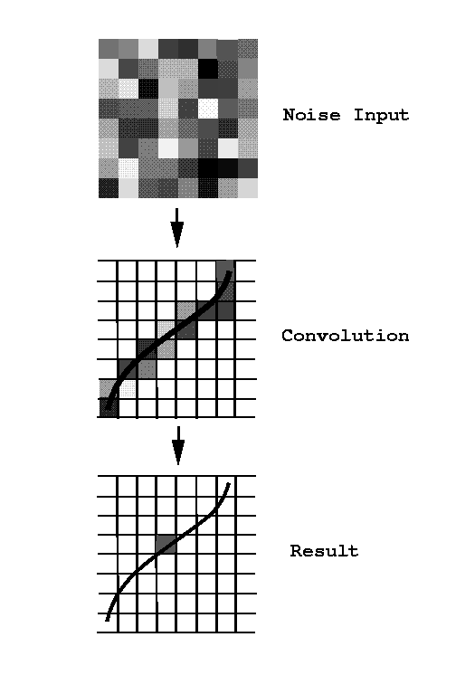
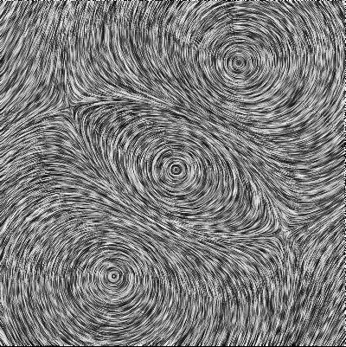
Line Integral Convolution (LIC)
Essence of method is:
Consider a white noise texture, T(x,y)
for each pixel, set its intensity as a function (e.g. average) of values of T along a short streamline segment through the pixel
This has effect of correlating the resulting pixel values along streamlines, so a sense of the flow direction is obtained.

Slide 70
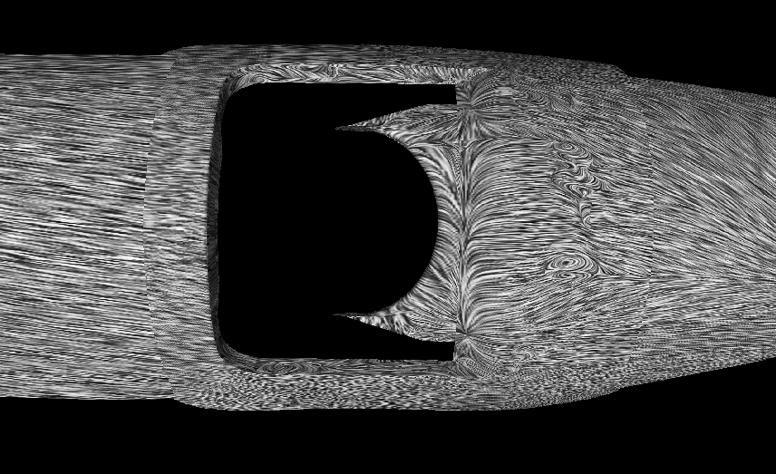
LIC Example

Slide 71
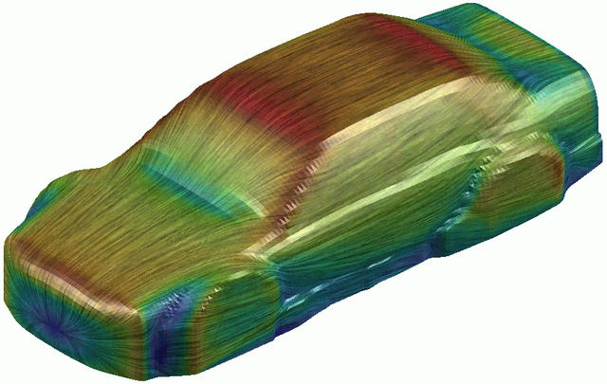
LIC Example
Flow over surface of car - from CIRA, Italy
Italian Aerospace Research Centre

Slide 72
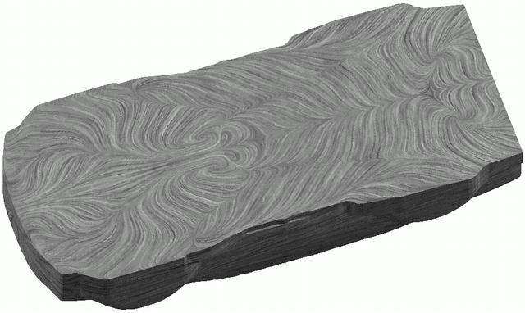
LIC Example
Flow underneath car - from CIRA, Italy

Slide 73
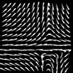
LIC Developments - Oriented LIC
Original LIC shows direction of flow but not orientation (i.e. -> or <- )
Oriented LIC uses a sparse texture and a weighting of samples along streamline to give orientation effect

Slide 74
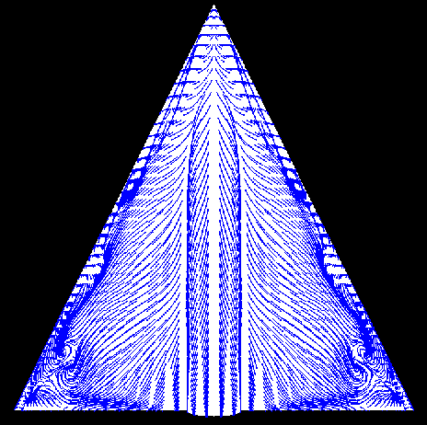
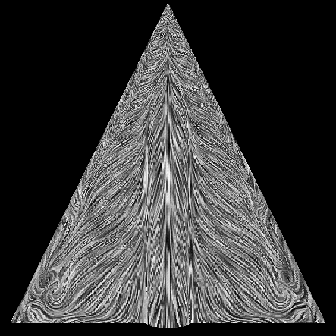
Comparison (LIC and Streamlines)

Slide 75
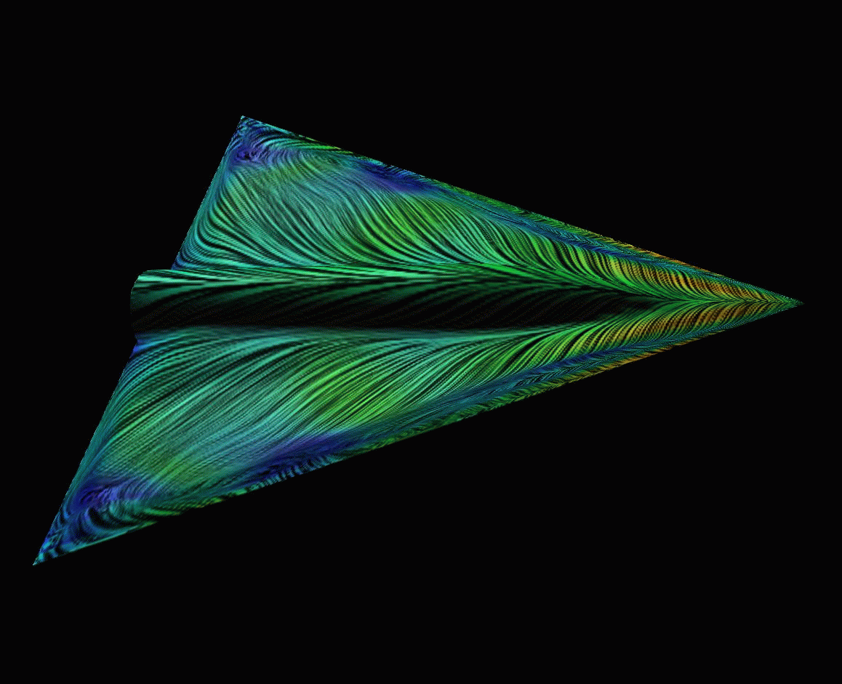
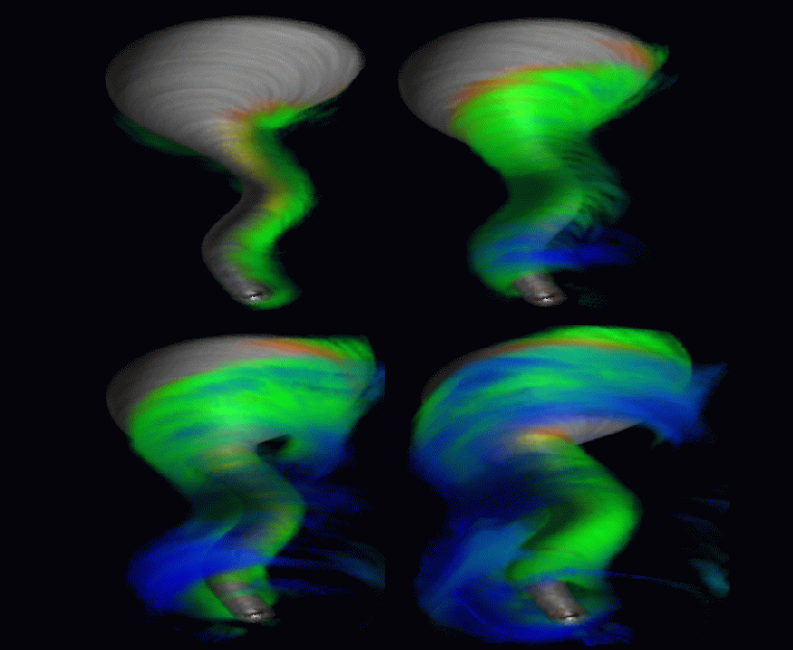
LIC on 3D surfaces and volumes

Slide 76
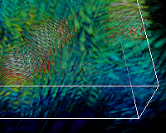
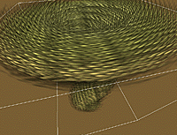
Texture Splats

Slide 77
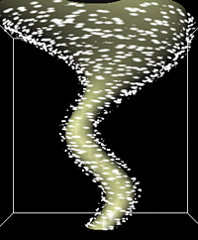
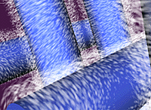
Spot Noise

Slide 78
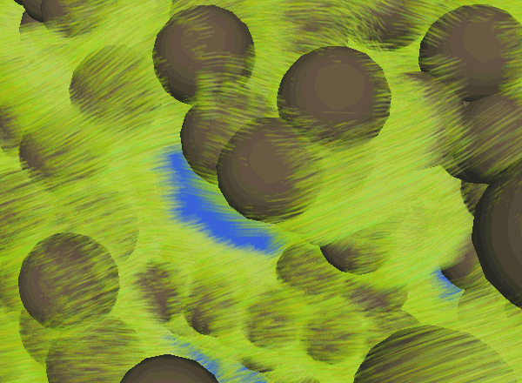
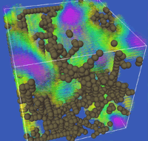
Line bundles

Slide 79
Vector Field Topology
This approach aims to visualize only the significant features of a flow field
It identifies critical points
points where velocity magnitude is zero
point of repulsion, attraction or a saddle point
streamlines from critical points divide space into regions of similar behaviour

Slide 80

Planar Topology
Planar topology of a VF is simply a graph with the critical points as nodes and the separatrices as edges. e.g.:

Slide 81
Poincaré Index
Another topological invariant
The index (a.k.a. winding number) of a critical point is number of VF revolutions along a closed curve around that critical point
By continuity, always an integer
The index of a closed curve around multiple critical points will be the sum of the indices of the critical points

Slide 82
Poincaré Index
The index around no critical point will always be zero
For first order critical points, saddle will be -1 and all others will be +1
There is a combinatorial theory that shows:

Slide 83
Three Dimensions
In 3D, we classify critical points in a similar manner using the 3 eigenvalues of the Jacobian
Broadly, there are 2 cases:
Three real eigenvalues
Two complex conjugates & one real

Slide 84

Three Dimensions
Left-to-right: Nodes, Node-Saddles, Focus, Focus-Saddles
Top: Repelling variants; Bottom: Attracting variables
Left-half: 3 real eigenvalues; Right-half: 2 complex eigenvalues
Images: Saddle Connectors – An approach to visualizing the topological skeleton of complex 3D vector fields, Theisel, Weinkauf, Hege, and Seidel

Slide 85

Three Dimensions
Separatrices now become 2d surfaces and 1d curves.
Thus topology of first-order critical points will be composed of the critical points themselves + curves + surfaces
Images: Saddle Connectors – An approach to visualizing the topological skeleton of complex 3D vector fields, Theisel, Weinkauf, Hege, and Seidel

Slide 86
Attachment and Detachment Points
There are also critical points along surfaces, where streamlines start (detachment points) or end (attachment points)
The flow field topology is produced by:
identifying critical points
drawing streamlines from detachment or attachment points and saddles (4 from saddles)... to repulsors and attractors
drawing streamlines to/from critical points that exit boundary

Slide 87

Flow Topology on Surface

Slide 88


Slide 89
Questions ?

