Slide 1
Science Visualization
Scalar Visualization Techniques : Part 2

Slide 2
Clipping

Slide 3
Clipping to See Inside
Obscuring critical information contained in a volume data
Contour displays show only exterior visible surfaces
Iso-surfaces can hide other iso-surfaces
Other displays can become crowded and complicated
Clipping
remove a part of a volume to observe the rest of its contents
cut away part of a volume to see what is behind it
intersection between a slicing plane and a volume dataset
also intersection of any surface with a volume dataset

Slide 4
Clipping to See Inside
Different approaches:
Planar clipping
Interactive clipping
Volume clipping
Planar Clipping
A 3D model is cut by a clip or slicing plane
It is performed by evaluating each volume element against the boundary of the half-space
If inside the half-space, display the element
If outside the half-space, discard the element
If partially contained in the half-space, check and display the face of the element
Notes:
Planar clipping: If a face is partially contained in the half-space, test for subpolygons

Slide 5
Clipping with Caping
Clip the model with a display of the scalar result on the clip surface
The caped surfaces are produced by generating additional display polygons for each volume element in the cutting region
Clipping alone can be performed in graphics hardware
Polygon clipping on a polygon-by-polygon basis in hardware
Capping must be performed in the software
Requires knowledge of the entire volume element to interpolate vertex values to form the capping polygon and its scalar values

Slide 6
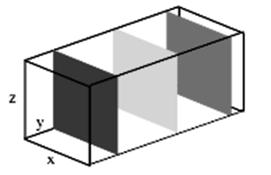
Sampling Planes
Combining two or more volume slicing operations with a wire-frame outline of the model
Allows a simultaneous display of scalar results at multiple locations within the volume

Slide 7
Interactive Clipping
A planar clipping used in an interactive manner
Once the clip plane is defined, it’s position and orientation can be changed in real time in order to cut away the given volume at any orientation and any position.
Clip plane equation
Ax + By + Cz + D = 0
All points with eye coordinates (x_{e}, y_{e}, z_{e}, w_{e}) that satisfy (A B C D)M⁻¹(x_{e}, y_{e}, z_{e},w_{e})T >= 0 lie in the half-space defined by the plane, where M is the current model-view matrix.
All points not in this half-space are clipped away.
Notes:
Initial plane is parallel to the z-axis:
A = y₂- y₁; B = -(x₂ – x₁); C = 0; D = 0
Coefficients A, B and C control rotation of the clip plane in a 3D space whereas the coefficient D controls translation.

Slide 8
Best View Mode
Dynamic manipulation of the clip plane
Small effective visible area of the clipped surface
Done in low-resolution mode for interactivity
Bringing to the best view mode
Clipped surface at its maximum exposure
Rendering at high resolution
Automated option for best-view mode
Tracking all transformations the clip plane has gone through
Simple case of initial xy plane setting:
First rotation about z-axis
Second rotation about the vector which is defined by the intersection of the clip and xy planes.

Slide 9
Rendering
Texture-based volume rendering
A stack of 2D textures (generated form the input data or images)
Multi-resolution rendering
High-resolution (HR) mode
The original fine grid of the input data or the original resolution of the input images
Low-resolution (LR) mode
The re-sample data at a lower resolution than the original resolution

Slide 10
Rendering
Rendering speed
LR gives a much better frame rate but HR retains complete information contained in the data.
Interactivity
Navigate through the volume data in LR and switch to HR for quality

Slide 11
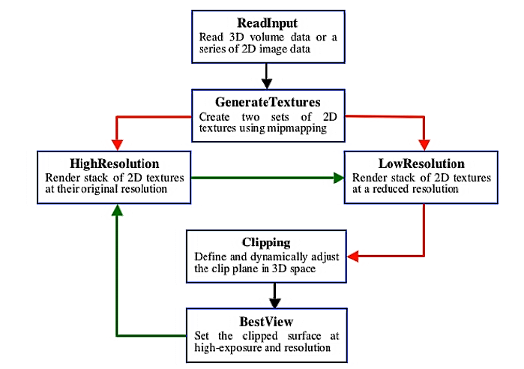
Flow Diagram

Slide 12
Charge Density
Example: Quantum mechanical simulations
MgO system
64 atoms and 864 electrons
Data defined on 5123 regular grid
HR rendering (bottom)
512 textures each with 512x512 pixel;
4 frames per seconds
LR rendering (top)
128 textures at 128x128 resolution
35 frames per second

Slide 13
Charge Density
Electrons are depleted from blue regions whereas electrons are deposited in red regions due to a vacancy defect located at the center of the system.

Slide 14
Confocal Data
Confocal data:
Tissues of a plant stem
A series of tiff images
HR rendering (bottom)
200 textures each with 512x512 pixel;
0.6 frames per seconds
LR rendering (top)
50 textures at 128x128 resolution
28 frames per second

Slide 15
Confocal Data
Twenty-five images (each with 512 x 512 pixels) were replicated to generate 200 images used in HR.

Slide 16
Volume Clipping
Using complex geometries for volume clipping
Cutting a cube-shaped opening into a volume
Segmentation information used for defining curved clip geometries
Iso-surface as clip object
Surface of a body in fluid dynamics
Clipping tailored to texture-based rendering on graphics hardware
Use per-fragment operations
Give interactivity (high frame rates)
Two clipping techniques
Depth-based clipping
Voxelized clip object

Slide 17
Depth-Based Clipping
Depth structure of a clip object
Clip geometry represented as a tessellated boundary surface
in the form of triangular meshes
Graphics hardware allows manipulation of depth values
To clip away unwanted parts of the volume
Produces high-quality images
Uses 2D textures with texels having a one-to-one correspondence to pixels
Clipping is performed with per-pixel accuracy

Slide 18
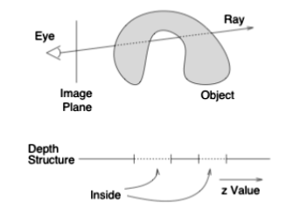
Building Depth Structure
Define depth structure (1 D representation) of a clip object for a single pixel in the frame buffer
Consider a single ray from eye point to the scene
Apply operations on those fragments that correspond to the respective position of the pixel in the frame buffer

Slide 19
Building Depth Structure
Build the depth structure per pixel basis
Stores the depth values for each boundary between object and background space
Classify intervals as inside or as outside of the clip object and specify them as visible or invisible
Rendering of each fragment of a volume slice has to check to which class of interval the fragment belongs
Based on visibility property, the fragment is blended into the frame buffer or clipped away.

Slide 20
Implementation Issues
Depth structure stored on a per-pixel basis
Exploits the depth buffer to store interval boundaries.
Only a single boundary can be implemented because only one depth value can be stored per pixel.
Depth test to decide the visibility property of a fragment less - clip away the volume behind the geometry greater - clip away the volume in front of the clip geometry.
How to handle multiple depth values corresponding to a pixel.
Implementation with OpenGL.

Slide 21
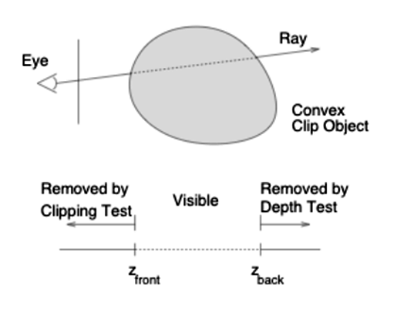
Volume Probing
Depth structure with two boundaries (for convex clip geometry)
Depth tests, depth clipping, and depth computations in the fragment-operations unit
Volume probing: Leaves visible only the volume inside the clip object

Slide 22
Volume Probing
Basic algorithm
Determine ‘z_front’ by rendering the front faces of the clip geometry into the depth buffer
The contents of the depth buffer are stored in a texture and are later used to shift the depth values of all fragments in the following rendering passes by ‘–z_front’
The depth buffer is cleared and the backside of the clip geometry is rendered into the depth buffer (with depth shift enabled) to build the secondary boundary.
Slices through the volume data set are rendered and blended into the frame buffer.
Depth shift and depth testing are enabled, but the depth buffer is not modified.

Slide 23
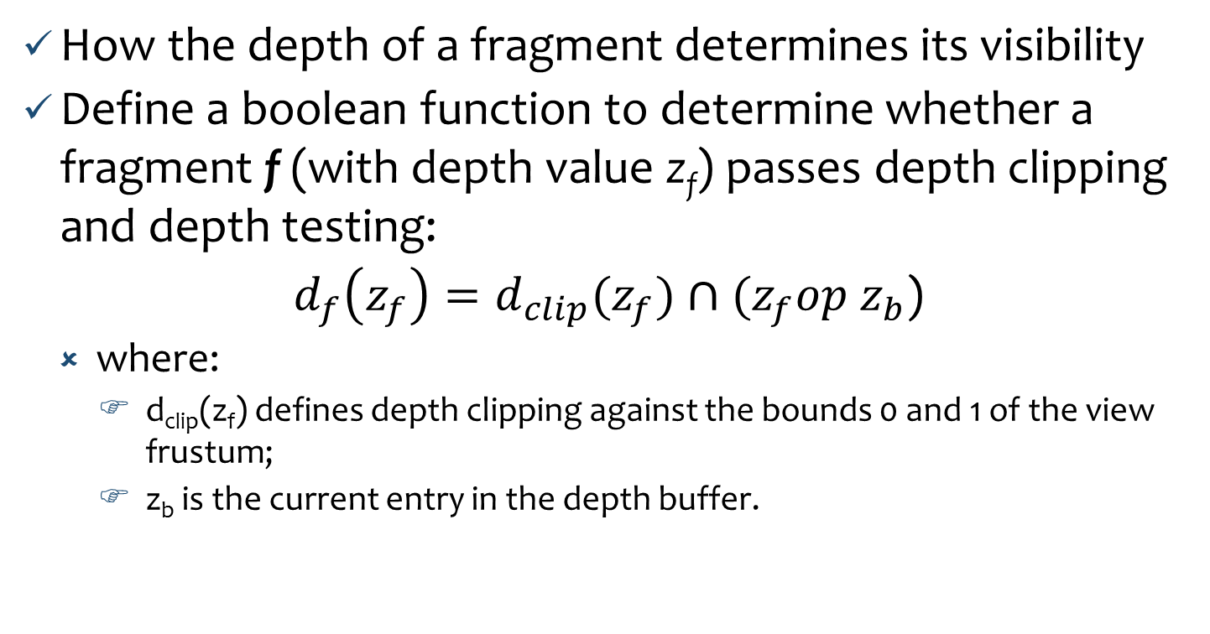
Probe Depth Function
How the depth of a fragment determines its visibility
Define a boolean function to determine whether a fragment f (with depth value z_{f}) passes depth clipping and depth testing:
$d_{f}\left(z_{f}\right)=d_{clip}(z_{f})∩(z_{f}op z_{b}$)
where:
d_{clip}(z_{f}) defines depth clipping against the bounds 0 and 1 of the view frustum;
z_{b} is the current entry in the depth buffer.

Slide 24
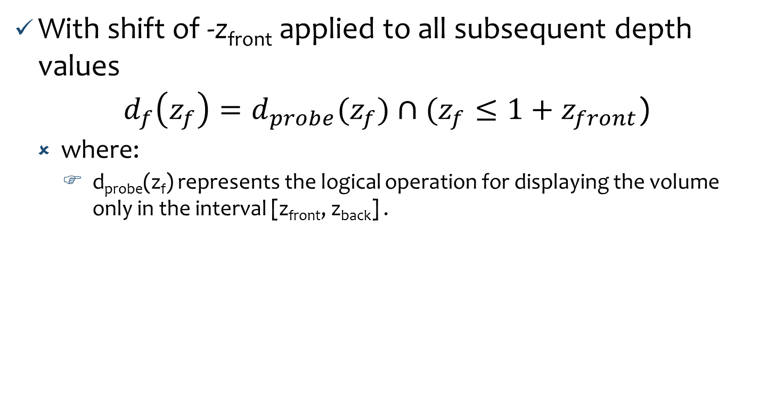
Probe Depth Function
With shift of -z_{front} applied to all subsequent depth values
$d_{f}\left(z_{f}\right)=d_{probe}(z_{f})∩(z_{f}≤1+z_{front}$)
where:
d_{probe}(z_{f}) represents the logical operation for displaying the volume only in the interval [z_{front}, z_{back}] .

Slide 25
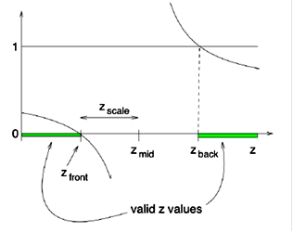
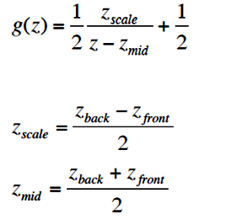
Volume Cutting
Only the volume outside the clip object remains visible
Invert the role of visibility property
Logical operation for volume cutting:
Inverse depth function:

Slide 26
Clipping Based on Volumetric Texture
Clip object is voxelized and represented by an additional volume data
Uses a second volumetric texture to specify clipping voxels of the real volume any arbitrary objects (convex or concave)
Store voxelized clip geometry as a binary volume
Voxel inside (1) or outside (0) the clip geometry
Rendering maps a texture slice of the data set and a slice of the clip texture onto the same slice polygon
Two textures are combined using a per-component multiplication
All voxels to be clipped are multiplied by zero and completely discarded

Slide 27
Clipping Based on Volumetric Texture
The clip object can be rotated or translated by applying any affine transformation to texture coordinates.
A change in volume probing and volume cutting by applying a per-fragment invert mapping to the clipping textures.

Slide 28
Texture-Based Visualization

Slide 29
Texture Mapping Techniques
Exploiting graphics hardware to perform volume
rendering
Graphics Processing Unit (GPU): increasing processing power and flexibility
Two major approaches:
2D texture mapping
Uses stacks of textured slices to represent the volume
3D texture mapping
Use a single three-dimensional texture to represent the volume.

Slide 30
Basic Steps
Upload the whole volume to the graphics hardware as textures
A stack of 2D textures
A single 3D texture
Make the textured slices are either object-aligned or view-aligned
Store three stacks of slices, one stack for each major viewing axis, and choose one most parallel to the current viewing direction
Map 3D texture onto polygons parallel to the viewing plane

Slide 31
Basic Steps
Render a number of partially transparent slices in front-to-back or back-to-front order using alpha bending
More efficient than raycasting
Entire 2D slice of the voxels are “cast” at one time rather than each image pixel built up ray by ray.

Slide 32
Object-Aligned Slices
Used in combination with 2D textures
Every slice represents one volume voxel slice
Image quality is best when the slices are parallel to the view plane
Store 3 stacks of textures representing the main view directions and display only the slice stack that is most parallel to the current viewing direction
Hardware does bilinear interpolation in a 2D texture resulting in fast rendering
Supersampling is not possible: opacity changes with rotation.

Slide 33
Object-Aligned Slices
Multitexture slices
Produce intermediate slices by blending together the 2 neighboring textures with position inside the 2 slices as blending factor
Make supersampling possible.

Slide 34
View-Aligned Slices
Used with one 3D texture representing the volume
Slices can be stacked along an arbitrary direction
Ø The slices stay parallel to the view plane while the volume texture is rotated
Image quality is independent of the viewing direction
Trilinear interpolation can be used
Opacity stays constant
Supersampling is possible.

Slide 35
Blending: Over and Under
Over
Most common way: back-to-front rednering.
Approximates the flow of light through a colored, translucent material
Texels with higher alpha values tend to obscure texels behind them
Under
Volume slices rendered front-to-back with the under operator gives the same result as the over operator blending slices from the front

Slide 36
Blending: Attenuate and MIP
• Attenuate
Simulates an X-ray of material
Texel’s alpha attenuates light shinning through the material along the view direction towards the viewer
Final brightness at each pixel is attenuated by the total texel density along the direction of view
MIP
MIP: Maximum Intensity Projection
Finds the brightest texel alpha from all the texture slices at each pixel location
Acts like a contrast enhancing operator

Slide 37
Sampling Frequency
A number of factors to consider in deciding the number of slices (data polygons) for rendering the volume
2D versus 3D textures
2D textures are constrained in a plane while 3D textures can sample data along any direction
Performance
Interactive and details modes for viewing the volume
Cubical voxels
Uniform sampling (texture sampling rate from slice to slice = texture sampling rate within each slice)

Slide 38
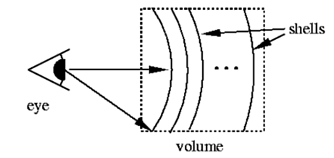
Sampling Frequency
Non-linear blending
Rescale the alpha values of data if the number of slices used to render the volume changes
Perspective
Increase the density of slices with distance from the viewer
Flat versus Spherical Slices
Use spherical slices to get good close-ups of the data
Spheres are centered at the eye-point
Tessellate the spheres finely enough to avoid concentric shells from touching each other

Slide 39
Shrinking the Image
Best visual quality
Render the volume image so that the size of a texel is about the same size of a pixel
Reducing the volume size will cause the texel data to be sampled into a smaller area
The smaller image can have density artifacts that are not in the original volume data
Better first render the image full size in the desired orientation and then shrink the resulting 2D image.

Slide 40
Virtualizing Texture Memory
Volume data does not have to be limited to the maximum size of the texture image
Divide the data volume into a set of smaller “bricks”.
Each brick is loaded into texture memory, then data slices are textured and blended from the brick
Bricks can be processed from back-to-front order
The process is repeated until the entire volume is loaded.
Transfer Functions
To highlight particular classes of volume data
If lookup tables are not available, the processing can be done to the volume data by the application before loading the volume.

Slide 41
Shading Textured Volume
Data can be lit and shaded
Lighting needs to be computed per volume texel
Two approaches:
Shading done on the host before you load the data as texture
Shading done while the texture being loaded
Interactive computation of data’s gradient vectors can be done.

Slide 42
Shading Textured Volume
Shading with texture:
Transform the texel data using the color matrix extension
Save the components of the gradient vectors as color components in the texture
Lighting can be done while the data is being visualized using three matrices
Light direction matrix, color matrix, and texture color matrix
Take dot product between the light and normal
Color matrix is a part of the pixel path so the calculations are done in the pixel pipeline

Slide 43
Transforming Textured Volume
Clipping
Additional surfaces can be created on the volume with user defined clipping planes.
A clipping plane can be used to cut through the volume, exposing a new surface.
Warping
Data volume can be warped by non-linear shifting the texture coordinates of the data slices.
Tessellate the vertices to provide more vertex locations to perturb the texture coordinate values.

Slide 44
Transforming Textured Volume
Including geometric objects
Opaque objects are rendered along with the volumetric data slice using depth buffering for both.
Pixels on the data planes behind the object are not rendered
Planes in front of the object blend the object in; this blending gradually obscure the object, making it appear embedded in the volume data
Transparent objects must be rendered a slice at a time
Chopping the object into slabs using user defined clipping planes
Slab thickness corresponds to the spacing between the volume data slices.

Slide 45
Skipping Invisible Voxels
Two types of invisible voxels
Empty voxel (with fully transparency)
Occluded voxel (lying behind other voxels)
How to skip such voxels in texture-based rendering
Partition a volume dataset into sub-volumes based on similarity of voxels
Consider volume domain (position) and transfer function domain (densities and gradient magnitudes)
Subdivide the texture space into an octree
Use texture hulls (of any shape) of all connected non-empty regions
Growing boxes (can be represented as orthogonal BSP tree)

Slide 46
Skipping Invisible Voxels
Skip subvolumes containing transparent voxels for rendering
Cull or clip occluded voxels with orthogonal opacity map updated from the contents of the frame buffer during rendering
Confocal 2D images

Slide 47
3D Construction
Load individual 2D images and stack them one above the other
A third dimension is thus added along the direction of stacking to get 3D data
Two ways for 3D reconstruction:
Texture-based
Each slice an individual texture object
All slices together as a 3D texture object
Pixel-by-pixel
Each slice is treated as an array of pixels.

Slide 48
Volume Rendering

Slide 49
Volume Rendering vs. Other Techniques
Volume rendering:
Creates a 2D image directly from 3D volumetric data
Mapping the entire 3D data into a 2D image
Volume images retain full information at the cost of increased algorithm complexity and rendering times
Rendering of amorphous phenomena such as clouds, fog
Surface rendering:
Creates an image of a surface contained within the volume data using geometric primitives
Triangles or points
Clipping:
Removes a part of a volume to display the rest of the contents
Applicable with volume or surface rendering.

Slide 50
Volume Rendering Techniques
Object-order technique
Uses a forward mapping scheme where the volume data is mapped into the image plane
Splatting
Image-order technique
Uses a backward mapping scheme where rays are cast from each pixel in the image plane through the volume data to determine the pixel value
Ray casting, Volume buffer
Hybrid technique
Combines the two approaches
Cell-by-cell V-buffer, Shear-warp

Slide 51
Splatting

Slide 52
What is Splatting?
Object-order rendering: Forward mapping algorithm that maps data samples onto the image plane
Splatting considers how a sample can contribute to many points in space, and hence to many pixels in the image plane in terms of a distribution function
Distributes energy from input samples into space
Calculates an image plane footprint for each data sample and uses the footprint to spread the sample’s energy onto the image plane
Works for regular grid with/out the same spacings in all directions
Can be parallel.

Slide 53
Basic Four Steps
Transforming sample from input <i,j,k> grid space to <x,y,z> screen space
Shading sample using some shading rule: <x,y,z,R,G,B,A>
Reconstruction step: Determine the portion of the image the sample can affect and add the sample’s contribution to the sheet accumulator
Defining and computing footprint function
Every data sample is convolved with a reconstruction kernel to produce the image of this data sample.

Slide 54
Basic Four Steps
Visibility: Matt the sheet accumulator to the working image using a compositing operator when all samples that lie in a sheet are processed
Once all samples are processed, the working image becomes the final image.

Slide 55
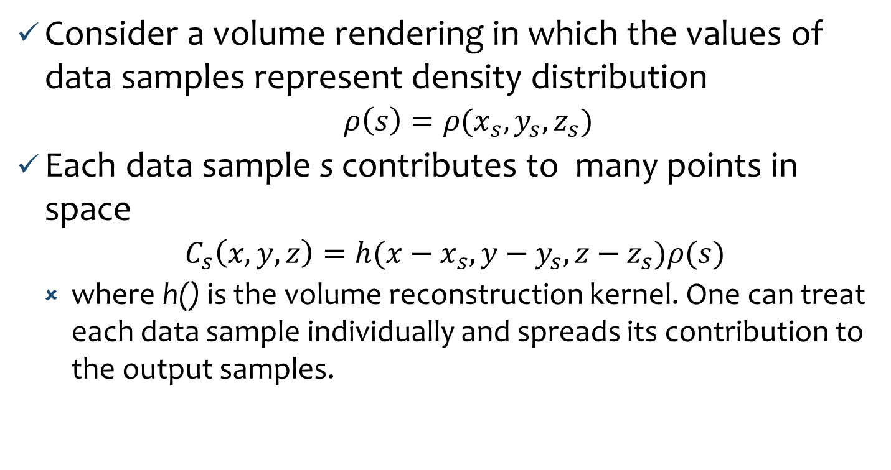
Contribution of a Voxel to Image Plane
Consider a volume rendering in which the values of data samples represent density distribution
$ρ\left(s\right)=ρ(x_{s},y_{s},z_{s})$
Each data sample s contributes to many points in space
$C_{s}\left(x,y,z\right)=h(x−x_{s},y−y_{s},z−z_{s})ρ(s)$
where h() is the volume reconstruction kernel. One can treat each data sample individually and spreads its contribution to the output samples.

Slide 56

Contribution of a Voxel to Image Plane
Contribution of sample s to an image plane pixel p->(x,y)
$I_{s}\left(p\right)=I_{s}\left(x,y\right)=ρ(s)\int_{−∞}^{+∞}{h\left(x−x_{s},y−y_{s},z−z_{s}\right)dw}$
where w is along a ray through the kernel that is perpendicular to the screen with its origin at <x,y>.

Slide 57
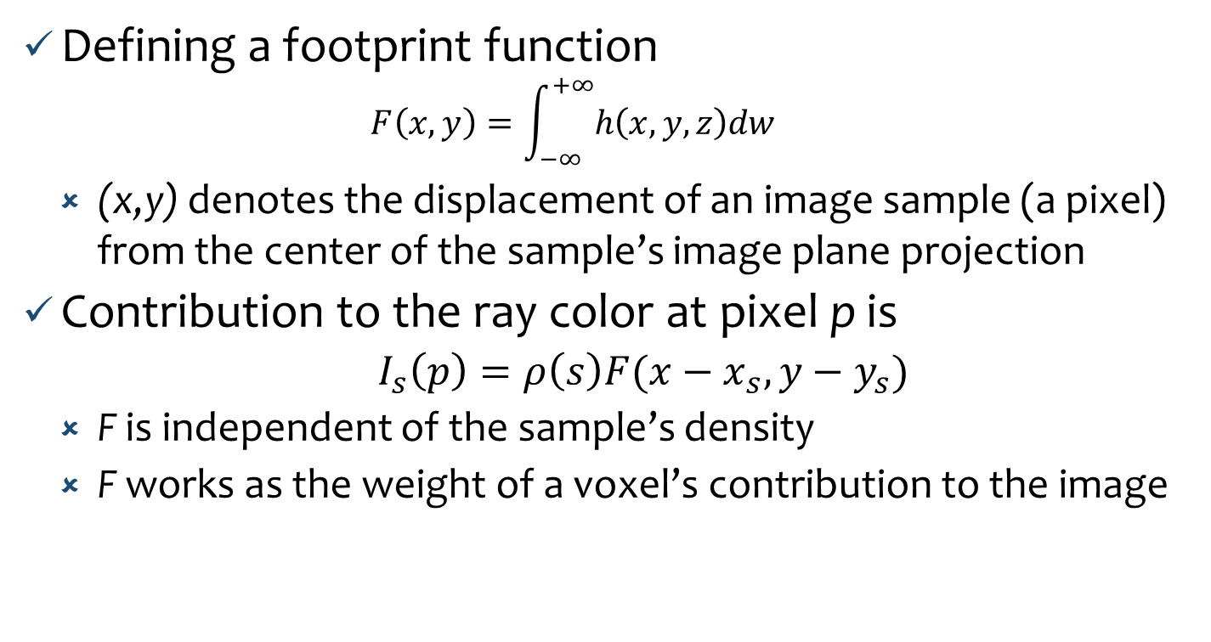
Splat Footprint
Defining a footprint function
$$F\left(x,y\right)=\int_{−∞}^{+∞}{h\left(x,y,z\right)dw}$$
(x,y) denotes the displacement of an image sample (a pixel) from the center of the sample’s image plane projection
Contribution to the ray color at pixel p is
$I_{s}\left(p\right)=ρ\left(s\right)F(x−x_{s}, y−y_{s})$
F is independent of the sample’s density
F works as the weight of a voxel’s contribution to the image

Slide 58
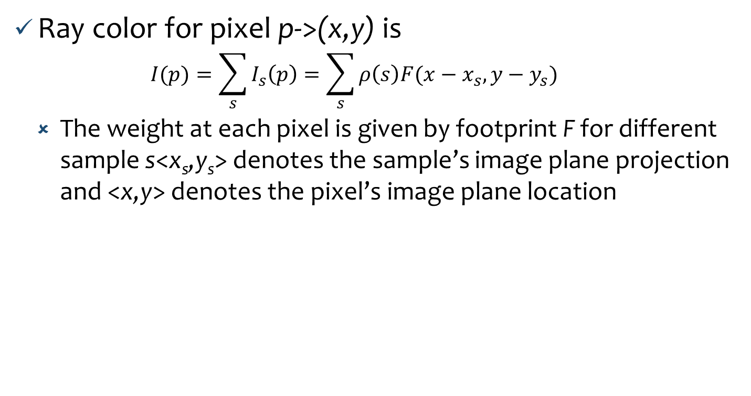
Total Contribution
Ray color for pixel p->(x,y) is
$$I(p)=\sum_{s}{I_{s}\left(p\right)=\sum_{s}{ρ\left(s\right)F(x−x_{s},y−y_{s})}}$$
The weight at each pixel is given by footprint F for different sample s<x_{s},y_{s}> denotes the sample’s image plane projection and <x,y> denotes the pixel’s image plane location

Slide 59
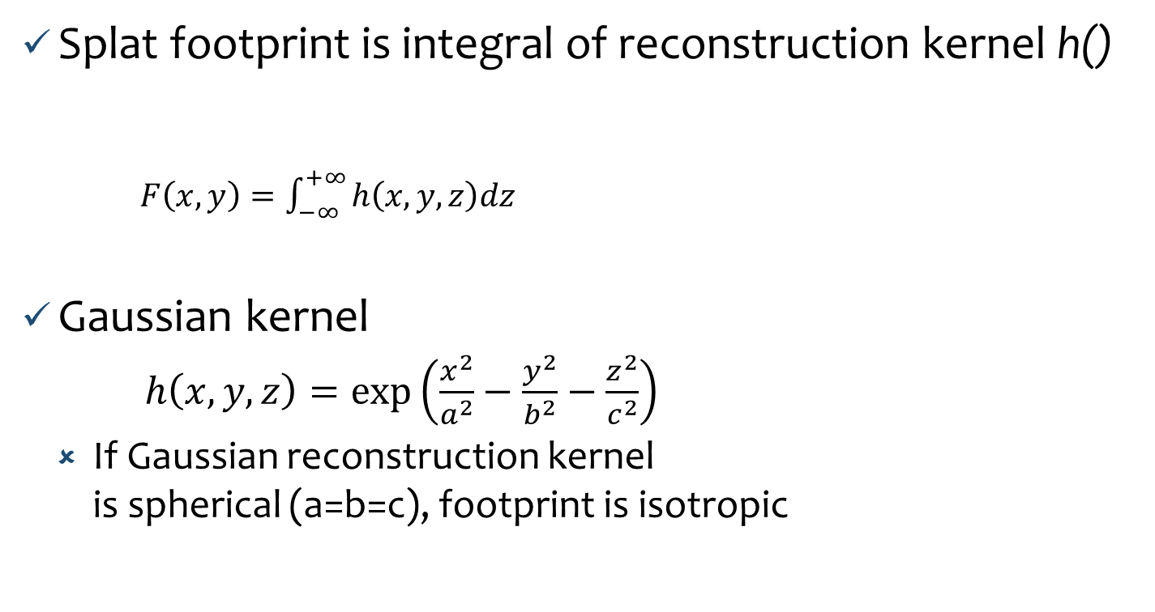
Reconstruction Kernel
Splat footprint is integral of reconstruction kernel h()
$F\left(x,y\right)=\int_{−∞}^{+∞}{h\left(x,y,z\right)dz}$
Gaussian kernel
$h\left(x,y,z\right)=\exp\left(\frac{x^{2}}{a^{2}}−\frac{y^{2}}{b^{2}}−\frac{z^{2}}{c^{2}}\right)$
If Gaussian reconstruction kernel is spherical (a=b=c), footprint is isotropic

Slide 60
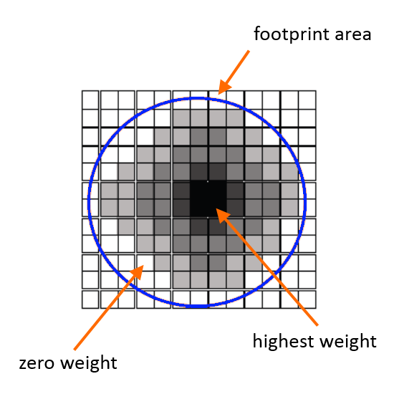
Footprint Table
Footprint can be computed analytically for some reconstruction kernels (such as Gaussian)
A footprint table can be generated with discrete integration
For orthographic projection, all voxels have the same footprint, except for an image space offset (x-x_{s},y-y_{s})
One footprint table is needed per view, and can be pre-computed and stored in a look-up table
View-transformed footprint table can be created from one generic footprint

Slide 61
View-Transformed Footprint Table
Calculate the screen space extent of the projection of the kernel
Map the view-transformed extent to an extent that surrounds the projection of a generic kernel (pre-computed)
Use the view-transformed table for each sample by centering the table at each sample’s projected screen position
Generic kernel is a sphere:
Two basic cases may result for extents and mapping
Sphere and ellipsoid

Slide 62
Spherical and Elliptical Kernels
A sphere results when the input volume has equal spacings along all grid directions and the viewing transform has only uniform scaling.
The sphere maps to circular footprint function.
An ellipsoid is more general then the spherical case.
It results if there is a difference in the scaling factors between the axis.
This ellipsoid maps to an elliptic footprint function.

Slide 63
Extent and Mapping
Calculate the offset and extent of each footprint.
T⁻¹ is the mapping that for each point X in the view-transformed footprint finds the point X’ in the generic footprint.

Slide 64
The Graphics Pipeline
Generic footprint kernel (preprocess stage)
Find offset of the data point into the screen
Find all pixels in the extent of that footprint
For every pixel get the reverse mapping into the generic table
Accumulate the contributions to every pixel

Slide 65
Ray Casting

Slide 66
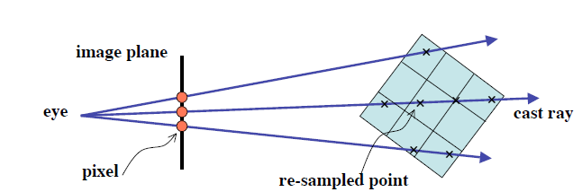
Ray Casting
Image-order rendering
We determine for each pixel on the image plane which data samples contribute to it
Ray casting is a rendering method that
Creates rays from the eye toward world objects
Determines the color of the ray using light transport information
Pixel color of the image is the color of the ray (passing through the pixel)
Rays typically do not spawned (only primary rays)

Slide 67
Projection Schemes
Use some specified scheme (also called a ray function) to process data encountered along the ray
Different schemes
Maximum value projection
Average value for the ray path
Distance to first voxel: of value at or above the given value
Composition technique: mapping scalar values on the ray path to various colors and opacity using transfer functions
Composite technique is most effective for volume rendering

Slide 68
Classification
Classify the relevant objects (or structures) of interest within a dataset
Map information (e.g., density) at a voxel location into different values such as material, color or opacity
This mapping function is called transfer function
Examples:
Ø Binary classification
0 - background (air)
1 - part of the object (bone)
Voxel density → optical properties (RGBA)
Classification based on scalar value and gradient magnitude

Slide 69
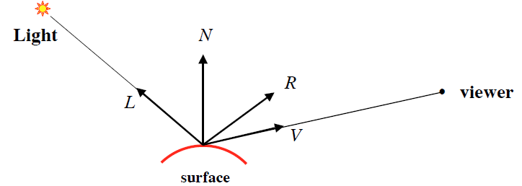
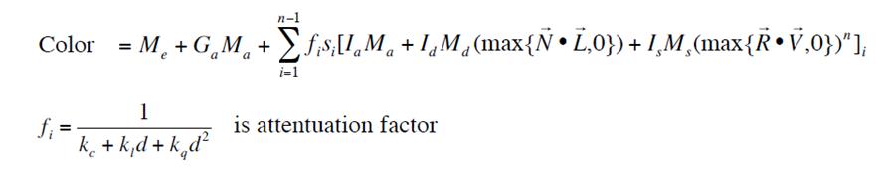
Volumetric Illumination

Slide 70
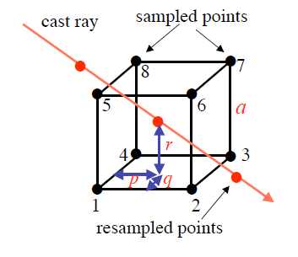
Interpolation
Traverse the data along a ray (parametric form)
(x,y,z)=(x₀, y₀, z₀)+(a,b,c)t
Need to sample the volume at uniform intervals
Trilinear interploation
Value at some location is defined by using linear interpolation based on distance along each of 3 axes

Slide 71
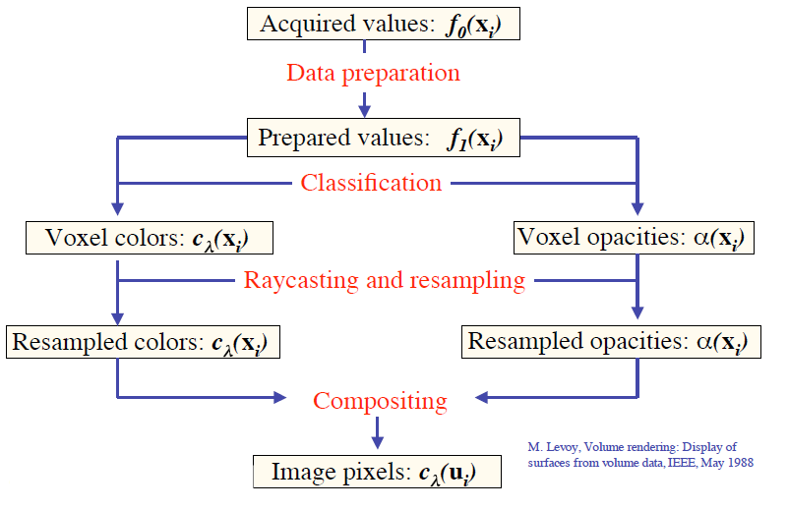
Levoy’s Method: Rendering Pipeline

Slide 72
Data Preparation
Begin with an array of acquired values f₀(x_{i}) at voxel locations x_{i} = (x_{i},y_{i},z_{i})
Make sure all grid points have data
Ø Fill the missing data by interpolation
Ø Corrections for nonorthogonal sampling grids
Remove noises (filtering, patient’s motion)
Enhance the contrast
Output is an array of prepared values, f₁(x_{i})

Slide 73

Illumination and Shading
A shading model provides illusion of smooth surfaces.
Phong model
where:
H is a half-vector between L and V

Slide 74
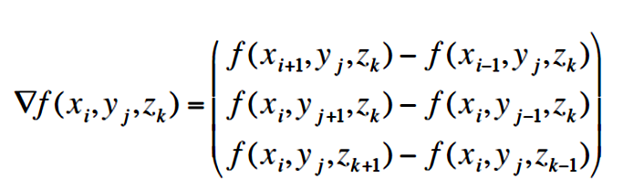
Illumination and Shading
Compute normal N(x) at voxel using central difference

Slide 75
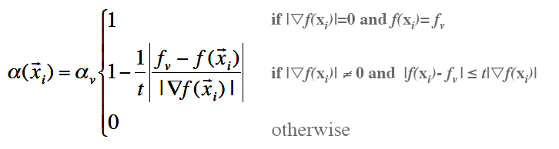
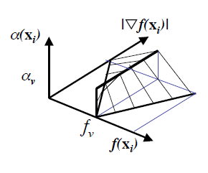
Classification Based on Isovalues
Assign an opacity α_{v} to voxels having selected value f_{v}, and zero opacity to all other voxels
Make the opacity fall off as you move away from the selected value at a rate inversely proportional to the magnitude of the local gradient vector

Slide 76
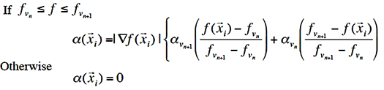
Classification Based on Boundaries
First map the voxel values of distinct regions to different opacities
Linearly interpolate the boundary regions between different regions
Enhance the boundaries using the gradient value

Slide 77
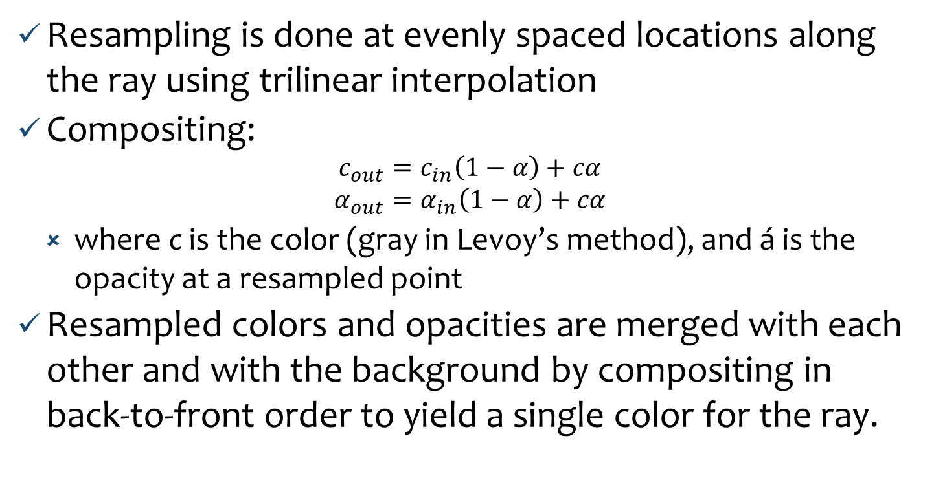
Resampling and Compositing
Resampling is done at evenly spaced locations along the ray using trilinear interpolation
Compositing:
$$c_{out}=c_{in}\left(1−α\right)+cα$$
$$α_{out}=α_{in}\left(1−α\right)+cα$$
where c is the color (gray in Levoy’s method), and á is the opacity at a resampled point
Resampled colors and opacities are merged with each other and with the background by compositing in back-to-front order to yield a single color for the ray.

Slide 78
Ray Casting V-Buffer
Ray casting method (Upson and Keeler, 1988)
Rays are cast from each pixel on the image plane into the volume
Each ray is stepped inside the cell, with calculations for scalar values, shading, opacity, etc., performed at each point
The process is repeated for each cell along the ray, accumulating color and opacity.
Computed colors can be stored in a buffer, called V-buffer
Z-buffer is 2D pixel array with depth value
V-buffer is an extension of 2D to 3D
V-buffer improves the performance because no need to re-compute the colors as the viewpoint moves.

Slide 79

Nodal Shading Function
Goal is not to provide a realistic image, but rather to provide an useful representation
A simplified shading model is used:
Omit the Phong term keeping only the ambient and diffuse term so lighting is independent of viewing direction
The diffusion coefficient is also varied with scalar value to highlight certain features in the final image
Accumulating along the ray gives the intensity or the pixel’s color.

Slide 80
Transfer Functions
Highlight three surfaces in the volume, one in red, one in green and one in blue

Slide 81
Example: Raycasting
The scalar values at eight vertices of the voxel of unit length (a=1) are
f₁=5.0, f₂=5.1, f₃=5.2, f₄=4.6
f₅=4.9, f₆=5.1, f₇=5.3, f₈=4.7
The ray is sampled at three points
P₁(0.2,0.3,0.8), P₂(0.5,0.5,0.5), P₃(0.8,0.7,0.2)
Color and opacity of the cast ray before it hits P₁ is (0,0,0,0)

Slide 82
Example: Raycasting
Find the color of the ray after it leaves P₃ by compositing from back-to-front order
Use trilinear interpolation to find the scalar values at P₁, P₂ and P₃
Use transfer functions (mapping) for the colors (RGB) and opacity (O)

Slide 83
Improving Ray Casting
Improvement approaches use one or more of the following principles:
Image-space coherency (M. Levoy).
Object-space coherency (T. van Walsum, et al.).
Inter-ray coherency (R. Yagel and A. Kaufman).
Inter-frame coherency (R. Yagel and Z. Shi).
Empty space skipping (M. Levoy).
Efficient memory access (S. Parker et al.).

Slide 84
Questions ?

