Slide 1
Science Visualization
Scalar Visualization Techniques

Slide 2
Scalar Dataset
Scalar data can be defined as
  Continuous field: f(x,y,z)
    Defined for all (x,y,z)
    Usually obtained as solution to a mathematically problem or by interpolating sampled data
  Sampled volume data: S = S(x,y,z)
    Defined only at particular points (x_{i},y_{j},z_{k})
    Most commonly on a cartesian grid
    Sample values are called voxels
    A cuboidal region with voxels at all 8 vertices is called a cell
    Each data element (cube or cell) often called voxel (volume pixel)

Slide 3
Scalar Dataset
Visualization of 1D, 2D, or 3D scalar fields
  – 1D scalar field: Ω ∈ R → R
  – 2D scalar field: Ω ∈ R² → R
  – 3D scalar field: Ω ∈ R³ → R
    → Volume visualization!

Slide 4
Visual Attributes
Suitability of visual attributes for displaying quantitative information
source: Burkhard Wuensche, 2006

Slide 5
Visualization Methods
Color mapping
  Associate scalar field values with colors
  Visualizes field over a surface
  Perception of qualitative information limited
"Quick look" techniques
  Easy to program & fast to compute
  Weak visualization

Slide 6
Visualization Methods
Surface-fitting methods
  Define surface(s) of constant field values: f(x,y,z)=c
  Called iso-level or iso-value surfaces, often abbreviated to iso-surfaces
  Choose "interesting" values (iso-surface levels)
    e.g. between soft tissue and bone
  Usually use polygonal meshes
  3D equivalent of contour lines
  Fast to display (e.g. OpenGL)
  Only displays data at the selected iso-surface level

Slide 7
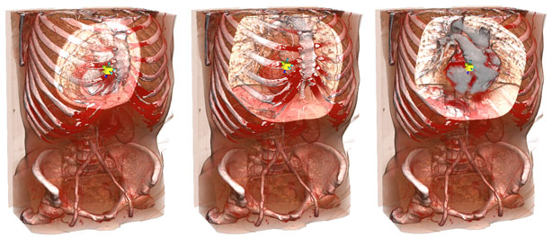
Visualization Methods
Direct Volume Rendering
  Use an optical model to define the colour and opacity/transparency of the continuous medium as a function of f()
  Display "whole volume" (e.g. by ray tracing)
  Contains more information (potentially)
  Slow & Fuzzy
source: http://3dph.miralab.unige.ch/main_demos.htm

Slide 8
Different Rendering Techniques
Simple approaches
  Symbols, Off-path display, Color mapping, Contour display
Iso-surface rendering
  Marching cubes algorithm, Fast iso-surface extraction
Implicit surfaces
  Particle sampling, Dividing cubes algorithm, Shape function interpolation
Volume slicing
  Clipping, Sampling planes, Interactive clipping, Clip objects
Volume rendering
  Object-oriented, Image-oriented, Hybrid techniques

Slide 9
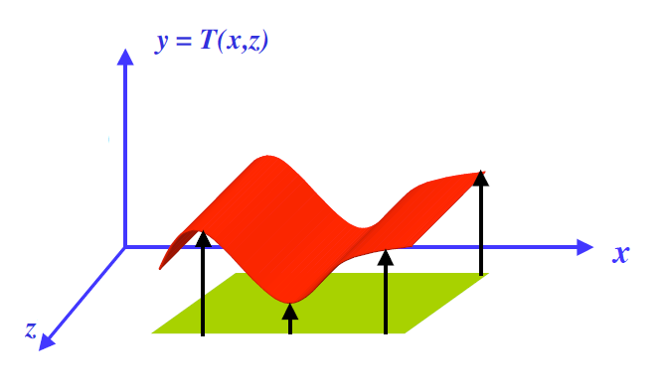
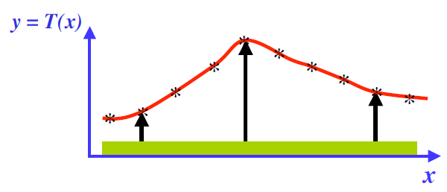
Symbols or Off-Path Displays
Useful for displaying one or two dimensional scalar data
  Temperature distribution along a rod or on sheet
Off-path displays

Slide 10

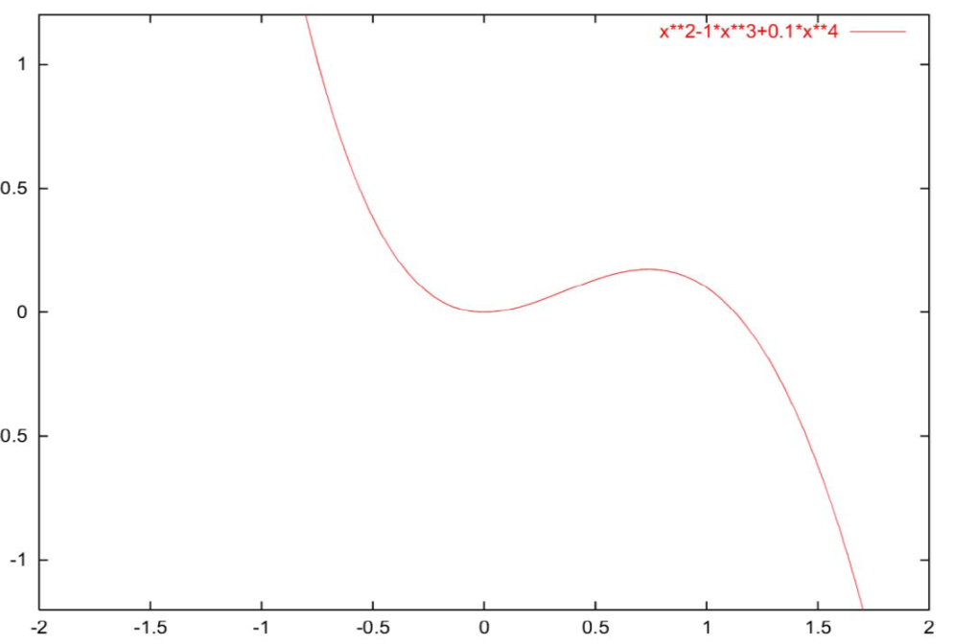
1D scalar field
Function plot for a 1D scalar field
  Points
  1D manifold: line

Slide 11

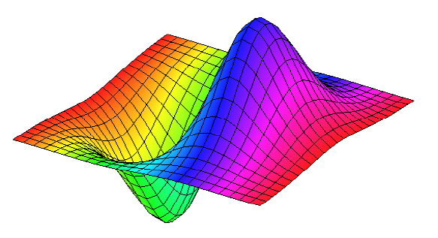
2D scalar field
Function plot for a 2D scalar field
  Points
  2D manifold: surface
Surface representations
  Wireframe
  Hidden lines
  Shaded surface

Slide 12
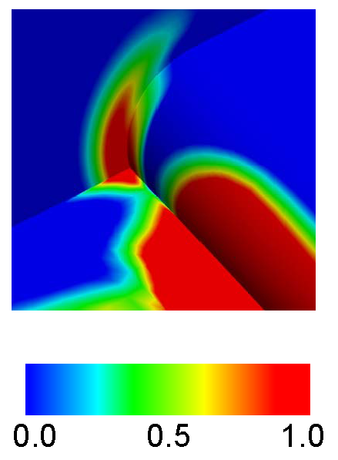
Color Mapping
Used to visualize scalar field over a line (2d space) or a surface (3d space)
Associate field’s range of values with a color scale
Color each point on surface according to its field value
Notes:
Color scales can also be mapped onto other visualization icons

Slide 13
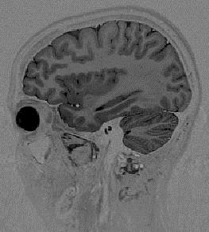
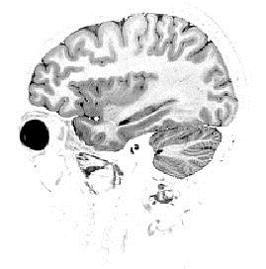
Color Mapping
Map scalar value to color
  Color table (e.g., array with RGB entries)
  Procedural computation
With opacity: 1D transfer function (e.g., RGBA table)

Slide 14
Color Mapping
Look-up Table (LUT)
  LUT is an array that replaces runtime computation with a simpler array indexing operation.
  Useful for scalar visualization in 1D, 2D or 3D
  Map scalar data to colors to display on the screen
  Lookup table:
    Holds an array of colors (RGB components)
    Scalar values serve as indices

Slide 15
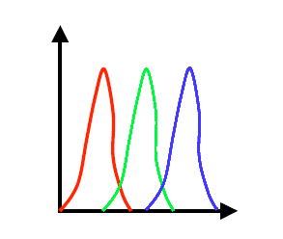
Look-up Table
Transfer function
  An expression that maps the scalar value into a color
specification
  Mapping to separate intensity values of R, G and B
A look-up table is a discrete sampling of a transfer function

Slide 16
Look-up Table
Characteristics
  Advantages
    Easy to implement
    Gives overall impression of distribution of a scalar field
    Can be mixed with other visualization icons
    Can use discontinuous color scale for accurate information along contours
  Disadvantages
    Quantitative information displayed by color can not be perceived accurately for a continuous color map
    Effectiveness of color map depends on the color scale used and perceptual issues
    No information about scalar field values outside the mapped surface

Slide 17
Look-up Table
Characteristics
  Desirable properties of a good color scale
    Colors should be perceived as preserving the order of the scalar values they represent.
    Colors should convey the distances between values they represent and should associate related values and separate unrelated values.
    Colors should be continuous for a continuous range.
    Accentuates important features.
  Note !
    If color mapping an illuminated surface choose color scale with hue variations only if.
    If we want to maximising the range of differentiable values then we choose a color scale with hue and intensity/brightness variations.

Slide 18
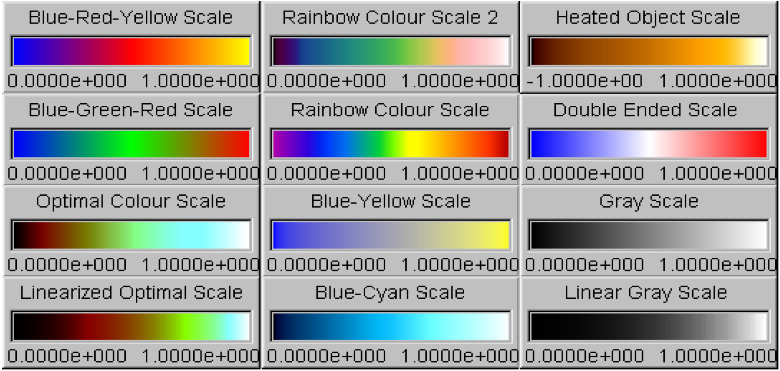
Look-up Table
Characteristics
  Common color scales
    E.g. H. Levkowitz and G. T. Herman. Colour scales for image data. IEEE Computer Graphics & Applicatios, 12(1):72-80, January 1992.

Slide 19
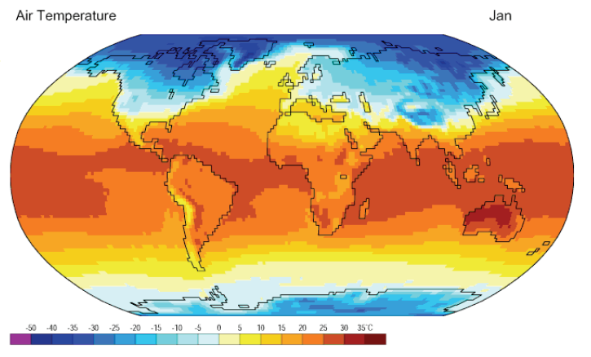
Examples of Color Mapping
Source: NCEP/NCAR Reanalysis Project, 1959-1997 Climatologies

Slide 20

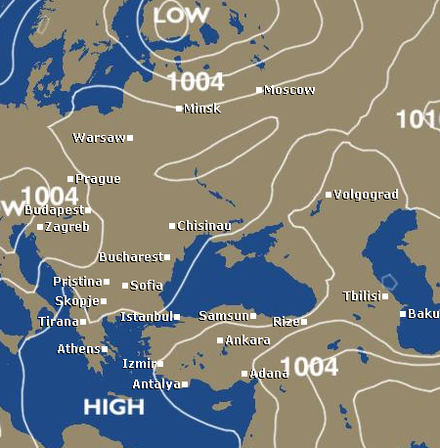
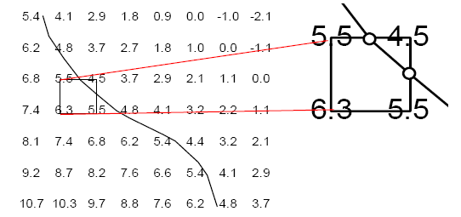
Contour Display
Common method for displaying scalar data across a surface
Contour lines:
  Represent a constant value across the surface (iso-value lines)
  Example: a contour for iso-line level = 5
    Compute where contour crosses each square cell.
    Connect intersection points.
source: http://news.bbc.co.uk/weather/

Slide 21
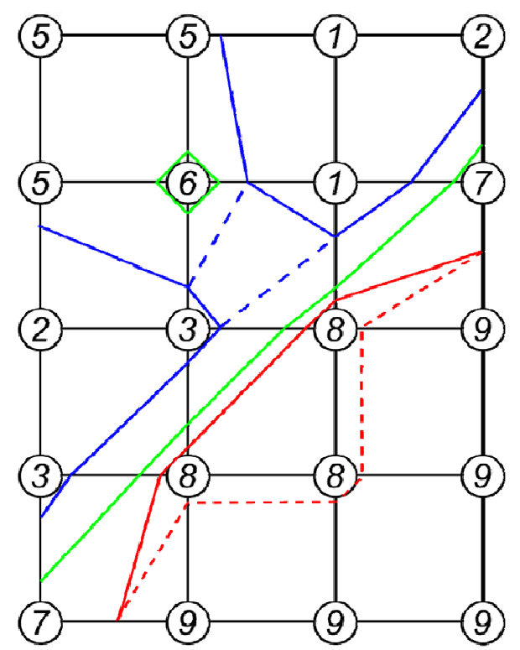
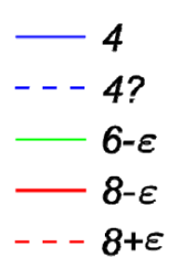
Contour Display
Example
  Contour levels:
  Two types of degeneracies:
    Isolated points (c=6)
    Flat regions (c=8)

Slide 22
Contour Display
Basic contour algorithms
  Cell-by-cell algorithms
    Simple structure
    Problems: generate disconnected segments
    Require post-processing
  Contour propagation algorithms
    More complicated
    Generate connected contours

Slide 23
Edge Tracking Algorithm
Select an element or cell
  Consider a 4-vertex quadrilateral element with scalar values S₁, S₂, S₃ and S₄
If all S_{i}’s > S_{iso} or all S_{i}’s < S_{iso}, no contour line passes through the element
Otherwise, start at the first pair of vertices, determine if the iso-value exists along the edge
If one vertex value > S_{iso} while the other
vertex value < S_{iso}, iso-value exists, in either order
If not, proceed in either clockwise or anticlockwise order until an edge containing the iso-value is found.

Slide 24
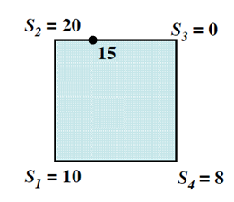
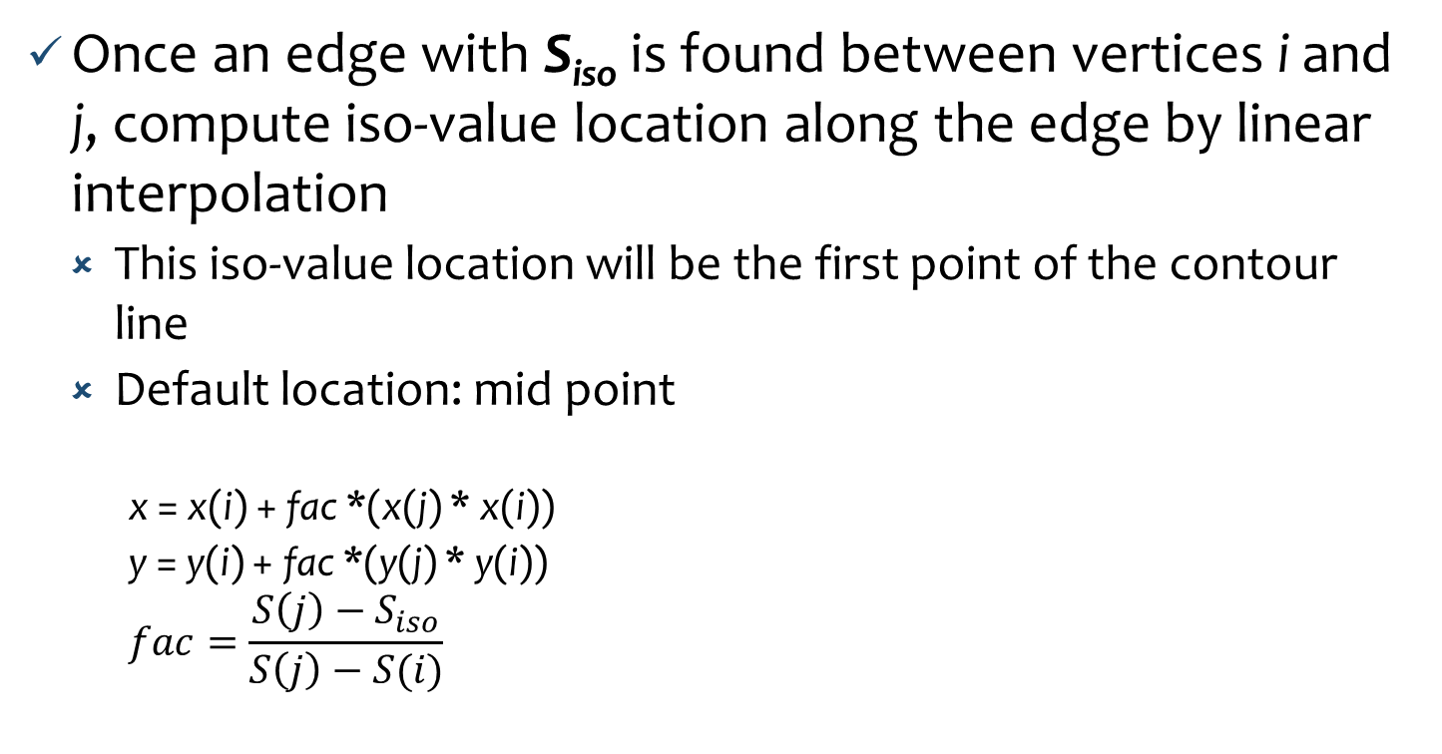
Edge Tracking Algorithm
Once an edge with S_{iso} is found between vertices i and j, compute iso-value location along the edge by linear interpolation
  This iso-value location will be the first point of the contour line
  Default location: mid point
    x = x(i) + fac *(x(j) * x(i))
    y = y(i) + fac *(y(j) * y(i))
    $$fac=\frac{S\left(j\right)−S_{iso}}{S\left(j\right)−S(i)}$$

Slide 25
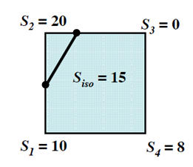
Edge Tracking Algorithm
Examine each subsequent edge until the next edge containing an iso-value is found and repeat previous step
  Connect these two points to form the contour segment
  Use shape function to give iso-lines some curvature.

Slide 26
Marching Squares Algorithm
Select a square element or cell
  Values at four corners
    below iso-value (marked)
    above iso-value (unmarked)
Calculate inside or outside state of each vertex of the cell
Determine the topology state of the cell by referring to a case table that has a list of all possible configurations
  Each square is either inside, outside or intersected
  2D cell index: 4 bits, 2⁴ (16) cases

Slide 27
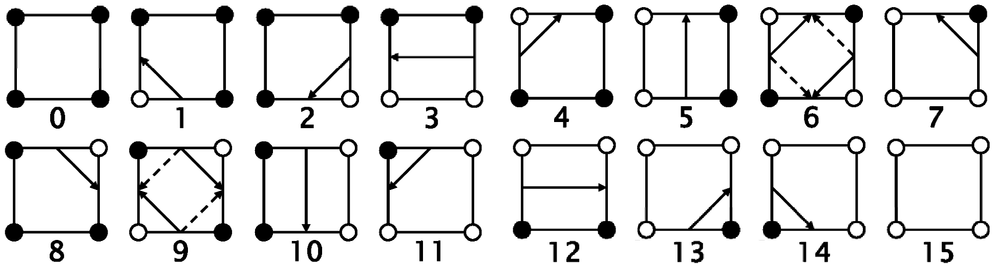

Marching Squares Algorithm
Calculate the contour location (via interpolation) for each edge in the case table
  One intersection per edge
By complementary and rotational symmetries (equivalence), the number of the basic cases is reduced to 4.

Slide 28
Marching Squares Algorithm
Topological consistency
  To avoid degeneracies, use symbolic perturbations:
    If level c is found as a node value, set the level to c-ε where ε is a symbolic infinitesimal
    Then:
      contours intersect edges at some (possibly infinitesimal) distance from end points
      flat regions be visualized be pair of contours at c-ε and c+ε contours are topologically consistent, meaning:
      contours are closed, orientable, nonintersecting lines

Slide 29
2D Ambiguous Cases
Ambiguous cases:
  5, 10
Contour ambiguity arises when adjacent vertices in different states but diagonal vertices in the same state
Break contour / Join contour
  Both are valid

Slide 30
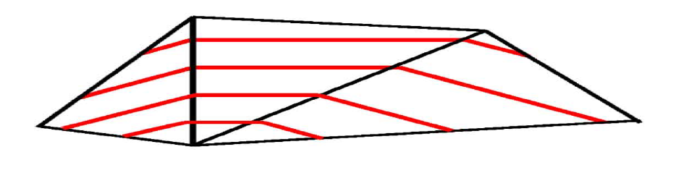
Contours in Triangle/Tetrahedral Cells
Linear interpolation of cells implies piece-wise linear contours.
Contours are unambiguous, making "Matching Triangles" even simpler than "Matching Squares".
  Question: Why not split quadrangles into two triangles (and hexahedra into five or six tetrahedra) and use matching triangles (tetrahedra)?
  Answer: This can introduce periodic artifacts !

Slide 31
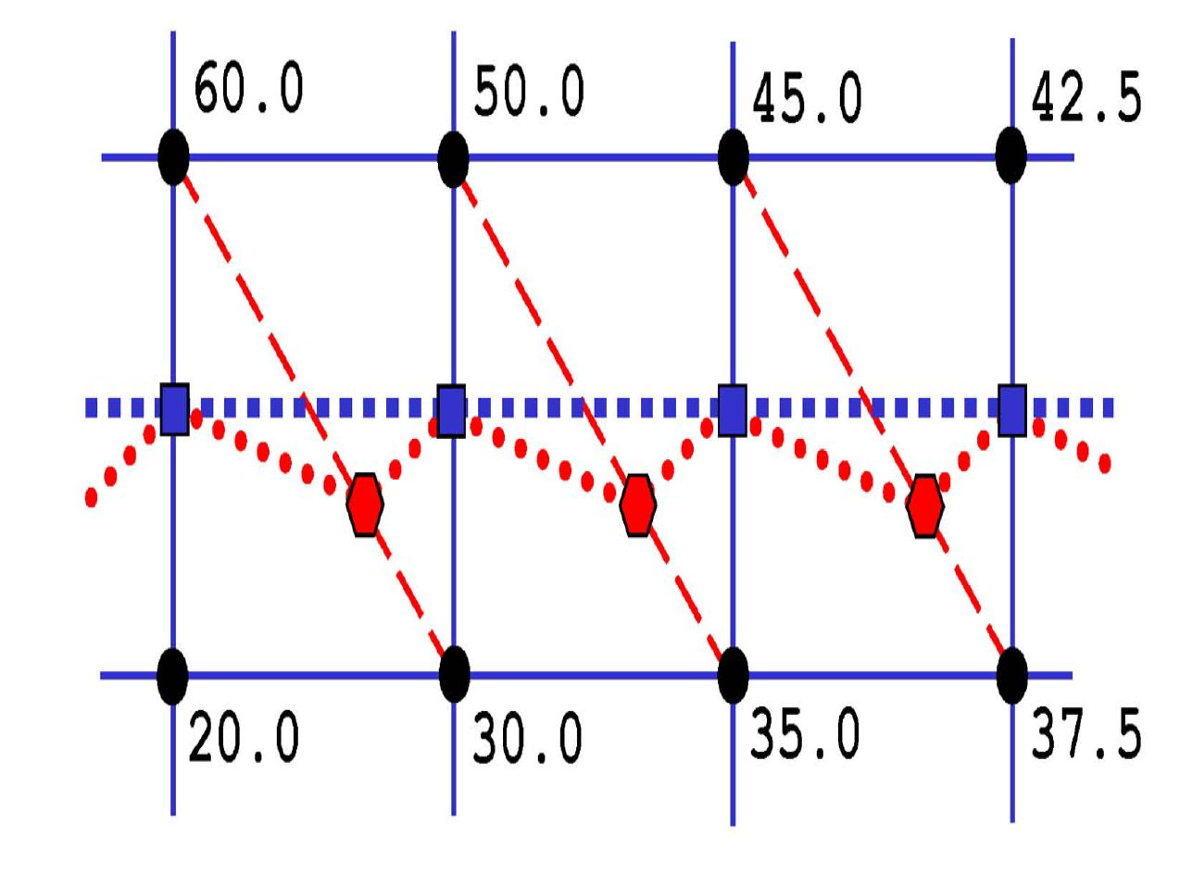
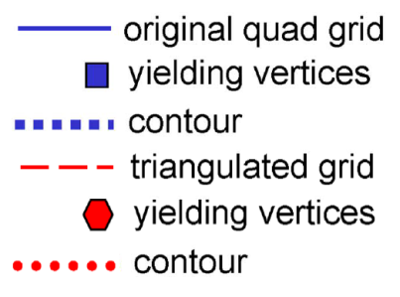
Contours in Triangle/Tetrahedral Cells
Example: Find contour at level c=40.0.

Slide 32
Contour Lines of MRI Data
Contour display of MRI data of a human head (single image and a stack of four images)

Slide 33
Iso-surface Rendering

Slide 34
Iso-surfacing
An iso-surface is the 3D surface representing the locations of a constant scalar value within a volume
  A surface with the same scalar field value
Iso-surfaces form the 3D analogy to the isolines that form a contour display on the surface
Iso-surfaces have the root in medical imaging where surfaces of constant density are often generated
  Bone skeletons, organ boundaries

Slide 35
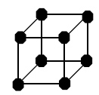
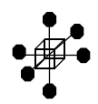
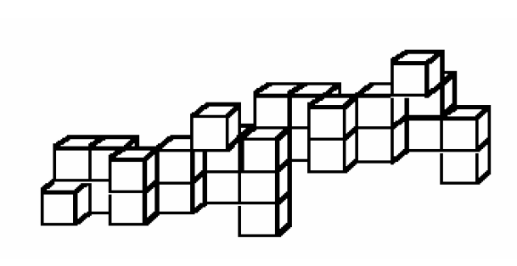
Surface Fitting
Is just contouring in 3D
  Contours are now surfaces
  Easiest method – "Opaque Cubes"
Is really another "quick look" method
Builds "Lego" approximation to object
For each cell in the volume
If cell's voxel values encompass the iso-level
then Display the cell as a solid cube

Slide 36
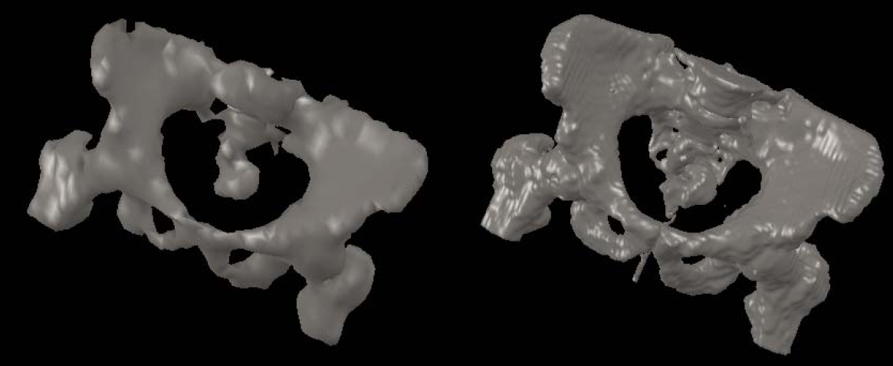
Marching Cubes Algorithm
To approximate an iso-surface of a 3D scalar field or function
  Input:
    Cubic grid data (voxels)
    Iso-value
  Output:
    Set of triangles approximating surface for a given iso-value
March through each of the cubes (voxels) replacing the cube with appropriate set of triangles
  Determine if and how an iso-surface would pass through it
  Generate polygonal iso-surface on a voxel-by-voxel basis
    Problem: a size of voxel

Slide 37
Marching Cubes Algorithm
Basic algorithm
  Select a cell
    Process each cell, one at a time
  Classify the inside/outside state of each vertex
  Create an index
    Find equivalent basic configuration by switching marked points or rotation
  Get edge list from the table
    Produce a set of triangles
  Interpolate the edge location
    Mid-edge (default)
    Linear interpolation along edge
  Go to the next cell

Slide 38
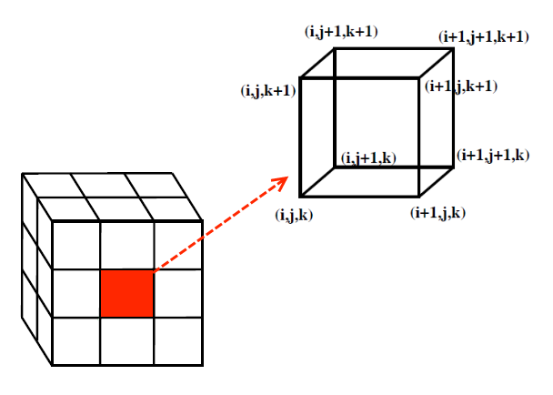
Marching Cubes Algorithm
Step 1: Select a Cell
  Process one cell at a time

Slide 39
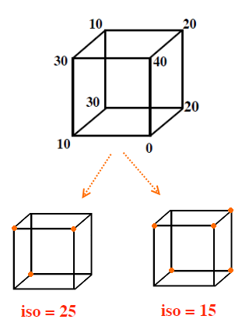
Marching Cubes Algorithm
Step 2: Classify States of Vertices
  Determine the inside/outside state of each vertex of the cell:
    Inside iso-surface (value >= iso-value)
      inside = marked with •
    Outside iso-surface (value < iso-value)
      outside = unmarked

Slide 40
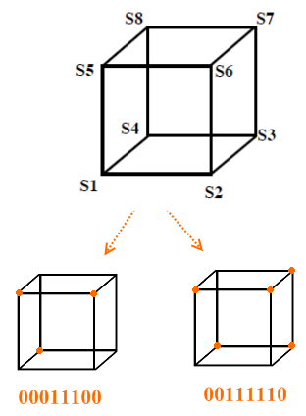
Marching Cubes Algorithm
Step 3: Create Index
  Marked vertex (inside = 1)
  Unmarked vertex (outside = 0)

Slide 41
Marching Cubes Algorithm
Step 4: Get Edge List
  An index corresponds to a list of edges the iso-surface cuts through
    Given an index, get edge list from table which is pre-created
  2D cell index: 4 bits, 2⁴ (16) cases
  3D cell index: 8 bits, 2⁸ (256) cases
  Can have multiple iso-surfaces
    make outermost one partially transparent
    use different colors for different surfaces

Slide 42
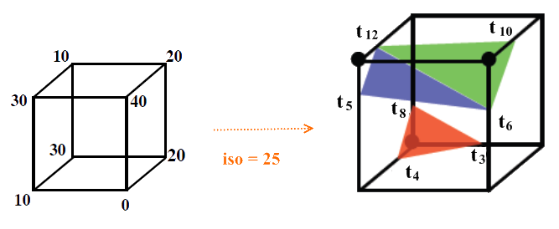
Marching Cubes Algorithm
Step 4: Get Edge List
  Example:
  Index = 00011100; triangle 1 = t3, t4, t8;
  triangle 2 = t5, t6, t12; triangle 3 = t6, t10, t12

Slide 43
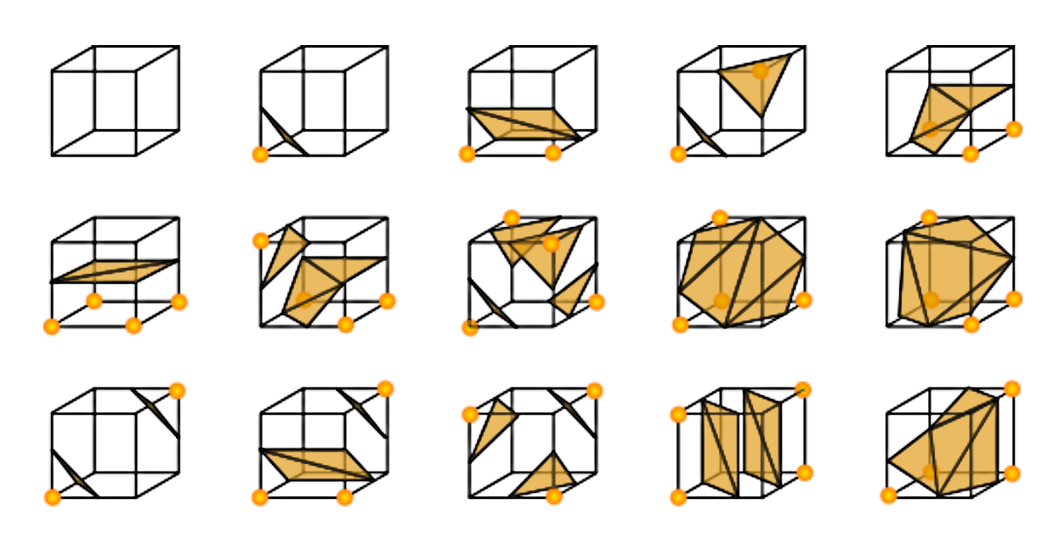
Marching Cubes Algorithm
Basic cases of 3D cells: 15 cases
  Symmetries: complementary and rotations
  Pre-defined look-up table enumerates
    How many triangles will make up the iso-surface segment passing through the cube ?
    Which edges of the cubes contain vertices of triangles, and in what order ?

Slide 44
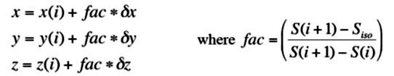
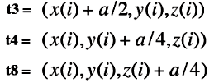
Marching Cubes Algorithm
Step 5: Interpolation of Triangle Vertices
  For each triangle, find an vertex location along the edge using linear interpolation of the values at the edge’s two end points.
  Vertices of triangle

Slide 45
Marching Cubes Algorithm
Algorithm
// Build look-up table [Table is constructed only once during initialisation]
For config = 0 to 255
  intersectingEdges = set of all intersecting edges computed from bit pattern of config
  LUTable[config].polygons = [ ];
  While unused intersectingEdges remain
    currentIntersectingEdge = any unused edge from intersectingEdges
    Initialise new outputPolygon
    firstIntersectingEdge = currentIntersectingEdge
    repeat
      outputPolygon.add(currentIntersectingEdge)
      Choose face to right of currentIntersectingEdge (if going 0→1)
      currentIntersectingEdge = first intersecting edge clockwise around face
      from currentIntersectingEdge
    until currentIntersectingEdge = firstIntersectingEdge
    LUTable[config].polygons += outputPolygon
// "March" through volume, outputing all polygons
  For each cell in volume
    Classify voxels at the 8 vertices as 0 or 1 to get 8-bit config value
    For each entry in LUTable[config].polygons
      For each “edge” stored in polygon
      Compute actual isosurface intersection point given the sample values
      at the edge endpoints – this is a vertex of the new polygon
      Compute isosurface normal at that vertex from the gradient (or its inverse)
    Output the polygon

Slide 46
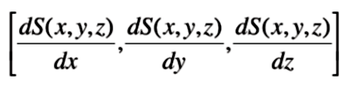
Marching Cubes Algorithm
Surface Normals
  Smooth shading of iso-surface segments requires the normal to the surface
    Calculate a unit normal at each cube vertex using central differences.
    Interpolate the normal to each triangle vertex.
    dx, dy, dz are the lengths of the cube
    dS’s are the central differences.

Slide 47
Marching Cubes Algorithm
Surface Normals
  The normal to the iso-surface at polygon vertices is given by the direction of the field gradient or its negation
    A normal vector: a perpendicular distance to the triangle from the marked vertex pointing away
    Either trilinearly interpolate the central difference estimates at sample points or directly evaluate the original (unsampled) field function at the vertex, if that’s possible.

Slide 48
Marching Cubes Algorithm
Performance
  Benefits:
    High quality images:
    Original data and structure is preserved
    Gradient data reflected in normal vectors
    Divide and conquer: good for parallel implementation

Slide 49
Marching Cubes Algorithm
Performance
  Problems:
    Inefficient: Slow in computation and large in memory requirement large number of triangles generated
      1003 dataset requires several megabytes memory
    Missing voxels
      How to fill up the data
    Ambiguities
      Iso-surface polygons may be discontinuous across two adjacent cells
      Triangles smaller than a single pixel

Slide 50
Marching Cubes Algorithm
Ambiguity in Marching Cubes
  Ambiguous cases: 3, 6, 7, 10, 12, 13
    Adjacent vertices in different states, but diagonal vertices in the same state.
    Ambiguous cases may cause holes.
    Iso-surface polygons are disjoint across the common element surface.

Slide 51
Marching Cubes Algorithm
Resolving the Ambiguity
  Using different triangulations, leading to consistency
    Asymptotic deciders
    Improved Marching Cubes
    Marching tetrahedral

Slide 52
The Asymptotic Decider
Techniques for choosing which vertices to connect on ambiguous face (Nielson and Hamann, 1991)
Uses bilinear interpolation over ambiguous face
Consider:
  Face is unit square
  B_{ij} values of four corners
  {(s,t): 0<= s <=1, 0<= t <= 1}

Slide 53
The Asymptotic Decider
Contour curves of B are hyperbolas
  {(s,t): B(s,t) = a}, where a is isovalue
Ambiguous case: both components of hyperbolas intersect the domain
Criteria for connecting vertices
based on whether they are joined
by a component of hyperbola.

Slide 54
The Asymptotic Decider
Selection determined by comparing values a and B(Sa,Ta).
  a = contour value
  B(Sa,Ta) = value of bilinear interpolantion at intersection point of the asymptotes
Possible triangulations
  Two or more.
  If a > B(S_{a},T_{a})
    connect (S₁,1) to (1,T₁) and (S₀,0) to (0,T₀)
  else
    connect (S₁,1) to (0,T₀) and (S₀,0) to (1,T₀)

Slide 55
The Asymptotic Decider
Selection determined by comparing values a and B(Sa,Ta).
Separated
Not separated

Slide 56
Improved Marching Cubes
8 extra cases to consider (Shoeb, 1998)
  They do not assume the complimentary cases to be equivalent
Choose cases so that shared sides have same connections between vertices.

Slide 57
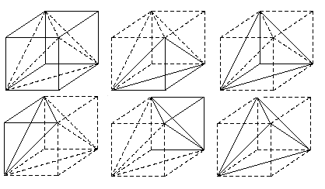
Marching Tetrahedra
Tessellates the cube with tetrahedron
  Every tetrahedron has four nodes and six edges
  Cubical cell can be subdivided into 5, 6 or 24 tetrahedra
  5-tetrahedron case requires flipping adjacent cells for continuity across faces
  Requires more triangles
No ambiguous cases exist
May result in artificial bumps in the iso-surface
  Interpolation along the face diagonals.

Slide 58
Improved Interpolantion
Improve the representation of the surface in the interior of each grid cell
  Model the topology of trilinear interplolantion within the cell
  a = S₀₀₀, b = S₀₀1-S₀₀₀, c = S₀₁₀-S₀₀₀, and so on.
Represent different topologies including the possibility of tunnels
Make surface visually continuous as the data and threshold change in value.

Slide 59
Dividing Cubes
Marching cubes can give huge number of polygons.
Can be very slow to render without special-purpose hardware – poor interactivity
A faster method in such cases is Dividing Cubes. Not widely known/used.
Simple idea – like opaque cubes but
  recursively subdivide each cube that contains isosurface until its projection area is pixel-sized.
  then colour the pixel(s) it projects onto with a shade computed using a standard illumination model. Use the gradient at the centre of the cube as the surface normal.
Can get real-time frame rates on modern PCs if you're sufficiently cunning.

Slide 60
Implicit Iso-surfaces

Slide 61
Particle Sampling
Volume data is sampled at regular points, and the results of the sampling are displayed as dots
Using point primitives for display
  Display consists of a dense group of points which imply the surface
  Rendering points faster than rendering polygons
  Geometric operations such clipping and merging data are simple with points
Color and density of points can vary with the magnitude of the scalar value within the specified range
Display the points of constant scalar value within the entire 3D volume as an implicit iso-surface

Slide 62
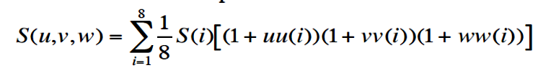
Shape Function Interpolation
Shape functions are used to interpolate the element data values
Generate a continuum of points at any desired density by using a small increment in the parametric u, v and w values
A linear 8 vertex shape function

Slide 63
Dividing Cubes Algorithm
Generates isosurface using dense cloud points
Use point primitives unlike triangles in Marching Cubes
Conditions
  Large number of points
  Density of points >= screen resolution
  Lighting and shading calculations

Slide 64
Find Intersecting Voxel
Select a voxel (cell) and determine whether the iso-surface passes through it
  Whether there are scalar values at vertices both above and below the iso-value.

Slide 65
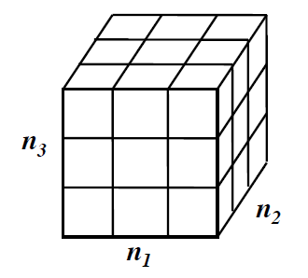
Subdivide Voxel
The voxel is subdivided into a regular grid of
n₁ X n₂ X n₃ subvoxels:
  n_{i} = w_{i} /R,
  where R is screen resolution and w_{i} is width of the voxel

Slide 66
Generate Points
Scalar values at the subpoints are generated using the interpolation function.
Find whether the iso-surface passes through each sub-voxel.
If it does, generate a point at the center of the subvoxel and compute its normal.
Collection of all such points compose the Dividing Cubes’ iso-surface.

Slide 67
Recursive Implementation
Recursively divide the voxel as in octree decomposition.
Scalar values at the new points are interpolated
Process repeats for each sub-voxel if the iso-surface passes through it
This process continues until the size of
the subvoxel =< R
A point is generated at the center of the sub-voxel

Slide 68
Dividing Squares’ Contour

Slide 69
Dividing Cubes’ Image
Image of human head
Image with voxel subdivision into 4x4x4 cubes

Slide 70
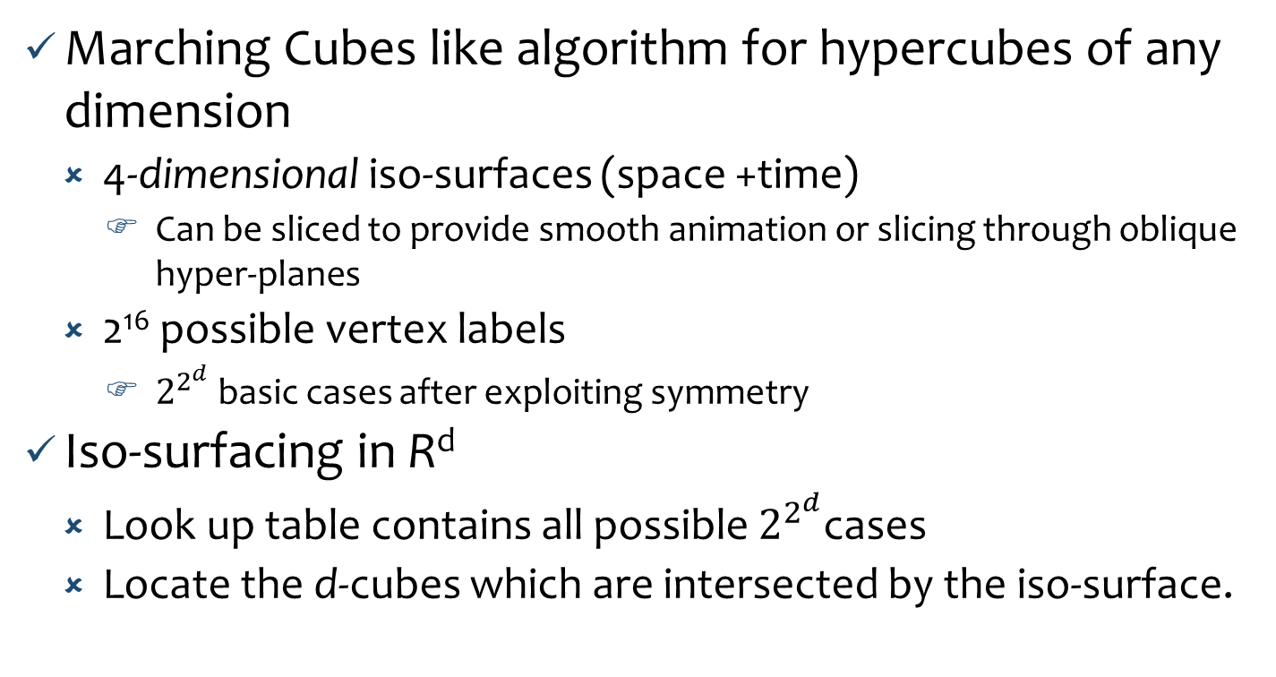
Iso-surfacing in Higher Dimensions
Marching Cubes like algorithm for hypercubes of any dimension
  4-dimensional iso-surfaces (space +time)
    Can be sliced to provide smooth animation or slicing through oblique hyper-planes
  2¹⁶ possible vertex labels
    $2^{2^{d}}$ basic cases after exploiting symmetry
Iso-surfacing in R^{d}
  Look up table contains all possible $2^{2^{d}}$cases
  Locate the d-cubes which are intersected by the iso-surface.

Slide 71
Fast Isosurface Extractions
View dependent iso-surface extraction
  Very large and complex iso-surfaces
    Multiple non-overlapping polygons may project onto individual pixels
Some sections may be occluded by the other sections of the iso-surface
  Extract only the visible portions of the iso-surface.

Slide 72
Fast Iso-surface Extractions
Interactive ray tracing of iso-surfaces
  Generate a single image of iso-surface from a given viewpoint
    No geometry generated but an analytical iso-surface intersection computation done
  Use ray-tracing in which one or more rays are sent from viewpoint through each pixel of the screen and into the scene
    Parallel processing.
Near optimal iso-surface extraction (NOISE)
  Maps the search phase onto a two-dimension space (the span space)
    Time complexity: O(√n+k) or O(log n = k), where k is the size of the iso-surface and n is the size of the data set.

Slide 73
Questions ?

