Slide 1
Science Visualization
Data in Vizalization: Types & Structures

Slide 2
Overview
“Visual Language is a Sign System:
  Image perceived as a set of signs
  Sender encodes information in signs
  Receiver decodes information from signs”
  Jacques Bertin

Slide 3
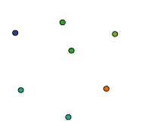
Discrete vs. Continuous
Real World is continuous
  Eyes designed towards the perception of continuous shape
Data is discrete
  Finite resolution representation of a real world (of abstract) concept
Difficult to visualize continuous shape from raw discrete sampling
  We need topology and interpolation

Slide 4
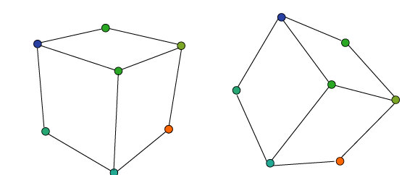
Topology
It is relationships within the data invariant under geometric transformation
  Which vertex is connected with which vertex by an edge?
  Which area is surrounded by which edges?

Slide 5
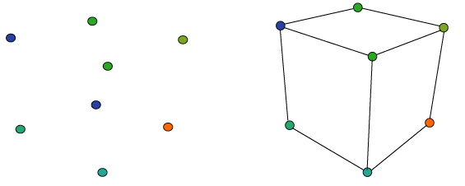
Interpolation & Topology
If we introduce topology our visualization of discrete data improves
  Why ? Because then we can interpolate based on the topology

Slide 6
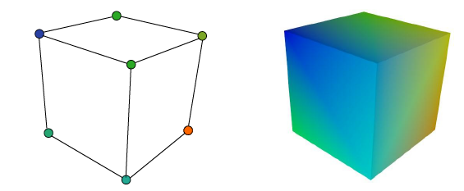
Interpolation & Topology
Use interpolation to shade whole cube:
  Interpolation: producing intermediate samples from a discrete representation

Slide 7
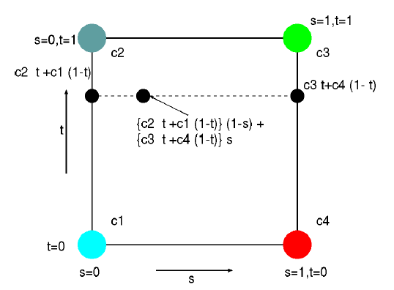
Interpolation Over Rectangle
Bi-linear interpolation
    The red dot affects the color of calculated point.

Slide 8
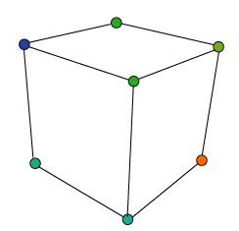
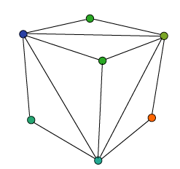
Importance of Representation
What happens if we change the representation?
Discrete data samples remain the same
  topology has changed ⇒ effects interpolation effects ⇒ visualization

Slide 9
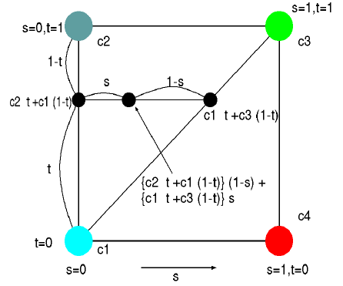
Interpolation Over Rectangle
Bi-linear interpolation
  The red dot doesn’t affect the color of calculated point.

Slide 10
Topological Dimension
Topological Dimension: number of independent continuous variables specifying a position within the topology of the data
  Different from geometric dimension (position within general space)
 | Topological | Geometric
point | 0D | 2D/3D | e.g. 2D (x,y)
curve | 1D | 2D/3D | e.g. 3D point on curve
surface | 2D | 3D | (in general)
volume | 3D | 3D | MRI or CT scan

Slide 11
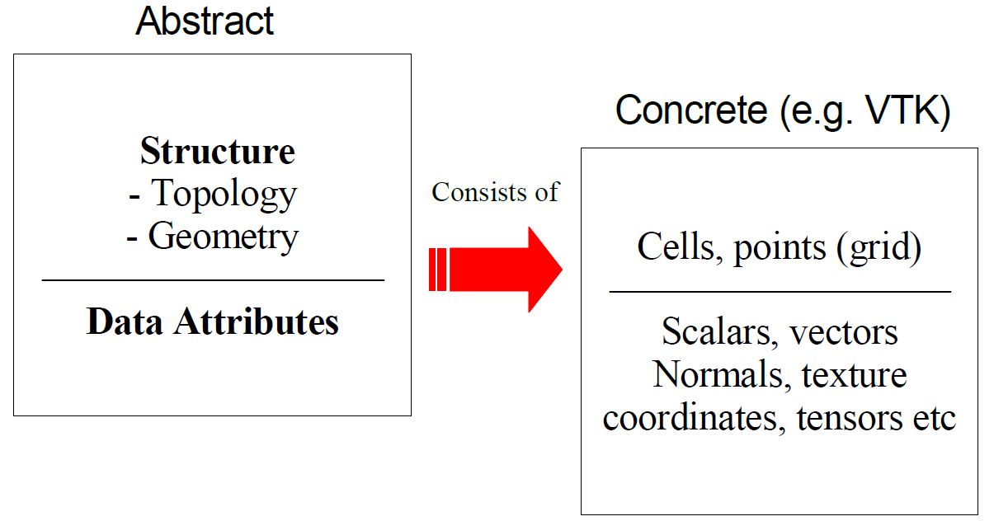
Data Representation
Data objects : structure + value
  referred to as datasets

Slide 12
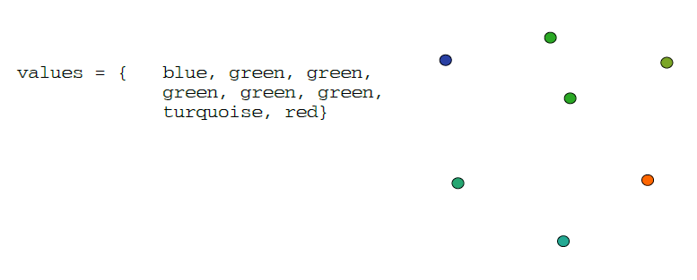
What is a dataset?
Dataset consists of 2 main components
  structure of the data
  value – attributes associated to particular parts of the structure
  structure gives spatial meaning to the attributes

Slide 13
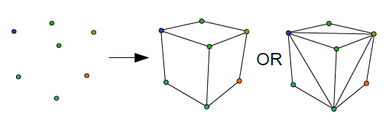
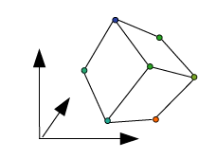
Structure of Data
Structure has 2 main parts
  Topology : “set of properties invariant under certain geometric transformations”
    determines interpolation required for visualization
    “shape” of data
  Geometry
    Instantiation of the topology
    Specific position of points in geometric space

Slide 14
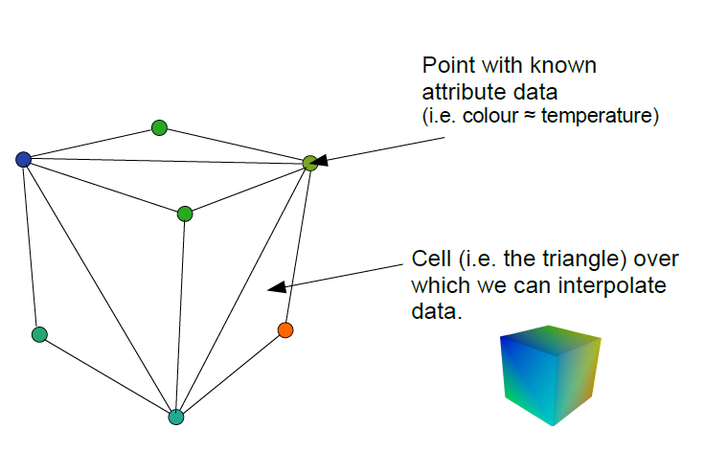
Representation Datasets
Points specify where the data is known
Cells allow us to interpolate between points
  specify topology of points
Follows VTK model

Slide 15
Cells
Fundamental building blocks of visualisation
  Our gateway from discrete to interpolated data
Various Cell Types
  Defined by topological dimension
  Specified as an ordered point list (connectivity list)
  Primary or composite cells composite: consists of one or more primary cells

Slide 16

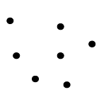
Zero-dimensional Cell Types
Vertex
  Primary zero-dimensional cell
  Definition: single point
Polyvertex
  Composite zero-dimensional cell
    composite: comprises of several vertex cells
  Definition:
    arbitrarily ordered set of points

Slide 17


One-dimensional Cell Types
Line
  Primary one-dimensional cell type
  Definition: 2 points, direction is from first to second point.
Polyline
  Composite one-dimensional cell type
  Definition:
    an ordered set of n+1 points, where n is the number of lines in the polyline

Slide 18
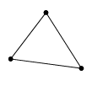

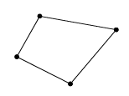
Two-dimensional Cell Types
Triangle
  Primary 2D cell type
  Definition:
    counter-clockwise ordering of 3 points
    order of the points specifies the direction of the surface normal
Triangle strip
  Composite 2D cell consisting of a strip of triangles
  Definition:
    ordered list of n+2 points n is the number of triangles
Quadrilateral
  Primary 2D cell type
  Definition:
    ordered list of four points lying in a plane
  constraints: convex + edges must not intersect
  ordered counter - clockwise defining surface normal

Slide 19
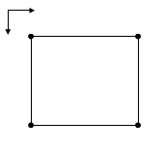
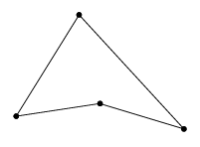
Two-dimensional Cell Types
Pixel
  Primary 2D cell, consisting of 4 points
    topologically equivalent to a quadrilateral
    constraints: perpendicular edges; axis aligned
  Numbering is in increasing axis coordinates
Polygon
  Primary 2D cell type
  Definition:
    ordered list of 3 or more points
    constraint: may not self-intersect

Slide 20
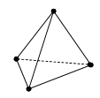
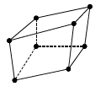
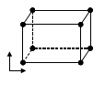
Three-dimensional Cell Types
Tetrahedron
  Definition: list of 4 non-planar points
    Six edges, four faces
Hexahedron
  Definition: ordered list of 8 points
    Six quadrilateral faces, 12 edges, 8 vertices
    Constraint: edges and faces must not intersect
Voxel
  Topologically equivalent to Hexahedron
  Constraint: each face is perpendicular
  to a coordinate axis
  “3D pixels”

Slide 21
Example Applications & Cell Types
Lines
  Digitized contour data from maps
Pixels
  Images, regular height map data
Quadrilaterals
  Finite element analysis
Voxels : “3D pixels”
  Volume data : medical scanners

Slide 22
Attribute Data
Information associated with data
  usually associated to points or cells
Examples :
  temperature, wind speed, humidity, rain fall (meteorology)
  Heat flow, stress, vibration (engineering)
  texture coordinates, surface normal, color (computer graphics)
Usually categorized into specific types:
  scalar (1D)
  vector (commonly 2D or 3D, or even more)
  tensor (N dimensional array)

Slide 23
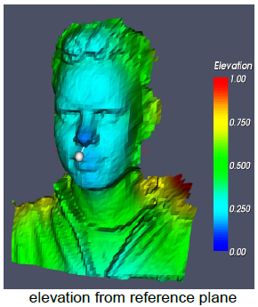
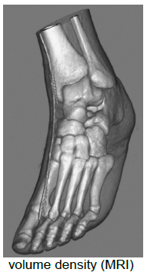
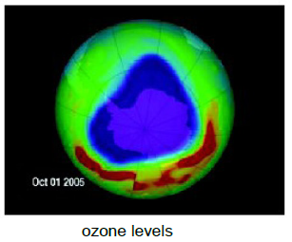
Attribute Data : Scalar
Single valued data at each location
  Simplest and most common form of visualization data

Slide 24
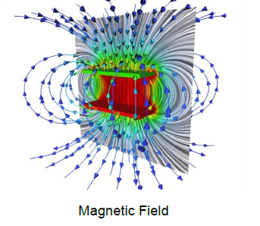
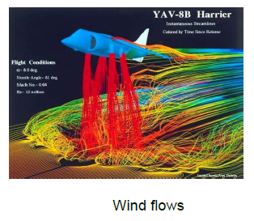
Attribute Data : Vector Data
Magnitude and direction at each location
  3D triplet of values (i, j, k)

Slide 25
Attribute Data : Tensor Data
K-dimensional array at each location
  Generalization of vectors and matrices
  Tensor of rank k can be considered a k-dimensional table
    Rank 0 is a scalar
    Rank 1 is a vector
    Rank 2 is a matrix
    Rank 3 is a regular 3D array
Tensor visualization is a bit difficult
  Need to show high dimensional data at every point

Slide 26
Visualization Algorithms
Generally, classified by attribute type
  scalar algorithms (e.g. color mapping)
  vector algorithms (e.g. glyphs)
  tensor algorithms (e.g. tensor ellipses)
Effectiveness of Mappings
  Mapping from (filtered) data to renderable representation
  Most important part of visualization
  Possible visual representations:
      Position, size, orientation, shape, brightness, color (hue, saturation), ….

Slide 27
Effectiveness of Mappings
Efficiency and effectiveness depends on input data:
  Nominal
  Ordinal
  Quantitative
Good visual design
  Based on psychology and psychophysics
Psychological investigations to evaluate the appropriateness of mapping approaches

Slide 28
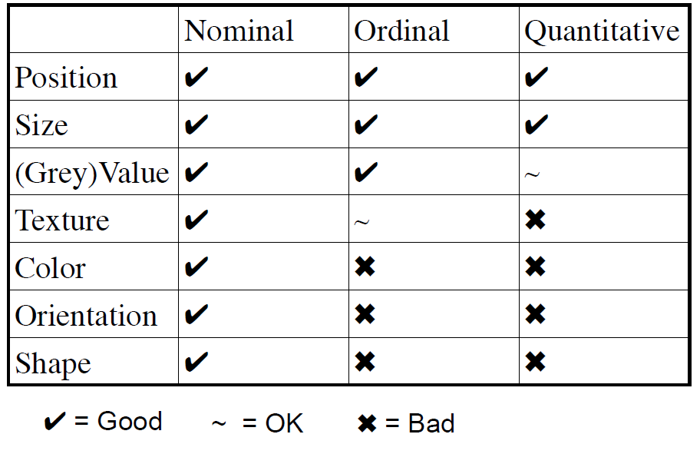
Mapping to Data Types

Slide 29
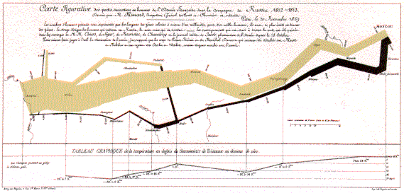
Minard 1869: Napoleon’s march
Example:

Slide 30
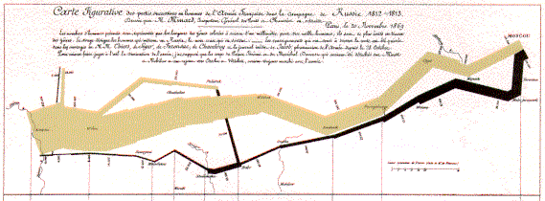
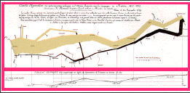



Minard 1869: Napoleon’s march
Single axis composition

Slide 31

Minard 1869: Napoleon’s march
Mark composition
  y-axis: temperature (Q)
  +
  x-axis: time (Q)
  =
  temp over time (Q x Q)

Slide 32

Minard 1869: Napoleon’s march
Mark composition
  y-axis: longitude (Q)
  +
  x-axis: latitude (Q)
  +
  width: army size (Q)
  =
  army position (Q x Q) and army size (Q)

Slide 33
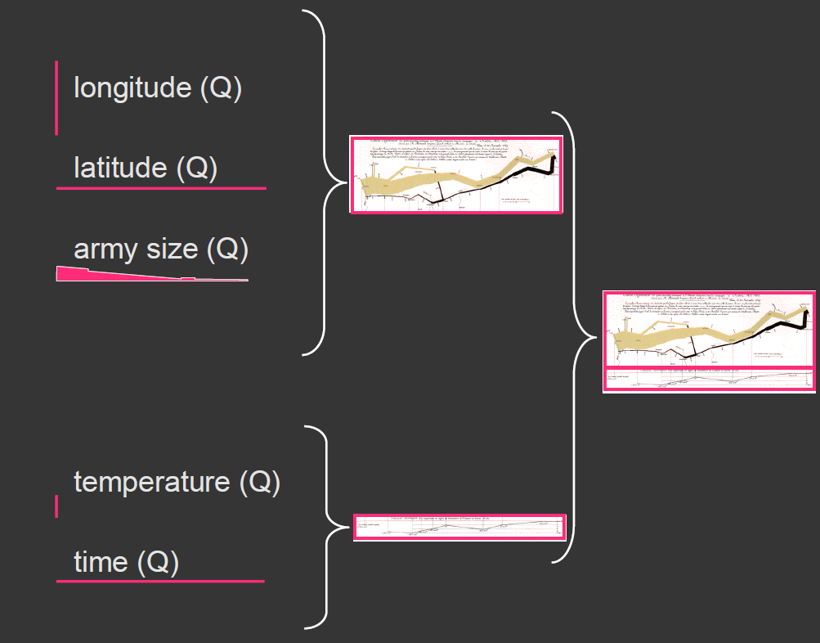
Minard 1869: Napoleon’s march

Slide 34
Combinatorics of encodings
Challenge
  Assume 8 visual encodings and n data attributes
  Pick the best encoding from the exponential number of possibilities (n+1)⁸
Principle of Consistency
  The properties of the image (visual variables) should match the properties of the data
Principle of Importance Ordering
  Encode the most important information in the most effective way

Slide 35
Mackinlay’s expressiveness criteria
Expressiveness
  A set of facts is expressible in a visual language if the sentences (i.e. the visualizations) in the language express all the facts in the set of data, and only the facts in the data.
    Cannot express the facts
    Expresses facts not in the data
  A visualization is more effective than another visualization if the information conveyed by one visualization is more readily perceived than the information in the other visualization.

Slide 36

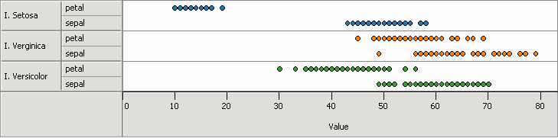
Mackinlay’s Expressiveness Criteria
Example:
  A one-to-many (1 → N) relation cannot be expressed in a single horizontal dot plot because multiple tuples are mapped to the same position

Slide 37
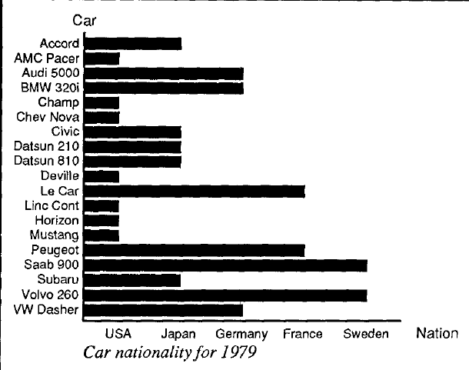
Expresses facts not in the data
Example:
  A length is interpreted as a quantitative value;
    Length of bar says something untrue about N data

Slide 38
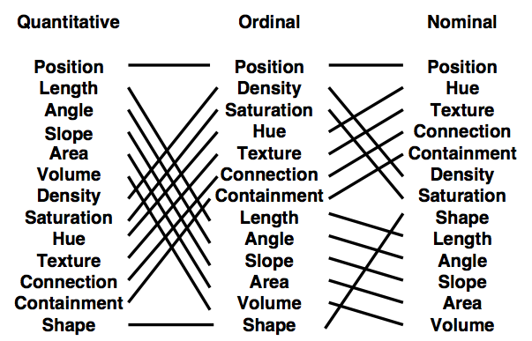
Mackinlay’s Retinal Variables
Ranking
The task shown in the orange boxes are not relevant to these data types.

Slide 39
Mackinlay’s Criteria: Limitations
Does not cover many visualization techniques
  Networks, maps, diagrams
  They do not consider 3D, animation, illustration, photography, …
Does not model interaction

Slide 40
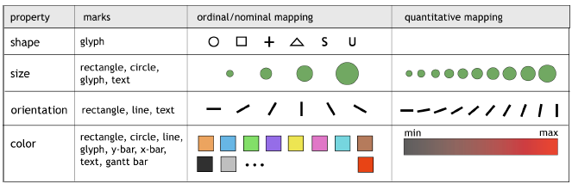
Stolte / Hanrahan
Elements

Slide 41
Effectiveness of Mappings
Effectiveness according to neurophysiology
Cells in Visual Areas 1 and 2 differentially tuned to each of the following properties:
  Orientation and size (with luminance)
  Color (two types of signal)
  Stereoscopic depth
  Motion
Grapheme
  Describes a graphical element that is primitive in visual terms
  Makes use of early stages of human vision

Slide 42
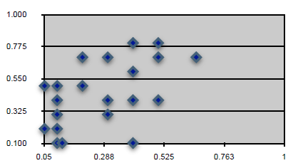
Mapping to Positional Quantities
Mapping to positional quantities:
  Position
  Size
  Orientation
Geometric mapping
Typically, very effective visual parameters
Generic diagram methods

Slide 43
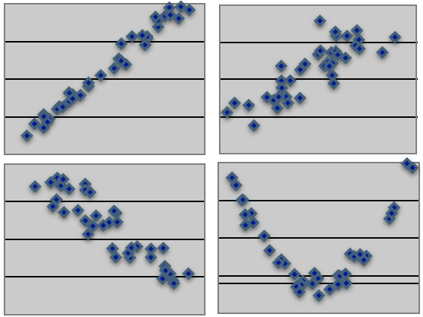
Mapping to Positional Quantities
Point diagrams
E.g. scatter plots: visual recognition of correlations

Slide 44
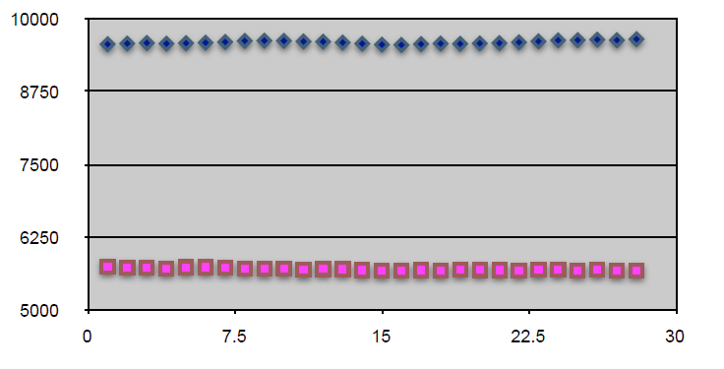
Mapping to Positional Quantities
Line and curve diagrams:
  Effective perception of differences in
Position and
Length

Slide 45
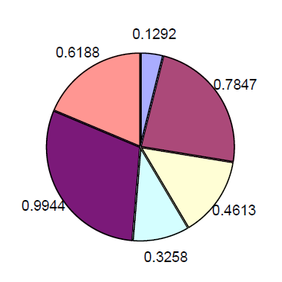
Mapping to Positional Quantities
Pie charts:
  Quantitative data that adds up to a (fixed?) number

Slide 46
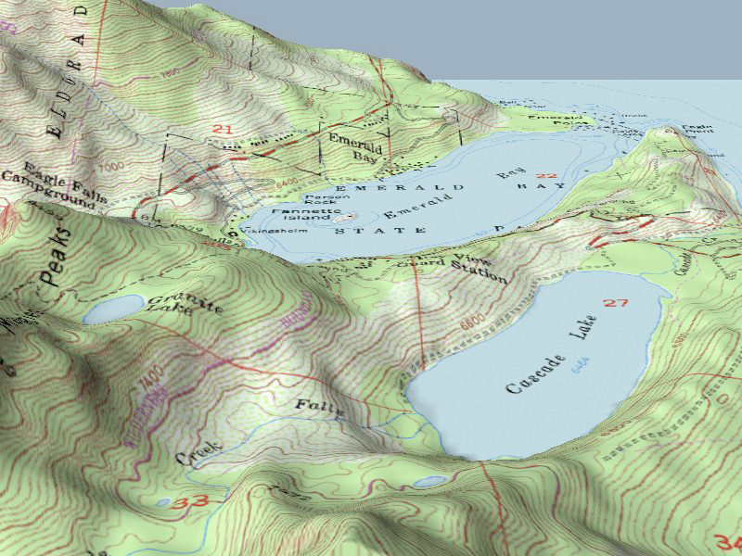
Mapping to Shape
Especially useful for data with direct relationship to locations
  Convey spatial structures
Examples
  Isolines (contour lines)
  Height fields
  Function graphs (function plots)
Direct encoding of qualitative data
  Typically in the form of glyphs

Slide 47
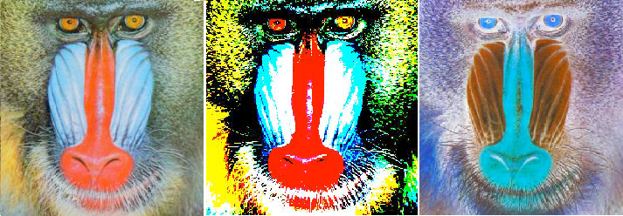
Mapping to Color
Issues:
  What kind of data can be color-coded?
  What kind of information can be efficiently visualized?
Areas of application
  Provide information coding
  Designate or emphasize a specific target in a crowded display
  Provide a sense of realism or virtual realism
  Provide warning signals or signify low probability events
  Group, categorize, and chunk information
  Convey emotional content
  Provide an aesthetically pleasing display

Slide 48
Mapping to Color
Possible problems:
  Distract the user when inadequately used
  Dependent on viewing and stimulus conditions
  Ineffective for color deficient individuals (use redundancy)
  Results in information overload
  Unintentionally conflict with cultural conventions
  Cause unintended visual effects and discomfort

Slide 49
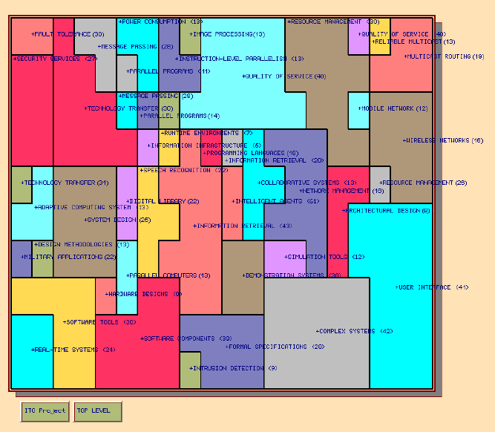
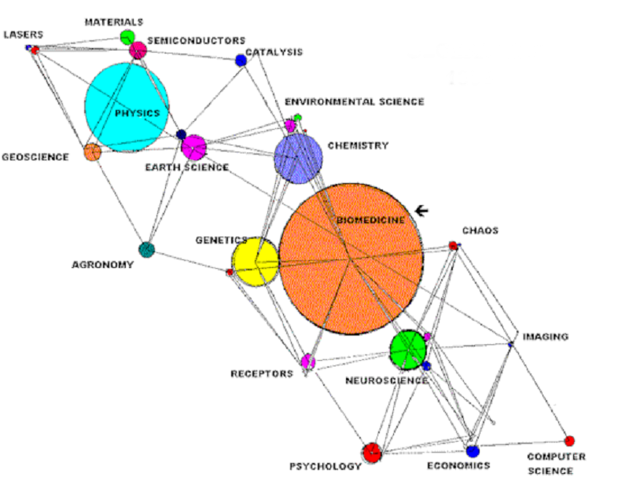
Mapping to Color
Nominal data
  Colors need to be distinguished
  Localization of data
  Around 8 different basis colors
Ordinal and quantitative data
  Ordering of data should be represented by ordering of colors
  Psychological aspects
  x₁ < x₂ < ... < x_{n} -> E(c₁) < E(c₂ ) < ... < E(c_{n} )

Slide 50
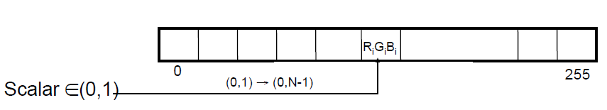

Mapping to Color
Color coding for scalar data
  Assign to each scalar value a different color value
  Assignment via transfer function T
      T : scalarvalue → colorvalue
  Code color values into a color LUT (LookUp Table)
Linear transfer function for color coding
  Specify color for f_{min} and for f_{max}
(R_{min} ,G_{min} , B_{min}) and (R_{max} , G_{max} , B_{max})
  Linearly interpolate between them

Slide 51
Mapping to Color
Pre-shading vs. post-shading
  Pre-shading
    Assign color values to original function values (e.g. at vertices of a cell)
    Interpolate between color values (within a cell)
  Post-shading
    Interpolate between scalar values (within a cell)
    Assign color values to interpolated scalar values

Slide 52



Mapping to Color
Different color spaces lead to different interpolation functions
In order to visualize (enhance/suppress) specific details, non-linear color lookup tables are needed
Gray scale color table
  Intuitive ordering
Rainbow color table
  Less intuitive
  HSV color model
  Perceptual issues
Temperature color table

Slide 53
Mapping to Color
Bivariate and trivariate color tables are problematic:
  No intuitive ordering
  Colors hard to distinguish
Many more color tables for specific applications
Design of good color tables depends on psychological / perceptional issues
Often interactive specification of transfer functions to extract important features

Slide 54
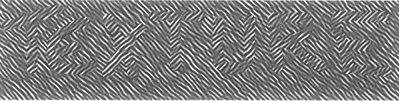
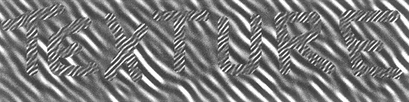
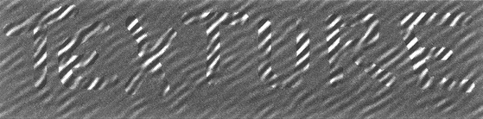
Mapping to Texture
Main parameters for texture
  Orientation
  Size
  Contrast
Alternatively – Tamura, 1978:
  Coarseness
  Roughness
  Contrast
  Directionality
  Line-likeness
  Regularity

Slide 55
Mapping to Texture
Goal:
  Avoid visual "crosstalk“
  “Orthogonal” perceptual channels
Restricts range of parameters
  E.g. approximately 30 degrees difference in orientation needed to distinguish textures
Main application for textures: nominal data
Some applications for direct visualization of orientations

Slide 56
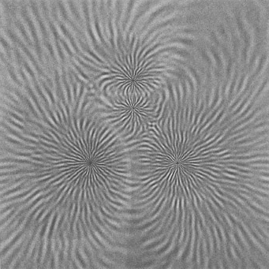
Mapping to Texture
Generate texture
Gabor functions as primitives
Parameters:
  Orientation
  Size
  Contrast
Randomly splatter down Gabor functions
  Blending yields continuous coverage
  Stochastic texture model
  Example: Visualization of a magnetic field

Slide 57
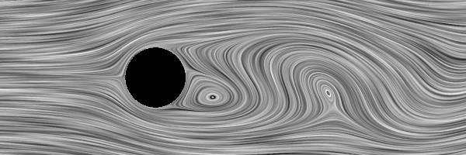
Mapping to Texture
Other stochastic texture models:
  LIC (Line integral convolution) for vector field visualization
Structural models
  Procedural description of texture generation
  e.g. Lindenmayer systems (L-systems)

Slide 58
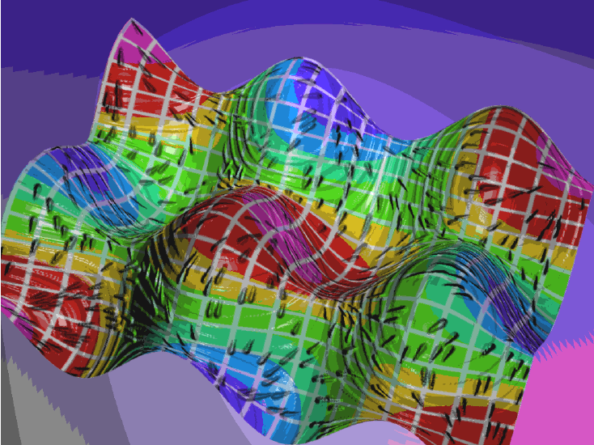
Other Mappings
More advanced mappings possible
Examples for other visual variables
  Motion
  Blink coding
  Explicit use of 3D
Multiple attributes
Typical combination of attributes:
  Geometric position, e.g., height field
  Color: saturation, intensity, tone
  Texture
Issue: Interference?

Slide 59

Glyphs
Glyphs and icons
  Consist of several components
Features should be easy to distinguish and combine
Icons should be separated from each other
Mainly used for multivariate discrete data

Slide 60


Glyphs
Picket & Grinstein, 1988:
  Glyphs are stick-figure icon
2D figure with 4 limbs
Coding of data via
  Length
  Thickness
  Angle with vertical axis
12 attributes
Exploits the human capability to recognize patterns/textures

Slide 61


Glyphs
Levkowitz, 1991
  Glyphs are color icons
Subdivision of a basic figure (triangle, square, …) into edges and faces
Mapping of data to faces via color tables
Grouping by emphasizing edges or faces

Slide 62

Glyphs
More integral coding pairs
Multi-dimensional coding
  Perceptual independence?
Integral display dimensions
  Two or more attributes
  perceived holistically
Separable dimensions
  Separate judgments about
  each graphical dimension
More separable coding pairs

Slide 63

Glyphs
Simplistic classification, with a large number of exceptions and asymmetries

Slide 64

Glyphs
Interesting graphical attributes for basic glyph design - C. Ware, “Information Visualization”

Slide 65


Glyphs
Stick-figure icon

Slide 66
Glyphs
Circular icon plots:
  Star plots
  Sun ray plots
  etc…
Follow a "spoked wheel" format
Values of variables are represented by distances between the center ("hub") of the icon and its edges

Slide 67

Glyphs
Star glyphs
  A star is composed of equally spaced radii, stemming from the center
  The length of the spike is proportional to the value of the respective attribute
  The first spike/attribute is to the right
  Subsequent spikes are counter-clockwise
  The ends of the rays are connected by a line

Slide 68


Glyphs
Sun ray plots
  Similar to star glyphs/plots
  Underlying star-shaped structure

Slide 69

Glyphs
Chernoff faces/icons
  The use of faces to represent points in k-dimensional space graphically.
Each facial feature represents one variable
Human ability to distinguish small features in faces

Slide 70

Chernoff faces/icons
Possible assignment in the decreasing order of importance:
  Area of the face
  Shape of the face
  Length of the nose
  Location of the mouth
  Curve of the smile
  Width of the mouth
  Location, separation, angle, shape, and width of the eyes
  Location of the pupil
  Location, angle, and width of the eyebrows
Coding of 15 attributes
Additional variables could be encoded by making faces asymmetric

Slide 71

Glyphs
Face morphing

Slide 72
Questions ?

