Slide 1
Science Visualization
Data in Vizalization: Types & Structures

Slide 2
Lecture’s Goals
Characterize the data that shall be visualized
Discuss processing of visualization data with respect to external formats, internal structure, and access
Provide examples for data and grid structures
Notes:
Thus people interested in perception have long struggled to explain what visual processing does to create what is actually seen.

Slide 3
Data Characterization
Data Sources:
  Measurement or Observation of Real World Data
    Medicine, Microscopy (MByte),
    Seismic Data (GByte),
    Astronomy, Meteorology (TByte)
  Computation or Simulation
    Business graphics, plant layout (dt. Anlagenplanung), mathematics (MByte), simulation of flow, models of climate, finance models (GByte)
Properties of measured and simulated data:
  Typically large amounts of data (MByte … TByte)
  Discrete, limited resolution
  Data are only available at discrete locations or points of time. The distribution of these locations is characterized by a grid type:
    Structured and unstructured grids

Slide 4
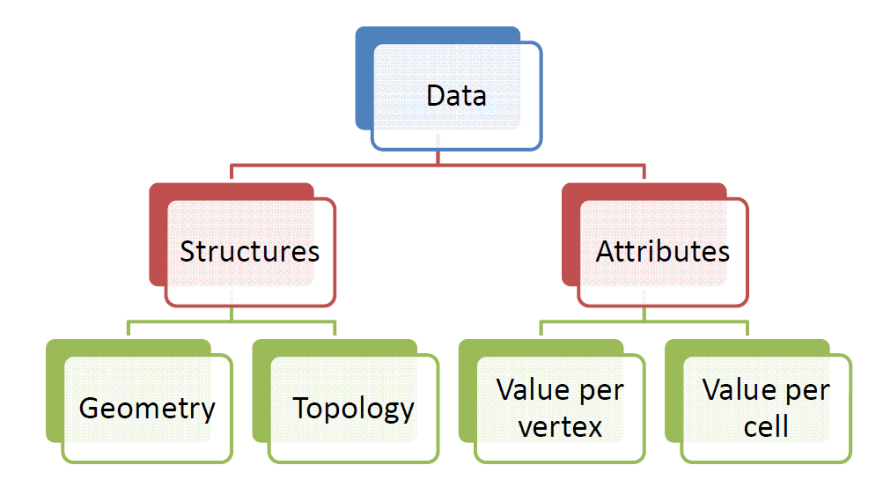
Data Characterization
Space of observation:
  Space, in which data are sampled.
Observation points:
  Elements of the space, where data are observed or sampled.
Dimension:
  Number of independent variables, typically:
    1D, 2D, 3D, 4D (3D + time).
Notes:
Definitions:
Geometry – coordinates of observation points (vertices)
Topology – connectivity of vertices (which vertices share an edge)
Cells – structural elements characterizing the topology

Slide 5
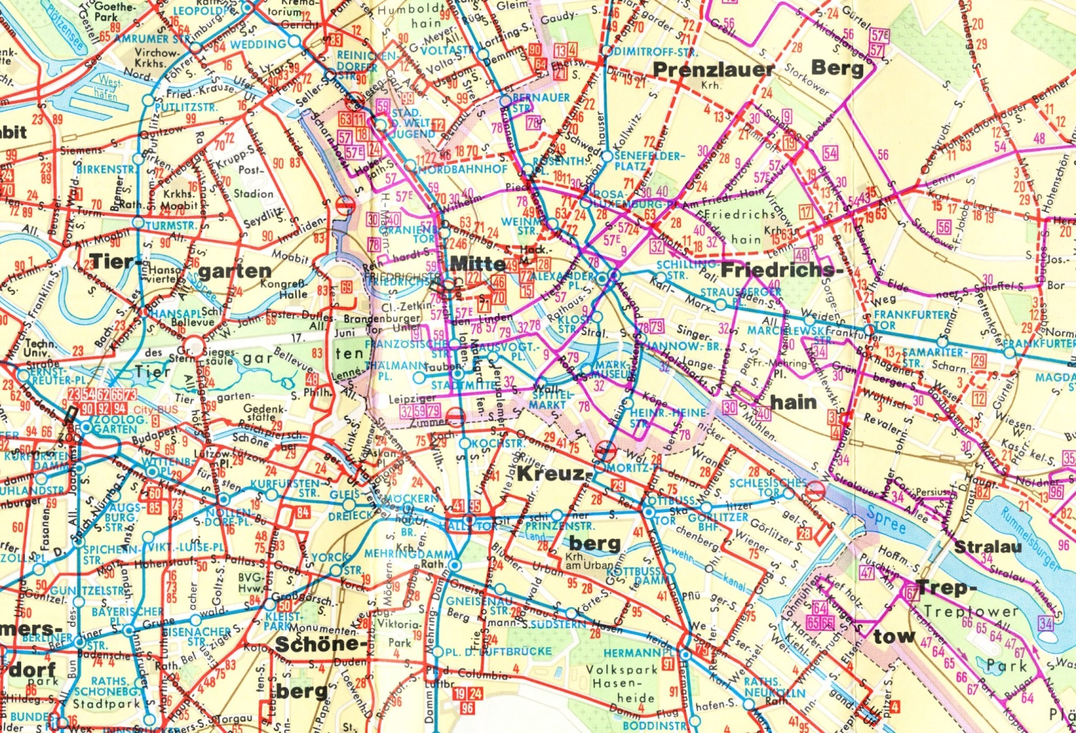
Data Characterization
Example
  Net of public transport (Berlin):
    observed, 2D, unstructured grid
  Observation points:
    Coordinates of tram/bus stops
  Topology:
    Sequence of tram/bus stops
  Attributes:
    Mapping of tram/bus stops to a set of lines (bus No. xx, tram No. yy, …)
    Type of the Line (underground, tram, bus)
    Terminal stop (Yes/No), Label with line numbers

Slide 6
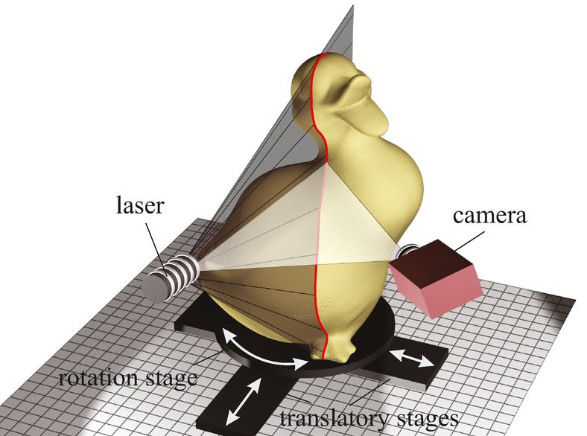
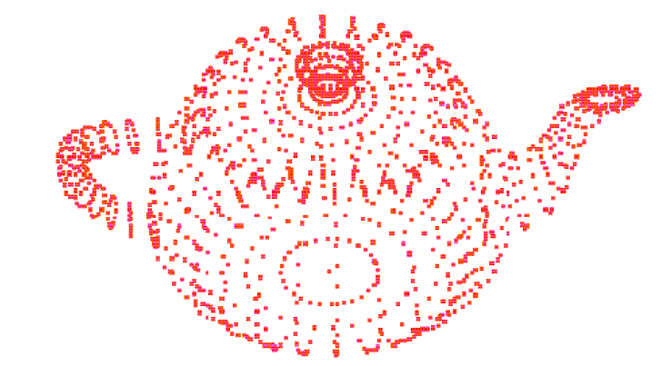
Data Characterization
Example
  Geometry acquisition: 3D scanner data

Slide 7
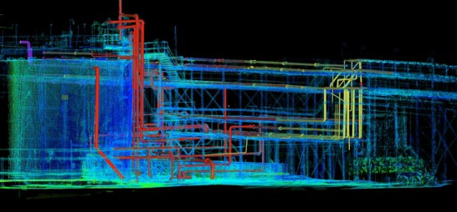
Data Characterization
Example
  3D scanner data
    measured, 3D, grid‐free (scattered) data
  Observation points:
    Points on the object’s surface
  Topology:
    Must be defined such that adjacent vertices are connected and holes are avoided
  Attributes:
    None

Slide 8
Topology vs. Geometry
Topology
  Describes properties which are invariant with respect to affine transformations (translation, shearing, rotation, …).
    Such transformations are topology preserving.
    Simplification of a polygonal mesh, in general, is not topology preserving.
  Topologic properties
    Connectivity of vertices, number of connected components, incidence of edges (at vertices).
    Public transport example: sequence of tram/bus stops, connecting stations
Geometry
  Coordinates which determine the shape
Example
  Topology: triangle, tetrahedra, …
  Geometry: 3 or 4 coordinates

Slide 9
Data: Scope of Observations
Measured or simulated data always refer to a certain scope.
Examples for scope:
  Point: Temperature measurement
  Local: Unemployment rate in a town, specific region, …
  Global: Pollution of a lake
    If there is any location in the lake where the pollution is above some threshold, the whole lake is regarded as heavily polluted

Slide 10
Data: Scope of Observations
Determination of local scopes based on point scopes (data without connectivity, scattered data):
  Assignment of regions to point scopes or
  Scattered‐data interpolation based on point scopes
Question:
  What is a good assignment of regions to points (P₀, …, P_{n})
  from R^{n} ?
    Regions G_{i} should be selected such that R^{n} is decomposed into G_{i}.
Possible answer:
  Voronoi‐decomposition, i.e. R^{n} is decomposed into regions such that for each position X in G_{j} the following is fulfilled:
  |P_{j} – X| < |P_{k} ‐X| ∀ k≠j

Slide 11
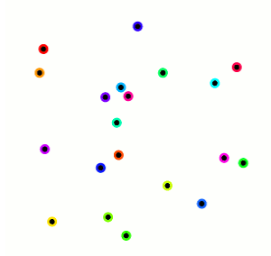
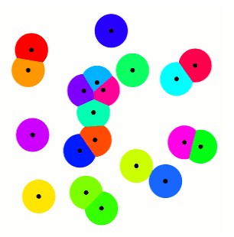
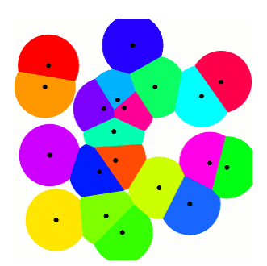
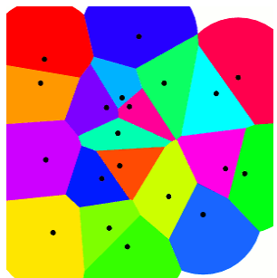
Data: Scope of Observations
Assignment of regions to point scopes

Slide 12
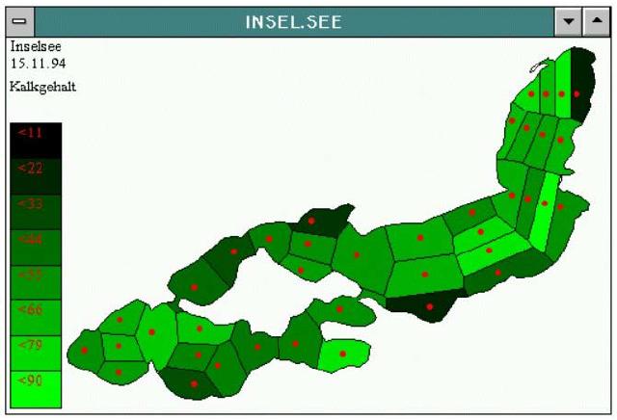
Data: Scope of Observations
Assignment of regions to point scopes
Example:
  a Voronoi decomposition in R² based on the red points of observation

Slide 13
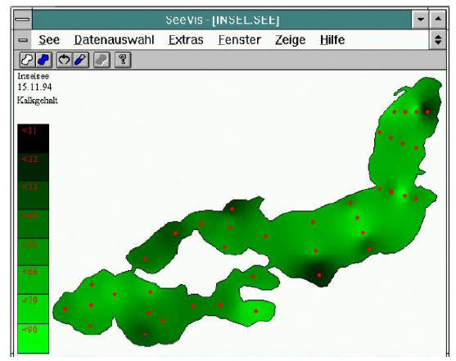
Data: Scope of Observations
Assignment of regions to point scopes
Example:
  Shepard‐Interpolation, based on the red points of observation
    Function f(p) which computes a value for all points p based on the point scopes PS.
    Constraint: values at PS must not change

Slide 14
Data Structures
Requirements:
  Compact storage of data
    Compress or pack data
    Employ dynamic data structures instead of arrays
  Efficient access (preferable in constant time)
    Prefer arrays instead of complex dynamic data structures
  Questions to guide the trade‐off:
    How much space can be saved by means of a dynamic data structure?
    What is the influence on the access time?
  Efficient generation of internal data structures from external data (consider typical external formats)
    Trade‐off: decrease time to import data at the expense of memory consumption

Slide 15
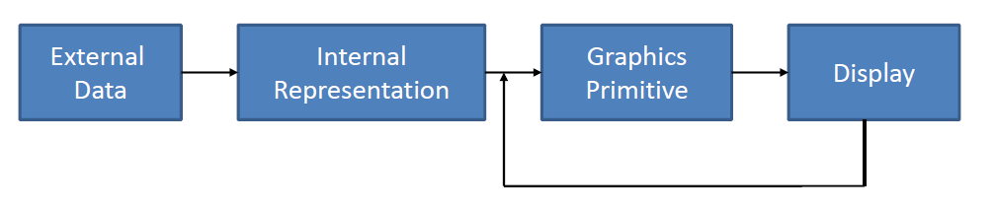
Data Structures
Requirements:
  Efficient generation of graphics primitives (fast update of visualization)
  Minimalism: hierarchical and non‐redundant data representation
  Simple design improves comprehensibility and speeds up algorithms
Data structures should be adapted to extern al formats and the rendering system.

Slide 16
Cells and Grid Structures
Cells:
  Elementary portions of a grid
  Primitives which characterize the topology
Grid Structures:
  Characterized by cell type(s)
  Topology implicitly or explicitly given
  Implicit: structured grids
  Explicit: unstructured grids

Slide 17
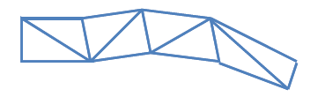
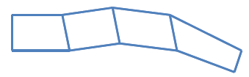
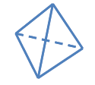
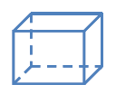
Cell Type Examples
Vertices, lines, triangles,
Triangle strips
Quadstrips
Tetrahedra
Voxel (Hexahedra)
Notes:
Voxel – volume pixel

Slide 18
Grid Structures
Structured (also regular) grids
  Regular or constant distances between observations: Coordinates of starting point and rule for the generation of coordinates is stored (e.g. constant distances)
    Applications: volume data (CT,MRT), images (Microscope)
    Advantage: Simple algorithms, efficient storage
Unstructured (also irregular) grids
  Arbitrary distances between observations: coordinates have to be stored explicitly (increased storage).
    Applications: climate data of irregularly distributed meteorological stations
    Advantage: more dense in regions with strong changes
Unstructured grids offer more flexibility than structured grids and hence are very useful in finite element and finite volume methods.

Slide 19
Structured Grids
A regular grid is a tessellation of n-dimensional Euclidean space by congruent parallelotopes (e.g. bricks).
  Each cell in the grid can be addressed by index (i, j) in 2D or (i, j, k) in 3D space.
  Each vertex has coordinates (i∙dx, j∙dy) in 2D or (i∙dx, j∙dy, k∙dz) in 3D for some real numbers dx, dy, and dz representing the grid spacing.
Types:
  Cartesian grid
  Regular grid
  Rectilinear grid
  Curvilinear grid
Notes:
Grids of this type appear on graph paper and may be used in finite element analysis as well as finite volume methods and finite difference methods.
Since the derivatives of field variables can be conveniently expressed as finite differences, structured grids mainly appear in finite difference methods.

Slide 20
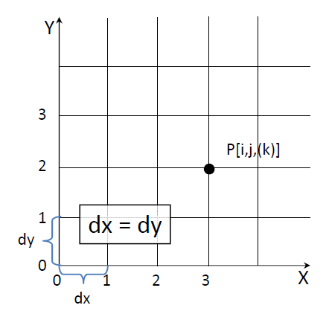
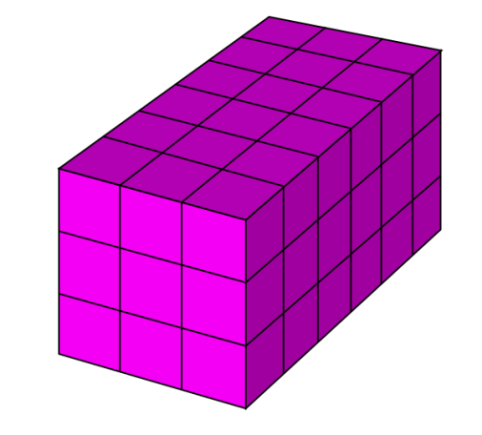
Grid Structures
Cartesian grid:
  It is a special case where the elements are unit squares or unit cubes, and the vertices are integer points.
    Axis‐aligned lines at which the points are located
    Distance between lines is constant and equal in each dimension (dx=dy=dz)

Slide 21
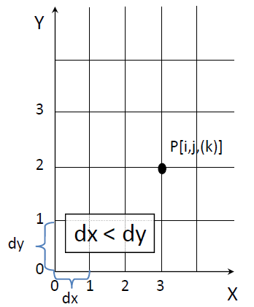
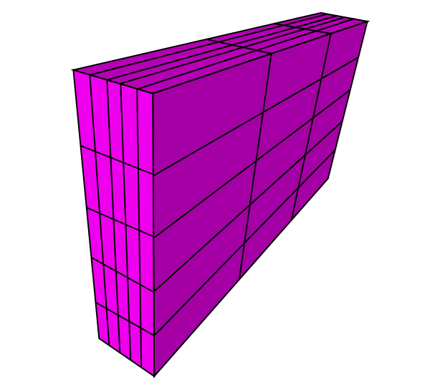
Grid Structures
Regular grid:
  Axis‐aligned lines
  Distance between lines is constant within each dimension but may vary across dimensions
    Originate from sampling devices with different resolution in x‐, y‐ and z‐direction
    Anisotropic data
  Examples:
    Computed Tomography (CT) and Magnetic Resonance (MR) scanning devices
  Typical resolution:
    CT: x‐ and y‐dimension: 0.7 mm; z‐dimension: 2 mm
    MR: x‐ and y‐dimension: 1.2 mm; z‐dimension: 4 mm

Slide 22
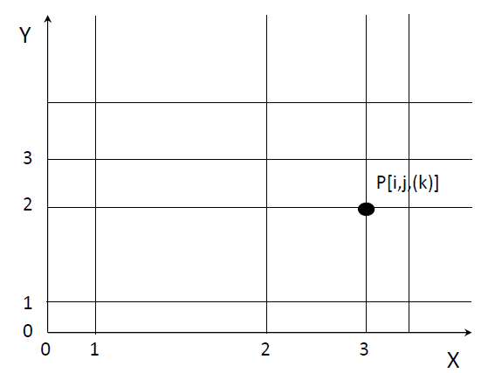
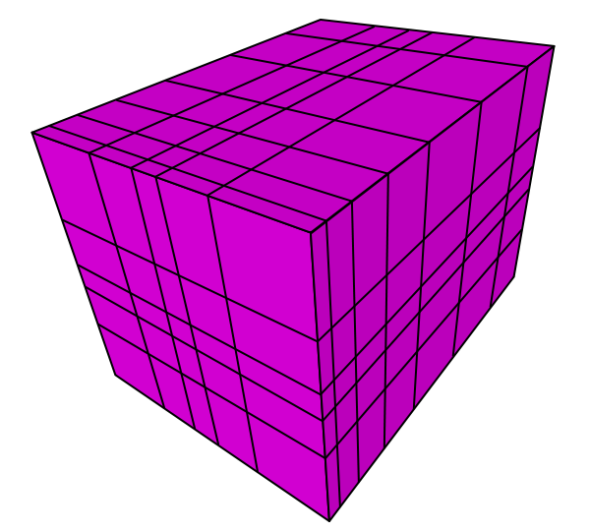
Grid Structures
Rectilinear grid:
  It is a tessellation by rectangles or parallelepipeds that are not, in general, all congruent to each other.
    The cells may still be indexed by integers as above, but the mapping from indexes to vertex coordinates is less uniform than in a regular grid.
  Axis‐aligned lines
  Variable distances between lines within dimensions and also across dimensions

Slide 23
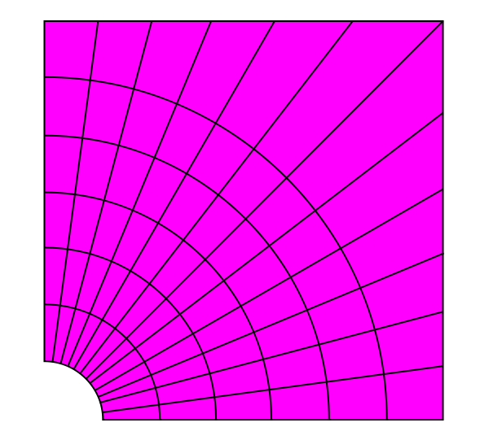
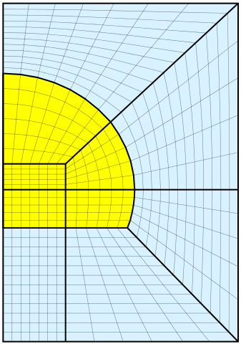
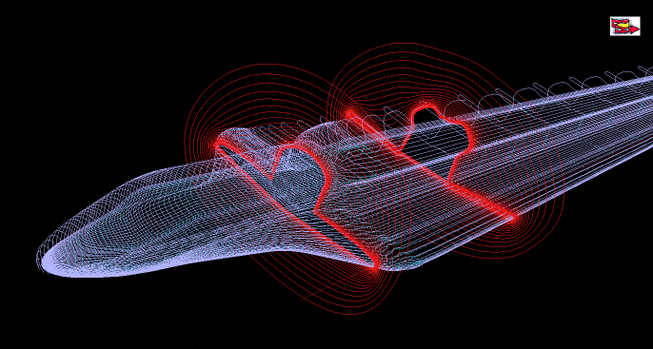
Grid Structures
Curvilinear grid:
  Grid points are located along parametric curves, e.g., Bezier curves
  Implicit topology (similar to rectilinear grids)
    x_coord[L,M,N]
    y_coord[L,M,N]
    z_coord[L,M,N]
  Geometric structure may be concave

Slide 24
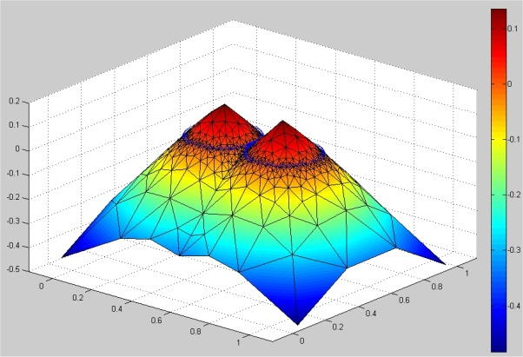
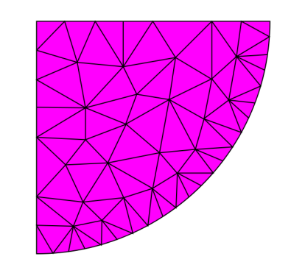
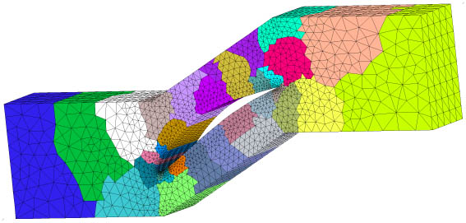
Grid Structures
Unstructured grid:
  Grid points are arbitrarily distributed in space
  Coordinates generated, e.g., by sampling a surface with a laser scanning device
  Topology is generated based on the coordinates
  Representation, e.g., by triangle or quad strips

Slide 25
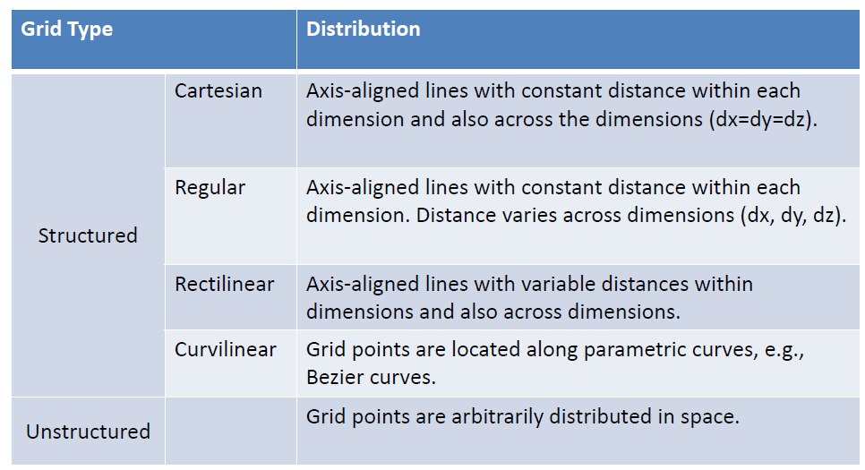
Grid Structures
Distribution of observation points

Slide 26
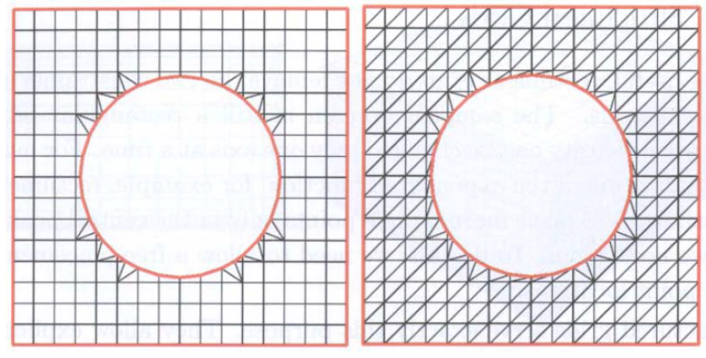
Grid Structures
Example: Element with a hole
  Two different unstructured grid representations.
  Structured grids fail to represent this complex area

Slide 27
Properties of Grid Structures
Storage requirements (increasing complexity):
  Regular grid:
    Minimal and maximal position plus the number of points in each dimension
  Rectilinear grid:
    In 2D list with x‐ and y‐coordinates in complexity
  Curvilinear grid:
    Curve descriptions and values of parameter ‘t’
  Unstructured grid:
    Lists with coordinates and topology

Slide 28
Properties of Grid Structures
Topology
  Regular Grids: It is implicitly represented.
    Based on the indices and the constant distance, coordinates are determined.
  Rectilinear Grids: It is implicitly represented.
    Distances along one row and column have to be stored. Coordinates can be easily computed based on the indices.
  Structured Grids: It is implicitly represented, most coordinates can be computed.
    The number of adjacent cells is equal for all inner cells (important for interpolation).
  Unstructured Grids:
    Coordinates of each measurement and their connectivity have 38 / 68 to be stored explicitly (high memory consumption!).

Slide 29
Properties of Grid Structures
Complexity of visualization algorithms and computational effort increase from regular to unstructured grids.
Some algorithms require regular or structured grids
  Data on other grid types has to be converted.
  Conversion requires interpolation.
Structured 3D data may be stored in a 3D array (low memory consumption, fast direct access)
Unstructured grid is appropriate if larger homogeneous areas and smaller inhomogeneous areas occur
  Strategy: adaptive refinement of an initial coarse grid in areas with higher variability in the data.

Slide 30
Representation of Unstructured Grids
Triangle strip:
  Data structure composed p of n triangles, n+2 vertices, triangle i with vertices (i, i+1, i+2).
  Why triangles (recall computer graphics)?
    Each polygon may be decomposed into triangles.
    Triangles are planar, convex polygons.
    Rendering of convex polygons is fast and simple.
    Rendering hardware supports transformation, clipping, illumination and texturing of triangles.
  Note on 3D:
    Polyhedra are decomposed into tetrahedra – the most simple and convex polyhedra.

Slide 31
Representation of Unstructured Grids
Indexed Faceset:
  Motivation:
    Reuse of vertex coordinates (e.g. triangle strip, quad strip) saves memory
  Large memory consumption for each vertex (3 floats with high accuracy → 12 Byte)
  Vertex list: Array with all coordinates
  Representation of shapes:
    Indices in the vertex list
  Variants:
    Separation of faces by a special value (often: ‐1)
    Faces with a constant number of vertices (e.g. triangle meshes)

Slide 32
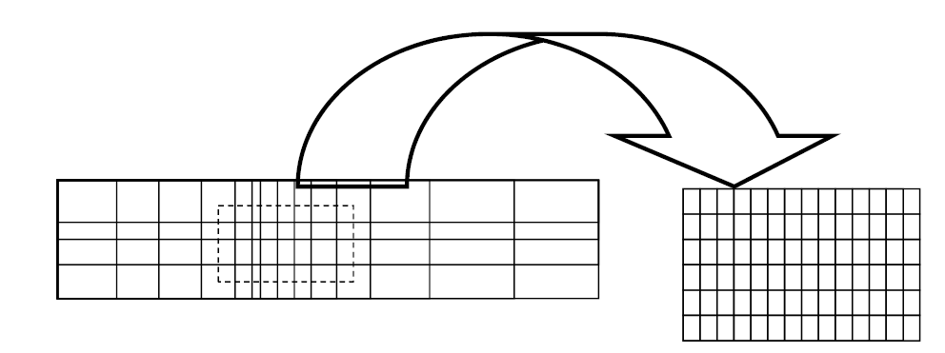
Multigrids
Focus in some areas (high resolution grid) and low resolution in less relevant regions (in order to avoid unnecessary data).
“Inflation” of interesting regions into a finer grid

Slide 33
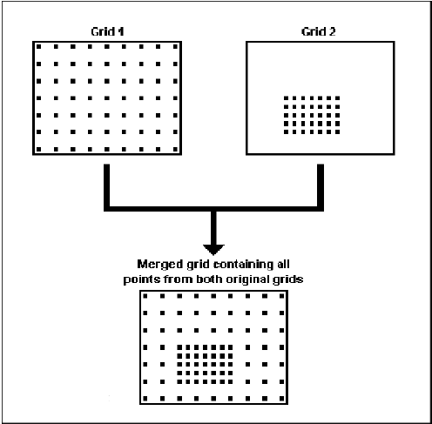
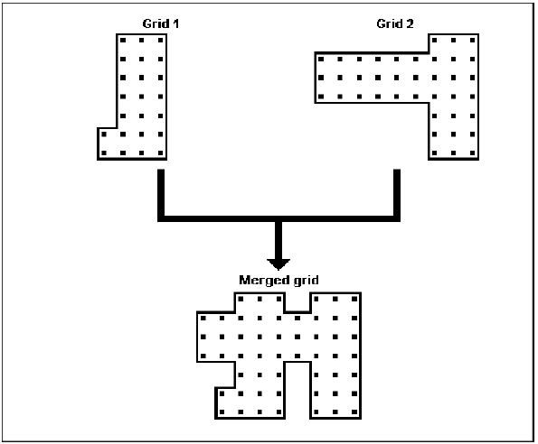
Merging Grids
Merging grids referring to different areas by means of a union of the domains.
  Note: The domains are not rectangular.
  Examples: Geographic data.
Merging grids in different resolutions.
  If a uniform resolution is desired,
  additional values must be interpolated.

Slide 34
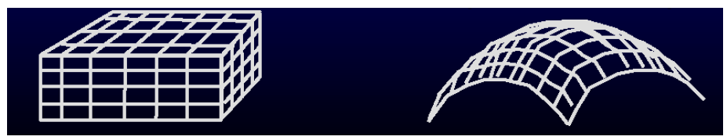
Polygonal meshes
Characterization of polygonal meshes
  nspace:
    physical dimension (number of coordinates per node)
  ndim:
    number of coordinates which characterize the space, the mesh is part of.
  Volume data:
    nspace, ndim = 3
  Curved plane:
    nspace =3, ndim = 2

Slide 35
Polygonal mesh
A polygon mesh is a collection of vertices, edges and faces that defines the shape of a polyhedral object in 3D computer graphics and solid modeling.
  The faces usually consist of triangles, quadrilaterals or other simple convex polygons, since this simplifies rendering, but may also be composed of more general concave polygons, or polygons with holes.
Volumetric meshes are distinct from polygon meshes in that they explicitly represent both the surface and volume of a structure, while polygon meshes only explicitly represent the surface (the volume is implicit).
  As polygonal meshes are extensively used in computer graphics, algorithms also exist for ray tracing, collision detection, and rigid-body dynamics of polygon meshes.

Slide 36
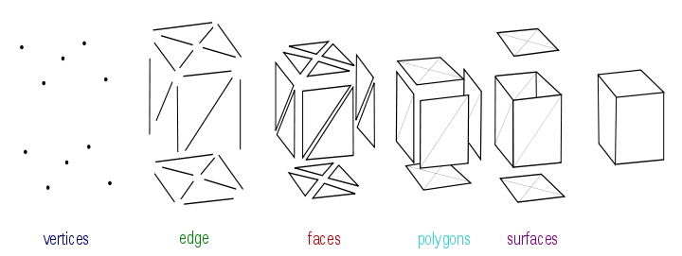
Elements of mesh model
A vertex is a position along with other information such as color, normal vector and texture coordinates.
An edge is a connection between two vertices.
A face is a closed set of edges, in which a triangle face has three edges, and a quad face has four edges.
A polygon is a coplanar set of faces. In systems that support multi-sided faces, polygons and faces are equivalent.
  Mathematically a polygonal mesh may be considered an unstructured grid, or undirected graph, with additional properties of geometry, shape and topology.
Surfaces group smooth regions.
Notes:
Objects created with polygon meshes must store different types of elements. These include vertices, edges, faces, polygons and surfaces. In many applications, only vertices, edges and either faces or polygons are stored. A renderer may support only 3-sided faces, so polygons must be constructed of many of these, as shown in Figure 1. However, many renderers either support quads and higher-sided polygons, or are able to convert polygons to triangles on the fly, making it unnecessary to store a mesh in a triangulated form. Also, in certain applications like head modeling, it is desirable to be able to create both 3- and 4-sided polygons.
Most rendering hardware supports only 3- or 4-sided faces, so polygons are represented as multiple faces.

Slide 37
Mesh Objects Representations
Vertex-vertex meshes
Face-vertex meshes
Winged-edge meshes
Half-edge meshes
Quad-edge meshes
Corner-tables meshes
Streaming meshes
Progressive meshes
Normal meshes
Render dynamic meshes

Slide 38
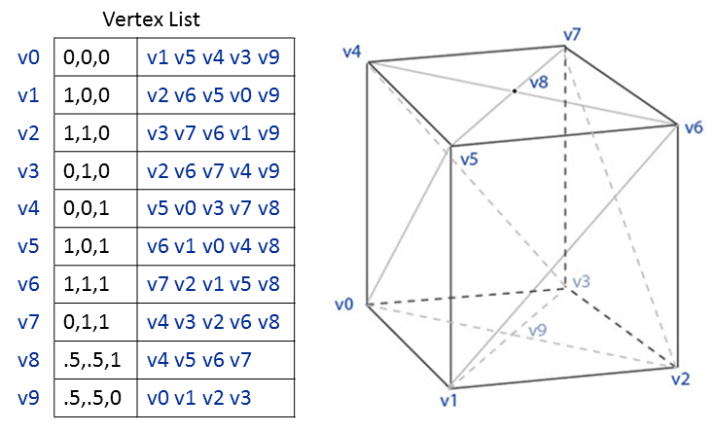
Vertex-Vertex Meshes (VV meshes)
They represent an object as a set of vertices connected to other vertices.
  This is the simplest representation, but not widely used since the face and edge information is implicit.
  It is necessary to traverse the data in order to generate a list of faces for rendering. In addition, operations on edges and faces are not easily accomplished.
They benefit from small storage space and efficient morphing of shape.
  A general system must be able to handle an arbitrary number of vertices connected to any given vertex.
Notes:
Example: the four-sided cylinder. Each vertex indexes its neighboring vertices.
The last two vertices, 8 and 9 at the top and bottom center of the "box-cylinder", have four connected vertices rather than five.

Slide 39
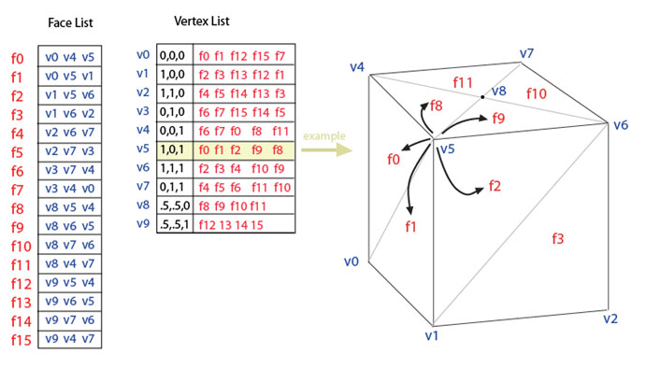
Face-Vertex Meshes (FV meshes)
They represent an object as a set of faces and a set of vertices.
  This is the most widely used mesh representation, being the input typically accepted by modern graphics hardware.
  They improve on VV-mesh for modeling in that they allow explicit lookup of the vertices of a face, and the faces surrounding a vertex.
  The vertex list contains a list of faces connected to each vertex.
    With FV meshes it is easy to find the vertices of a face.
    Unlike VV meshes, both faces and vertices are explicit, so locating neighboring faces and vertices is constant time.
Notes:
Modeling requires easy traversal of all structures.
The edges are implicit, so a search is still needed to find all the faces surrounding a given face.
Other dynamic operations, such as splitting or merging a face, are also difficult with face-vertex meshes.

Slide 40
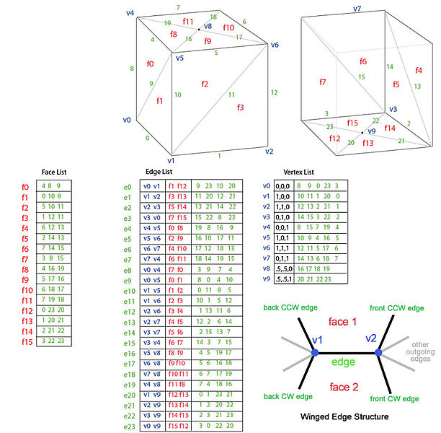
Winged-edge meshes
They explicitly represent the vertices, faces, and edges of a mesh.
  This representation is widely used to provide the greatest flexibility in dynamically changing the mesh geometry, because split and merge operations can be done quickly.
  Their primary drawback is large storage requirements and increased complexity due to maintaining many indices.
They address the issue of traversing from edge to edge, and providing an ordered set of faces around an edge.
Notes:
For any given edge, the number of outgoing edges may be arbitrary. To simplify this, winged-edge meshes provide only four, the nearest clockwise and counter-clockwise edges at each end. The other edges may be traversed incrementally. The information for each edge therefore resembles a butterfly, hence "winged-edge" meshes.
Example: the "box-cylinder" as a winged-edge mesh. The total data for an edge consists of 2 vertices (endpoints), 2 faces (on each side), and 4 edges (winged-edge).

Slide 41
Other meshes types
Half-edge meshes:
  Similar to winged-edge meshes except that only half the edge traversal information is used.
Quad-edge meshes
  They store edges, half-edges, and vertices without any reference to polygons.
  The polygons are implicit in the representation, and may be found by traversing the structure.
  Memory requirements are similar to half-edge meshes.

Slide 42
Other meshes types
Corner-tables
  They store vertices in a predefined table, such that traversing the table implicitly defines polygons.
    This is in essence the triangle fan used in hardware graphics rendering.
  The representation is more compact, and more efficient to retrieve polygons, but operations to change polygons are slow.
    They do not represent meshes completely.
    Multiple corner-tables (triangle fans) are needed to represent most meshes.

Slide 43
Other meshes types
Render dynamic meshes
  They combine winged-edge meshes and face-vertex meshes.
    They explicitly store the vertices of a face, the faces of a vertex, and the faces and vertices of an edge (like winged-edge).
  They require slightly less storage space than standard winged-edge meshes, and can be directly rendered by graphics hardware since the face list contains an index of vertices.
    Traversal from vertex to face is explicit (constant time), as is from face to vertex.
    RD meshes do not require the four outgoing edges since these can be found by traversing from edge to face, then face to neighboring edge.
  They benefit from the features of winged-edge meshes by allowing for geometry to be dynamically updated.

Slide 44
Other meshes types
Streaming meshes
  They store faces in an ordered, yet independent, way so that the mesh can be transmitted in pieces.
    The order of faces may be spatial, spectral, or based on other properties of the mesh.
  They allow a very large mesh to be rendered even while it is still being loaded.

Slide 45
Other meshes types
Progressive meshes
  They transmit the vertex and face data with increasing levels of detail.
    Unlike streaming meshes, progressive meshes give the overall shape of the entire object, but at a low level of detail.
  Additional data, new edges and faces, progressively increase the detail of the mesh.

Slide 46
Other meshes types
Normal meshes
  They transmit progressive changes to a mesh as a set of normal displacements from a base mesh.
    With this technique, a series of textures represent the desired incremental modifications.
  They are compact, since only a single scalar value is needed to express displacement.
    However, the technique requires a complex series of transformations to create the displacement textures.

Slide 47
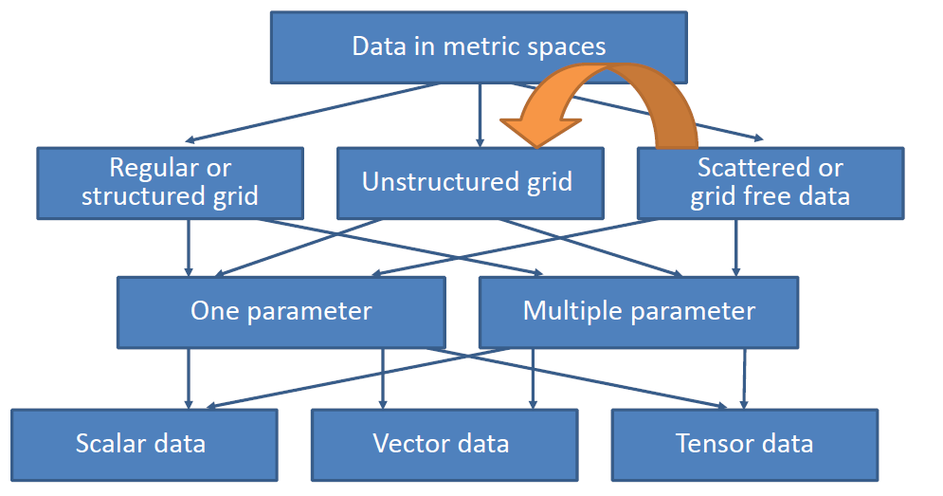
Data in Metric Spaces

Slide 48
Mesh Quality
Element type?
  2d: triangles vs quadrilaterals
  3d: tetrahedra vs hexahedra
  This talk: primarily triangles and tetrahedra
  Quality guarantees for quad/hex meshes much less developed
Element shape?
  Avoid sharp angles, flat angles, distorted elements
  Affects accuracy of numerical simulation
Number of elements?
  More elements = slower solution time

Slide 49
Mesh Quality
Element size?
  Need small elements near small features or abrupt changes in solution large elements ok in uninteresting parts of domain
Elements on domain boundaries?
  May be required to match existing domain boundary mesh for quality reasons or to mesh multi-domain input

Slide 50
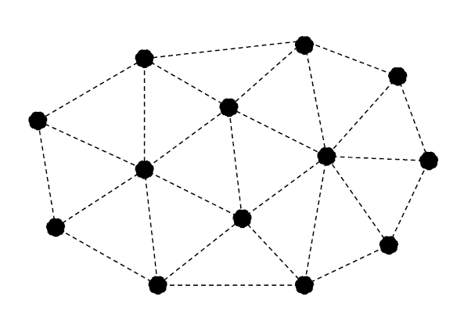
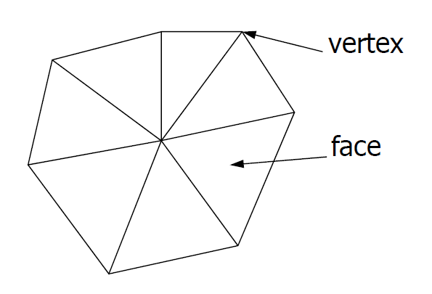
Scattered Data Triangulation
Scattered Data (data without grid)
  Irregularly distributed points
  No connectivity information
  Connectivity is determined by means of triangulation
    Net with triangles (2D) or tetrahedra (3D)
    Points as vertices

Slide 51
Scattered Data Triangulation
There are many variants how a given point set may be transformed into a triangle mesh.
  Preferred triangulations prevent thin, elongated triangles.
Criteria for thinness:
  Ratio of the radius of the incircle and the enclosing circle should be large for all triangles.
  Ratio of the smallest to the largest inner angle should be large.
Ideal result is a polygonal mesh with the following properties:
  No artificial holes
  No overlapping triangles
  No T‐junctions

Slide 52
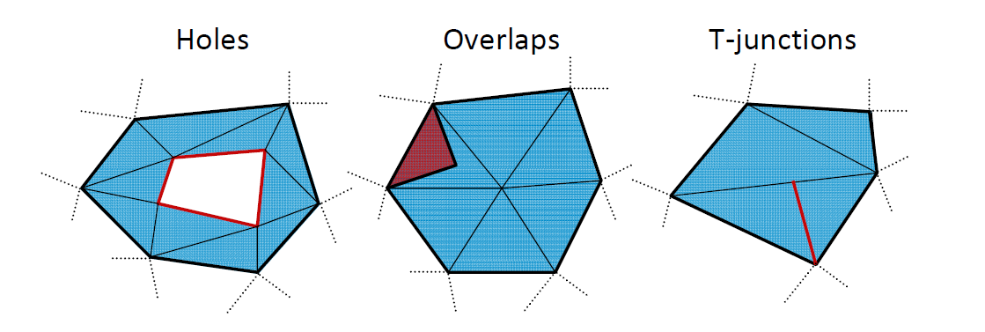
Scattered Data Triangulation
Examples for invalid triangle meshes:

Slide 53
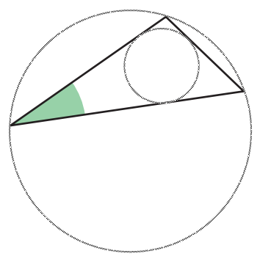
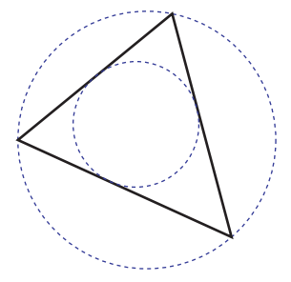
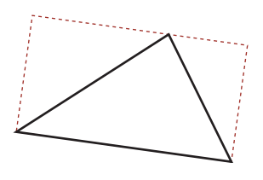
Triangle Quality
Minimum angle bounded below by a constant.
  Radius of incircle/Radius of enclosing circle ~ 0.1
Ratio of perimeter² to area bounded above by a constant.
Ratio of circumcircle and incircle radii bounded above by a constant.
  Radius of incircle/Radius of enclosing circle ~ 0.5
Semiperimeter is longer than longest side by a factor of at least 1+ε for some constant ε.
Ratio of diameter to height bounded by constant.

Slide 54
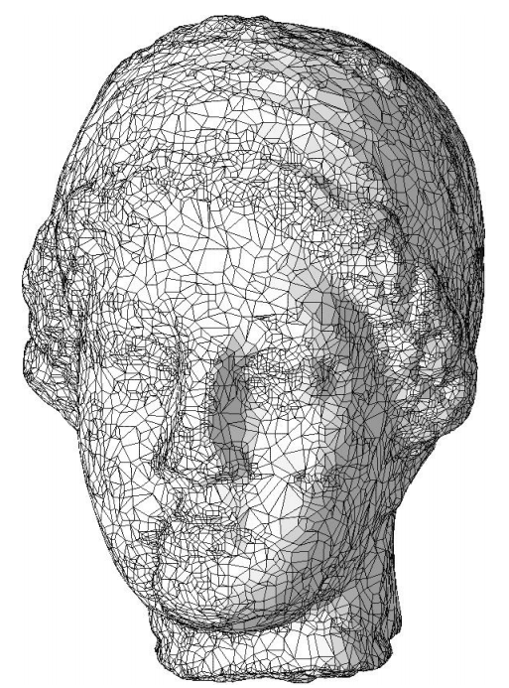
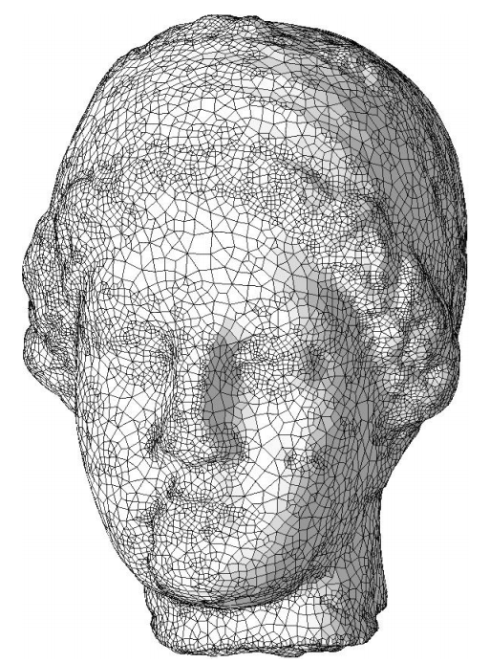

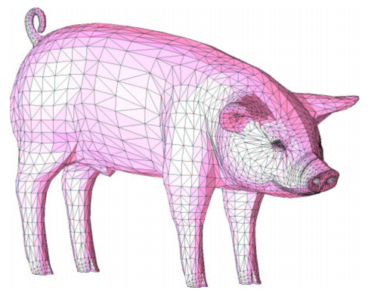
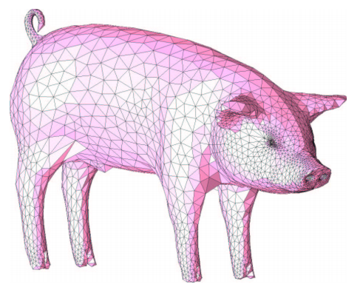

Triangle Quality
Optimization of triangle quality

Slide 55
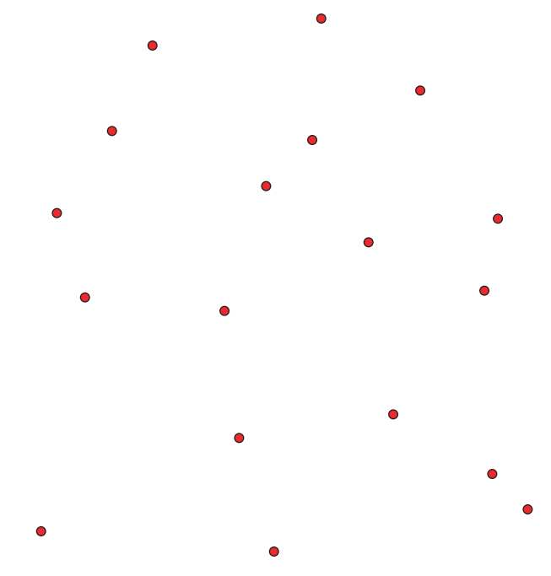
Scattered Data Triangulation
Generation of a triangulation for a given point set:
  Voronoi diagram
  Delaunay Triangulation

Slide 56


Delaunay‐Triangulation
Delaunay‐Triangulation
  Connect two points by edge if some circle exists with them on boundary, empty interior
  Collection of all such edges for points in general position (no four cocircular) forms triangle mesh covering convex hull
  Properties
    Uniquely defined
    Maximizes the ratio of incircle to enclosing circle
    Maximizes the smallest angle in all triangles
    The enclosing circle of the triangle pa, pb, pc does not contain any p_{i} for all p_{i} ∈ P, i ≠ a,b,c

Slide 57

Scattered Data Triangulation
Voronoi diagram
  It is partition into cells having given points as nearest neighbors
    For a pointset P in a plane, the Voronoi diagram represents a decomposition into cells z_{i} for each Point p_{i} ∈ P, with the property that for each point q in cell z_{i} the following relation is fulfilled:
  dist (q, p_{i}) < dist (q, p_{j}) for all p_{i,j} ∈ P, j ≠ i
  dist represents the Euclidean distance.
  Delaunay triangulation is planar dual of Voronoi diagram
    Voronoi edges = centers of empty circles touching two points
    Unless points cocircular, cells meet in threes → triangulation

Slide 58
Questions ?

