Slide 1
Imperative
(Procedural)
Paradigms
Fortran, Algol,
Modula, Ada, Pascal, C

Slide 2
Introduction
The imperative (procedural) programming paradigm is the oldest and the most traditional one.
  It has grown from machine and assembler languages, whose main features reflect the John von Neuman’s principles of computer architecture.
An imperative program consists of explicit commands (instructions) and calls of procedures (subroutines) to be consequently executed.
  They carry out operations on data and modify the values of program variables (by means of assignment statements), as well as external environment.
Within this paradigm variables are considered as containers for data similar to memory cells of computer memory.

Slide 3
Introduction
The imperative paradigm is the most popular programming paradigm because:
  Imperative programs tend to run much faster than other types of program.
  The imperative paradigm is much more in tune with the computer community's way of thinking.
  Programmers are prepared to sacrifice some of the advanced features of higher level languages in exchange for speed of execution.
  There is a tendency for programmers to get "bogged down" with control issues.

Slide 4
Imperative languages
Programming languages can be grouped according to the characteristics that they display.
Imperative languages have following characteristics:
  By default statements (commands) are executed in a step-wise, sequential, manner.
    As a result order of execution is crucial.
  Destructive assignment.
  Control is the responsibility of the programmer
    Programmers must explicitly concern themselves with issues such as memory allocation and declaration of variables.
Interpretation or compilation ?
  Most imperative languages are designed explicitly for compilation.
  Some very high-level imperative languages are interpreted (e.g. ICON).

Slide 5
Imperative programming
State-based, assignment-oriented approach:
  A program is a sequence of state-changing actions.
Any imperative program consists of
  Declarative statements which gives a name to a value.
    A named value is called a variable. Thus, declarative statements create variables.
    In procedural languages it is common for the same variable to keep changing value as the program runs.
  Imperative statements which assign new values to variables.
  Program flow control statements which define order in which imperative statements are evaluated.
Program units:
  Data: Variables and constants
  Computation: Statements and routines

Slide 6
Imperative programming
Example:
var factorial = 1; /*Declarative statement*/
var argument = 5;
var counter = 1;
while (counter <= argument) /*Program flow statement*/
{
factorial = factorial*counter; /*Imperative statement*/
counter++;
}

Slide 7
Imperative programming
Oldest and most popular paradigm
  Fortran, Algol, C, Pascal …
Mirrors computer architecture
  In a von Neumann machine, memory holds instructions and data
Key operations: assignment
  Side effect: updating state (i.e., memory) of the machine
Control-flow statements
  Unconditional (GoTo) and conditional branches, loops slide.

Slide 8
Imperative programming
Any imperative program manipulates an abstract machine with:
  Variables that name memory locations
  Arithmetic and logical operations
  Reference, evaluate, assign operations
  Explicit control flow statements
A programming language is said to be Turing complete if it contains
  Integer variables, values and operations
  Assignment statements
  Statement sequencing
  Conditionals (if)
  Branching statements (goto)

Slide 9
Imperative programming
An imperative programming language is one which is Turing complete and also (optionally) supports:
  Data types for real numbers, characters, strings, booleans and their operators
  For and while loops, case (switch) statements
  Arrays
  Records
  Input and output commands
  Pointers
  Procedures and functions

Slide 10
Structured programming
The concept of structured programming devised in late 1960s (Dijkstra and others).
Emphasizes programming using sequences, conditions and repetition (no jumps and “goto” statements).
Constructs which have a predictable logic, i.e. they are entered at the top and exited at the bottom.
Structured programming enhances readability and hence maintainability.

Slide 11
Modular programming
The concept of modular programming was first taken seriously in the early 1970s.
Modular programming is concerned with sub-division of programs into manageable “chunks”.
The concept also encompasses ideas about levels of abstraction.
  Modules are usually arranged in a hierarchy of abstraction.
Modularity also espouses the concept of information hiding.

Slide 12
Information hiding
It is concerned with the idea that the programmers attention shouldn’t be distracted by details not central to their current programming task.
  Programmers should not be required to be concerned with unnecessary details.
In the imperative paradigm this is achieved through the use of modules or packages.
  Modules (packages) should be designed so that information contained within those modules is “hidden” from other modules (packages).

Slide 13
Imperative programming languages
FORTRAN
  `The IBM Mathematical FORmula TRANslating system'.
    Designed circa 1955 (by, amongst others, Backus).
  First successful attempt to improve on "assembly languages".
    Still widely used for numerical applications.
  Has been revised to take account of ideas on structured programming etc.
    However is decreasing in popularity.

Slide 14
Imperative programming languages
ALGOL’60
  `ALGOrithmic Language 1960'.
    Developed in 1950s through a joint European-American committee.
  First block-structured language.
  First language whose syntax was defined using BNF.
  Direct ancestor of most modern imperative languages.
COBOL
  `COmmon Business Oriented Language'
    Developed in 1950s through a committee consisting mainly of US computer manufacturers.
  Designed to process large data files and is therefore the most extensively used language for data processing.
  Has been revised several times, but revisions have been unable to take into account programming concepts such as structured programming and modularity.

Slide 15
Imperative programming languages
BASIC
  Beginner's All-purpose Symbolic Instruction Code.
  Teaching language made popular by the advent of the microcomputer in the mid 70s.
PL/1
  Intended to be an all purpose programming language to support both scientific and data processing applications.
  Did not live up to its aspirations.
Algol'68
  Successor to ALGOL'60. Proved less popular than its predecessor.
Pascal
  A popular block structured teaching language devised by Niklaus Wirth.
Simula'67
  Simulation language, significance of which is that it introduced the "class" concept.

Slide 16
Imperative programming languages
Modula-2
  Pascal extended with modules.
Ada
  Pascal based language sponsored by the US Department of Defence.
BCPL
  Systems programming languages, significance of which is that it is a precursor to C.
C
  Systems programming language used in the development of the UNIX system.
  Is at a lower level than most imperative languages.
  Standardised in 1988 to ANSI C.
C++

Slide 17
Features of imperative programming languages
They are usually "typed".
  Two main categories of imperative data type:
    Basic data types.
    Higher level data types.
Components comprise:
  Data declarations.
  Expressions which yield values.
  Statements which carry out some operation, e.g. assignment statements, conditional statements, program constructs.
An I/O mechanism.
An error-handling mechanism.
A method of grouping all of the above into a complete program (program composition).

Slide 18
Imperative programming
  Examples:
for (i = 1; i <= 10; i++)
x = x+2*i;
C
for i := 1 to 10 do
x := x + 2*i;
Pascal
for i in 0..10 loop
x := x+2*i;
end loop;
ADA
DO 11 I=1,10
X = X + 2*I
11 CONTINUE
FORTRAN

Slide 19
Procedural programming
Procedure:
  the act, method or manner of proceeding in some process or course of action
  a particular course of action or way of doing something.
When imperative programming is combined with subprograms, it is called procedural programming.

Slide 20
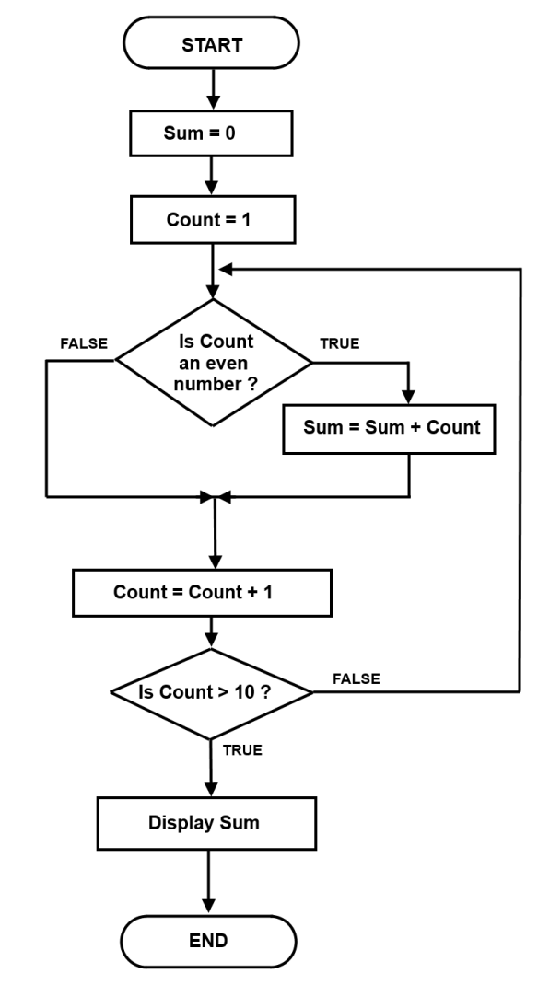
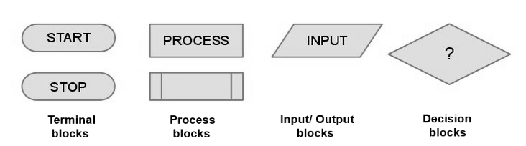
Flowchart
Used to model imperative programs
  Based on the three control statements that are essential to have Turing machine capability.
Originated to describe process flow in general.
  Precursor of UML and other modern techniques.
  Basic blocks are:

Slide 21
Elements of imperative programs
Data type definitions
Variable declarations (usually typed)
Expressions and assignment statements
Control flow statements (usually structured)
Lexical scopes and blocks
  Goal: provide locality of reference
Declarations and definitions of procedures and functions (i.e., parameterized blocks)

Slide 22
Data and Computation
Binding
Data
  Variables
  Data types
Computation
  Assignments and expressions
  Control structures
  Subprograms / routines

Slide 23
Binding
Program units/entities have attributes
  e.g., a variable has a name, a statement has associated actions
  Examples:
    the meaning of a keyword such as if
    the operation associated with a symbol such as +
    the entity (variable, keyword, etc.) represented by an identifier
    the memory location for the value of an identifier
A binding in a program is an association of an attribute with a program component such as an identifier or a symbol.
The binding time for an attribute is the time at which the binding occurs.
  In C the binding time for a variable type is when the program is compiled.
  In C the value of the variable is not bound until the program executes.
Notes:
The binding time for a variable type is when the program is compiled - the type cannot be changed without changing and recompiling the program.
The value of the variable is not bound until the program executes - that is, the value of the variable can change during execution.

Slide 24
Binding Time
The most common binding times for attributes are (in chronological order):
  Language definition
    Example: general meaning of symbol / in C because it is an operator .
  Language implementation
    Example: size of an int in C.
  Program translation (compile time)
    Example: specific meaning of symbol / in C: <int> / <int> or <float> / <float>
  Link edit
    Example: specific computation performed by an external function
  Load
    Example: memory address of a global variable
  Program execution (run time)
    Examples: memory address of a local variable; value of a global variable
Notes:
Meaning of /: The general meaning of + was defined (as numerical division) when the language was defined. The specific addition operation (float, double, int, etc.), however, cannot be determined until program translation time, when it becomes bound to the / symbol used in the operation.
Computation performed by an external function: A function in another program file (i.e., an external function) can come from a library or from another compilation. The specific function that is linked to the function call is not determined until the program modules are combined by the linkage editor, and in fact different computations could be done by using different external modules in different link edits.

Slide 25
Variables
A named location in memory that can hold a value.
  Formally, a 5-tuple: Name, Scope, Type, l-value, r-value
Name of variable
  Declaration
  Identifier rules and significant characters
  Name bound during compile time
Scope of variable
  Definition
    range of instructions over which variable name is known
    namespaces
  Blocks (as in Pascal or C)
  Static vs dynamic scope binding

Slide 26
Variables: Declaration
Typed variable declarations restrict the values that a variable may assume during program execution
  Built-in types (int, char …) or user-defined
  Initialization
    What about C?
Variable size
  How much space needed to hold values of this variable?
    C on a 32-bit machine: sizeof(char) = 1 byte, sizeof(int) = 2/4 bytes,
    sizeof(float) = 4 bytes, sizeof(void *) = 4 bytes
    What about this user-defined datatype:
struct Data {
int num;
char *name;
}
union Data {
int num;
char *name;
}

Slide 27
Data types
Purpose: classification and protection
  note that all data are ultimately represented as bit-strings
Consists of
  Set of values
  Operations
Built-in/Primitive vs User-defined types
  binding?
Implicit declarations
  e.g., FORTRAN and first letter of a variable and first assignment in BASIC
Dynamic typing

Slide 28
Data types
Advantages:
  abstraction
  compile-time checking and resolution
  explicit specification
Types can be weak or strong.
  Strong type means that at any point in the program, when it is running, the type of a particular chunk of data (i.e. variable) is known.
  Weak type means that imperative operators may change a variable type.
  Example:
      var PersonName; /*variable of a weak type”*/
      PersonName = 0; /*PersonName is an “integer”*/
      PersonName = ‘Nick’; /*PersonName is a “string”*/

Slide 29
Data types
Obviously, languages supporting weak variable types need sophisticated rules for type conversions.
  Example:
      var PersonName; /*variable of a weak type”*/
      PersonName = 0; /*PersonName is an “integer”*/
      PersonName = PersonName + ‘Nick’ + 0; /*PersonName is a string “0Nick0”*/
To support weak typing, values are boxed together with information about their type - value and type are then passed around the program together.

Slide 30
Data types
Primitive data types
  Integer, Real, Decimal
  Character, String
  Boolean
User-defined data types (using type constructor)
  Pointer, Reference type
  Complex types
    Enumeration, Subrange
    Composite types
    Aggregations
      cartesian product (records or structures)
      mapping (arrays, associative array)
      unions

Slide 31
Variables: Location and values
When a variable is declared, it is bound to some memory location and becomes its identifier
  Location could be in global, heap, or stack storage.
l-value:
  Memory location (address)
    lifetime
    Memory allocation
r-value
  Value stored at the memory location identified by l-value
    initialization
    constants
Assignment: A (target) = B (expression)
  Destructive update: overwrites the memory location identified by A with a value of expression B.
Notes:
What if a variable appears on both sides of assignment?

Slide 32
Copy vs. Reference Semantics
Copy semantics
  Expression is evaluated to a value, which is copied to the target.
  Used by imperative languages.
Reference semantics
  Expression is evaluated to an object, whose pointer is copied to the target.
  Used by object-oriented languages.

Slide 33
Variables: Assignment
On the right hand side (RHS) of an assignment, use the variable’s r-value; on the left hand side (LHS), use its l-value
  Example: x = x+1
    Meaning: “get r-value of x, add 1, store the result into the l-value of x”
An expression that does not have an l-value cannot appear on the LHS of an assignment
  What expressions don’t have l-values?
    Examples: 1=x+1, ++x++
    What about a[1] = x+1, where a is an array?

Slide 34
l-values and r-values
Any expression or assignment statement in an imperative language can be understood in terms of l-values and r-values of variables involved
  In C, also helps with complex pointer dereferencing and pointer arithmetic
Literal constants
  Have r-values, but not l-values
Variables
  Have both r-values and l-values
  Example: x=x*y
    Means “multiply r-value of x by r-value of y and store it in l-value of x”

Slide 35
l-values and r-values
int x = 5; // lvalue(x) is some (stack) address, rvalue(x) == 5
int *p = &x; // lvalue(x) is some (stack) address, rvalue(x) == 5
*p = 2 * x;
Pointer variables
  Their r-values are l-values of another variable
    Intuition: the value of a pointer is an address
Overriding r-value and l-value computation in C
  &x always returns l-value of x
  *p always return r-value of p
    If p is a pointer, this is an l-value of another variable
int x = 5;
int *p = &x;
*p = 2 * x;
lvalue(x) is some (stack) address, rvalue(x) == 5
rvalue(p) == lvalue(x)
rvalue(p) <- rvalue(2) * rvalue(x)
The value of x is 10 after this point

Slide 36
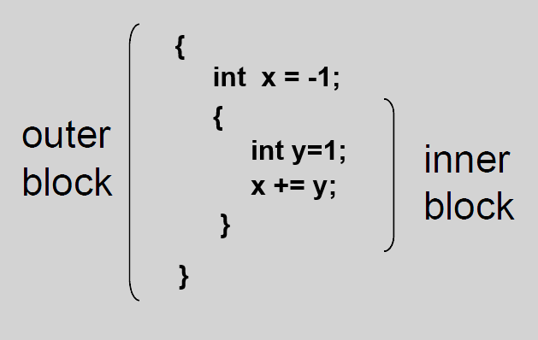
Block-structured languages
Examples
  { … } -> C
  begin … end -> Algol, Pascal, Modula
Two forms of blocks
  Inline blocks
    Data structure stored on run-time stack
    Contains space for local variables
  Blocks associated with functions or procedures
Nested blocks
  Local/global variables
  Storage management
    Enter block: allocate space for variables
    Exit block: some or all space may be deallocated

Slide 37
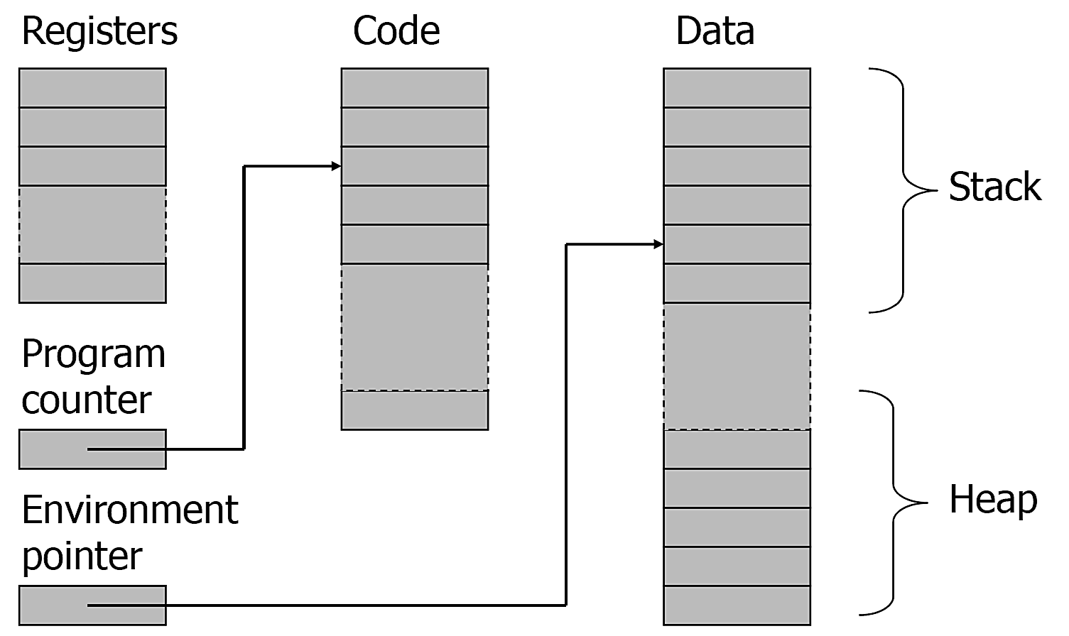
Simplified machine model

Slide 38
Simplified machine model
Registers, Code segment, Program counter
  Ignore registers (for our purposes) and details of instruction set
Data segment
  Stack contains data related to block entry/exit
  Heap contains data of varying lifetime
  Environment pointer points to current stack position
    Block entry: add new activation record to stack
    Block exit: remove most recent activation record

Slide 39
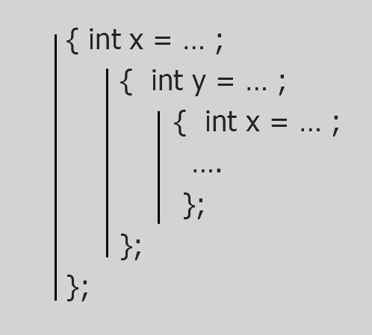
Scope & Lifetime of variables
Scope
  Region of program text where declaration is visible
Lifetime
  Period of time when location is allocated to program
Example:
  Inner declaration of x hides outer
  one (“hole in scope”)
  Lifetime of outer x includes time
  when inner block is executed
    Lifetime ≠ scope

Slide 40
Structured control flow
Control structures are program building blocks that determine the order in which statements in a program are executed
Control flow in imperative languages is most often designed to be sequential
  Instructions executed in order they are written
  Some also support concurrent execution
Program is structured if control flow is evident from syntactic (static) structure of program text
  Big idea: programmers can reason about dynamic execution of a program by just analyzing program text
  Eliminate complexity by creating language constructs for common control-flow “patterns”
    Iteration, selection, procedures/functions

Slide 41
Structured control flow
The structure theorem states that all programming problems can be solved by using 3 control structures
  Sequence
  Selection
  Repetition

Slide 42

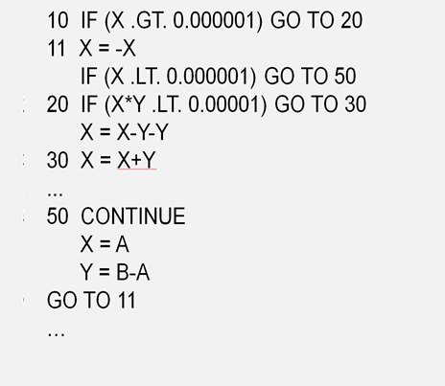
Structured programming
A disciplined approach to imperative program design.
Uses procedural abstraction and top-down design to identify program components
Does not use goto statements
  Example:
    FORTRAN control structure
Notes:
Similar structure may occur in assembly code

Slide 43
Historical debate
Dijkstra, “GO TO Statement Considered Harmful”
  Letter to Editor, Comm. ACM, March 1968
  Linked from the course website
Knuth, “Structured Programing with Go To Statements”
  You can use goto, but do so in structured way …
Continued discussion
  Welch, “GOTO (Considered Harmful)^{n}, n is Odd”
General questions
  Do syntactic rules force good programming style?
  Can they help?

Slide 44
Modern style
Standard constructs that structure jumps
  if … then … else … end
  while … do … end
  for … { … }
  case …
Group code in logical blocks
Avoid explicit jumps (except function return)
Cannot jump into the middle of a block or function body

Slide 45
Expressions & Statements
Operators
  Unary, binary, and others (functions?)
  Value returned vs effect
  Precedence rules & Associativity rules
Operands: variables, literals
  Order of evaluation: Operator & Operand
  Order of operand
    Functional side effect
  Short-circuit evaluation
    Side effect in expression
Statements
  The semicolon: C (terminator) vs Pascal (separator)
  Blocks: C { } vs Pascal (begin-end)
  Control structures: decision, iteration, routines

Slide 46
Selection
Allows programs to “select” a set of instructions to execute based on the presence (or absence) of a condition.
  This is a conditional execution: conditions and Boolean values.
Most programming languages have 2 selection statements
  Two-way selector( if in C, if in Pascal, IF in FORTRAN)
    Single- and multi-statement body
    Someone don’t have an “else” part
  Arithmetic IF-statement – FORTRAN
    IF (X) 10, 20, 30
  Multi-way selector (switch in C, case in Pascal)

Slide 47
Selection
Examples:
  if with multi-statement body
  if with single-statement body
  If <condition> Then
    <statements to execute when true>
  Else
    <statements to execute when false>
  End If
  If <condition> Then
    <the statement to execute when true>
  Else
    <the statement to execute when false>

Slide 48
Selection problem
Assume that you have been asked to write a program to find the largest of a set of 3 numbers. The user will enter 3 integers between 0 and 100. The program will display appropriate messages and display the largest of the 3 numbers.
  FindLargest (Version1)
  Get Num1, Num2 and Num3
  If Num1 > Num2 Then
  Largest = Num1
  Else
  Largest = Num2
  End If
  If Num3 > Largest Then
  Largest = Num3
  End If
  Display label and Largest
  End
  FindLargest (Version 2)
  Get Num1, Num2 and Num3
  If Num1 > Num2 Then
  If Num3 > Num1 Then
  Largest = Num3
  Else
  Largest = Num1
  End If
  Else
  If Num3 > Num2 Then
  Largest = Num3
  Else
  Largest = Num2
  End If
  End If
  Display label and Largest
  End
  FindLargest (Version 3)
  Get Num1, Num2 and Num3
  If Num1 > Num2 and Num1 > Num3 Then
  Largest = Num1
  Else If Num1 > Num2 and Num3 > Num1 Then
  Largest = Num3
  Else If Num2 > Num1 and Num2 > Num3 Then
  Largest = Num2
  Else If Num2 > Num1 and Num3 > Num2 Then
  Largest = Num3
  End If
  Display label and Largest
  End

Slide 49
Selection problem
Many kinds of “variations” of two-way selection.
  This one doesn’t have an “else” part
    If <condition> Then
    <statements to execute when true>
    End If
  This one has a cascade “else” part (more than one “else”)
    If <condition1> Then
    <statements to execute if condition1 is true>
    Else If <condition2> Then
    <statements to execute if condition2 is true>
    Else If <condition3> Then
    <Statements to execute if condition3 is true>
    …
    Else
    <Statements to execute if all conditions are false>
    End If

Slide 50
Selection problem
Many kinds of “variations” of two-way selection.
  This one is “nested”
    If <condition1> Then
    <statements to execute if condition1 is true>
    Else
    If <condition2> Then
    <statements to execute if condition2 is true and condition 1 is false>
    Else
    <statements to execute if condition2 is false and condition1 is false>
    End If
    End If
  Conditions can be more complex too
    Most programming languages have logical operators that can be used to make compound conditions (NOT, AND, OR, XOR)

Slide 51
Multi-way selection
Many programming languages have another kind of selection statement – the multi-way selector (case statement)
Case statements
  Are very different in structure and function in different programming languages.
  Examples:
case letter is
when 'a'..'z'| 'A'..'Z' => put (“1");
when '0'..'9' => put (“2"); put(“3”);
when ‘&' => put (“4");
when others => put (“default");
end case;
ADA
case I of
7: write(2);
2: begin write(5); write(1) end;
99: write(7)
end;
Pascal
switch ( i )
{
case 3: i +=10;
case 1: i += -5; break;
default: i = 0;
}
C

Slide 52
Iteration
Definite
  Iteration steps are fixed – a control variable has fixed original_value, final_value and iteration_step_size.
Indefinite
  Termination depends on a dynamically computed value: pre-checked loop or post-checked loop.
“Breaking Out” of a loop: break in C
Forced loop re-entry: continue in C
DO 20, I = 0,100,3
WRITE(*,*) I
20 CONTINUE
FORTRAN
for i:= 1 downto 100 do
write(i);
Pascal
do {
k = scanf(“%d”, &a);
} while (k != 1 || i <= 0);
C
repeat
read( a );
until (a > 0);
Pascal

Slide 53
Routines
Program unit
  Named sequence of instructions with defined input/output interface.
Main problems
  Procedures and functions
  Local referencing environments
  Parameter-passing methods
    By value
    By reference
    Others? (call by value-result, call by name)
    Procedures as parameters

Slide 54
Routines
Program unit
  Named sequence of instructions with defined input/output interface.
Main problems
  Activation records
    Formal parameters: indicated in routine definition
    Actual parameters: indicated in invocation
  Overloaded subprograms
    User-defined overloaded operator
  Generic subprograms
  Recursion
  Coroutines

Slide 55
Routines
Programmers have dreamed/attempted of building systems from a library of reusable software components bound together with a little new code.
  Imperative (procedural) programming paradigm is essentially based on concept of so-called “Functions” also known as “Modules”, “Procedures” or “Subroutines”.
A function is a section of code that is parceled off from the main program and hidden behind an interface:
  The code within the function performs a particular activity, here generating a factorial value.
  The idea of parceling the code off into a subroutine is to provide a single point of entry.
    Anyone wanting a new factorial value has only to call the “factorial” function with the appropriate parameters.
function factorial(parameter)
{
  var i = 1;
  var result = 1;
  while(i <= parameter)
  {
  result = result * i;
  i++;
  }
  return(result);
}

Slide 56
Functions vs. Procedures
Difference: functions return a value, procedures don’t.
Languages treat this distinction differently
  C: procedures are just functions that don’t return anything (void)
  Modula: functions are just procedures with a return type
  Pascal: some restrictions on function parameters

Slide 57
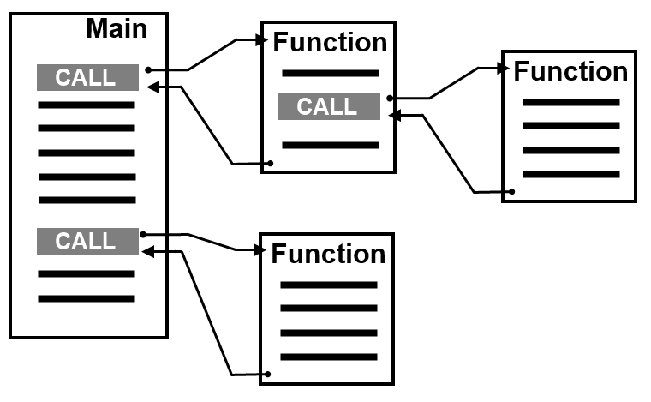
Routines
Here's what the conventional application based on the Imperative (procedural) programming paradigm looks like:
  Main procedure determines the control flow for the application
  Functions are called to perform certain tasks or specific logic
  The main and sub procedures that comprise the implementation are structured as a hierarchy of tasks.
  The source for the implementation is compiled and linked with any additional executable modules to produce the application

Slide 58
Routines: l-values and r-values
Declared functions and procedures
  Have l-values, but no r-values
  Example: C
lvalue(fun) is some global address
int fun(int y);
typedef int (*PtrFun)(int);
PtrFun p_fn = f;
(*p_fn)(5);
Pointer to an int function that takes an int argument
lvalue(p_fn) <- lvalue(fun)
lvalue(p_fn) == lvalue(fun), so *p_fn invokes fun with argument rvalue(5)
The function call operator () has higher precedence than * (operator ‘pointer to variable’) so we have to write (*p_fn)(5) to deference p_fn to invoke fun(5).

Slide 59
Routines: Data Exchange
When a software system functionality is decomposed into a number of functional modules, data exchange/flow becomes a key issue.
  Imperative programming paradigm extends the concept of variables to be used as such data exchange mechanism.
  Thus, each procedure may have a number of special variables called parameters.
    The parameters are just named place-holders which will be replaced with particular values (or references to existing values) of arguments when the procedure is called.
function main()
{
  var argument = 25;
  var result = factorial(argument)
  /* Note, the imperative operator replaces the “parameter” place holder with a current value of the variable “argument”*/
}
function factorial(parameter)
{
  var i = 1;
  var result = 1;
  while(i <= parameter)
  {
    result = result * i;
    i++;
  }
  return(result);
}

Slide 60
  Parameter-passing methods
Call by value
  Formal parameter is a local variable
  Actual parameter serves as an initial value for the formal parameter
  Actual parameter could be an expression
  Language examples:
    In C, all parameters are called by value, use of pointers is just a workaround
    In Pascal, call by value is the default, but call by reference is supported
Call by reference
  Formal parameter serves as an alias/synonym for the actual parameter during the invocation
    Formal and actual parameters share the same l-value
  Actual parameter must be a variable (or have an l-value)
  Language examples
    Pascal (precede formal parameter declaration with var; also called pass by variable)

Slide 61
  Parameter-passing methods
Call by value result
  Copy-in/copy-out
  Actual parameters are initially copied into the formal parameters
  Formal parameter values are copied back to actual parameters after routine completes execution
  In and out parameters are sometimes distinguished
    Language example: ADA (in, out, and in-out parameters)
  Example: Value of a?
    By Reference: a = 11
    By Value-Result: a = 7
int a = 5;
change( a );
write(a);
void change( int x )
{
x++;
a = 10;
x++;
}

Slide 62
Activation records
Activation record (or frame): contains the data needed for the activation of a routine
Typical Contents
  Local variables
  Formal parameters
  Function result, if applicable
  Control link (to activation record of caller) and access link (to access other data within scope)
Activation records stored in a runtime stack

Slide 63
Variable scope
Normally, variables that are defined within a function, are created each time the function is used and destroyed again when the function ends.
  Such variables are called dynamic local variables.
function fun1()
{
  var local_dynamic_var = 25;
  fun2();
    /* at this point just one variable local_dynamic_var exists */
  alert(local_dynamic_var);
    /* this operator displays the current value 25 */
}
function fun2()
{
  var local_dynamic_var = 55;
    /* at this point two variables local_dynamic_var exists */
  alert(local_dynamic_var);
    /* this operator displays the current value 55 */
}
Notes:
The value that the function returns is not destroyed, but it is not possible to assign a value to the variable inside the function definition from outside.

Slide 64
Variable scope
There may be also so-called static local variables.
  Static local variables that are defined within a function, are created only once when the function is used for a first time.
  The fun2() returns different values for one and the same set of arguments. Such functions are called reactive functions.
    Generally, testing and maintenance of projects having many reactive functions becomes a very difficult task.
    For practical reasons many software projects do use some static data.
  It is still not possible to assign a value to the local static variable inside a function from outside.
function fun1()
{
  var x = fun2();
  alert(x);
    /* this operator displays the current value 10 */
  x = fun2();
  alert(x);
    /* this operator displays the current value 20 */
}
function fun2()
{
  var static local_static_var = 0;
  local_static_var = local_static_var + 10;
  return(local_static_var);
}
Notes:
The value of such variable is not destroyed and can be reused when the function is called again.

Slide 65
Variable scope
There may be also so-called static global variables.
  Static global variables that are defined within any function, are created only once when the whole software system is initiated.
  The value of such variable is never destroyed and can be reused by imperative operators inside any function.
  The fun2() also demonstrates a “reactive” behavior.
    Maintaining and testing of projects heavily based on global variables becomes even more difficult than in case of local static variables.
    Nevertheless, for practical reasons many software development paradigms do use such global static variables.
function fun1()
{
  var global global_local_var = 0;
  fun2();
  alert(global_local_var);
    /* this operator displays the current value 10 */
  fun2();
  alert(global_local_var);
    /* this operator displays the current value 20 */
}
function fun2()
{
  global_local_var = global_local_var + 10;
}

Slide 66
Questions ?

